Slide 1
SUMMER READING CAMP
Engaging Learning in the Summer Months

Slide 2

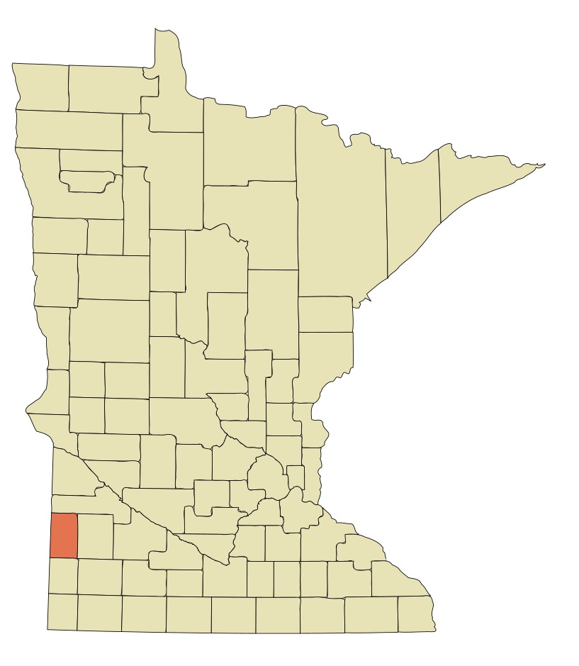
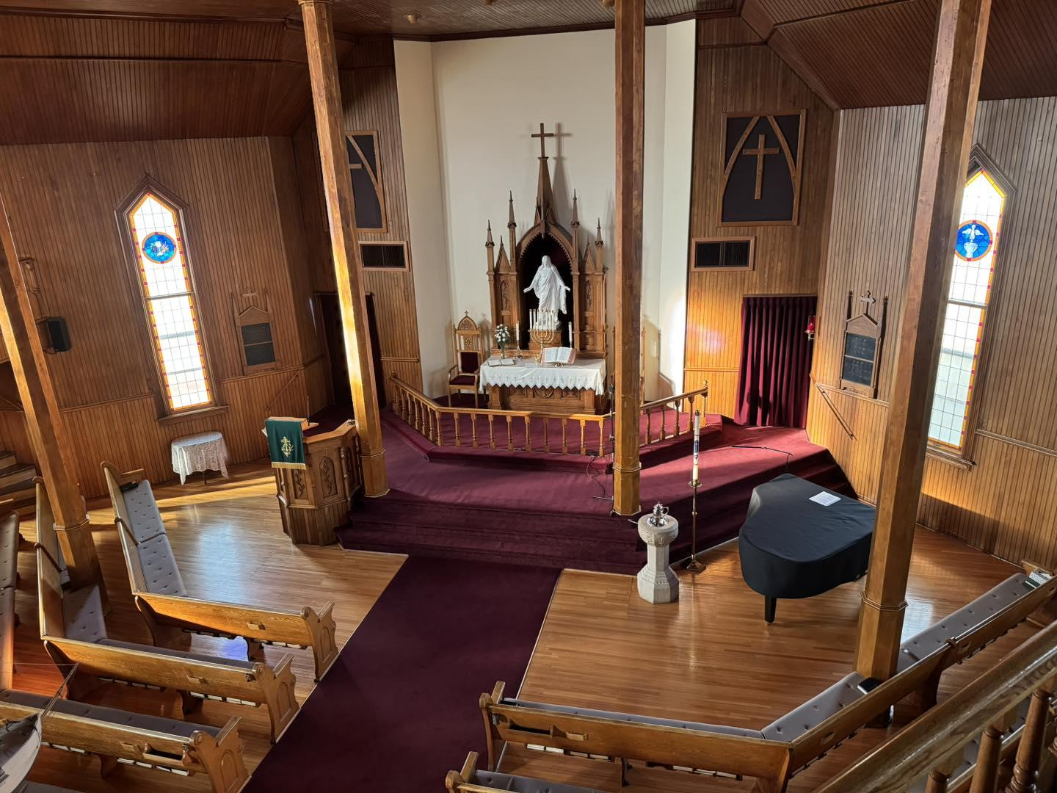
Tyler Public Library
Located in Tyler, MN
  Lincoln County
  Small town library
  Solo librarian
Danebod Lutheran Church

Slide 3


What is Summer Reading Camp?
5-day day camp intended to help keep kids’ brains engaged in learning during the summer months
Started in response to concerns of local teachers
Research shows Summer Reading Programs benefit low-income students and they can raise reading test scores.

Slide 4
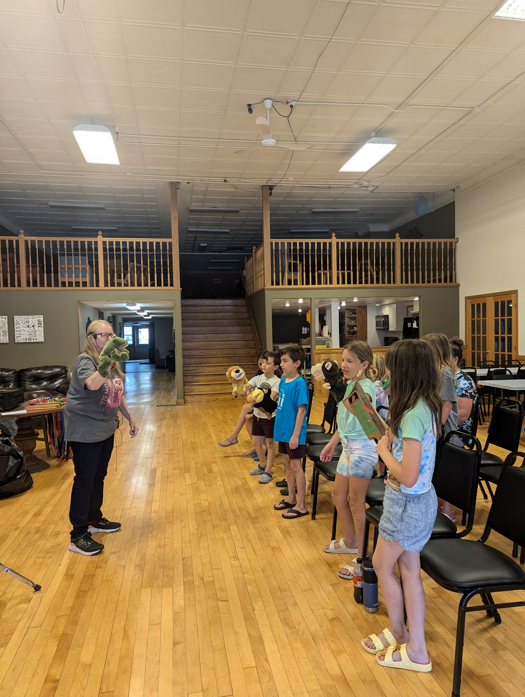
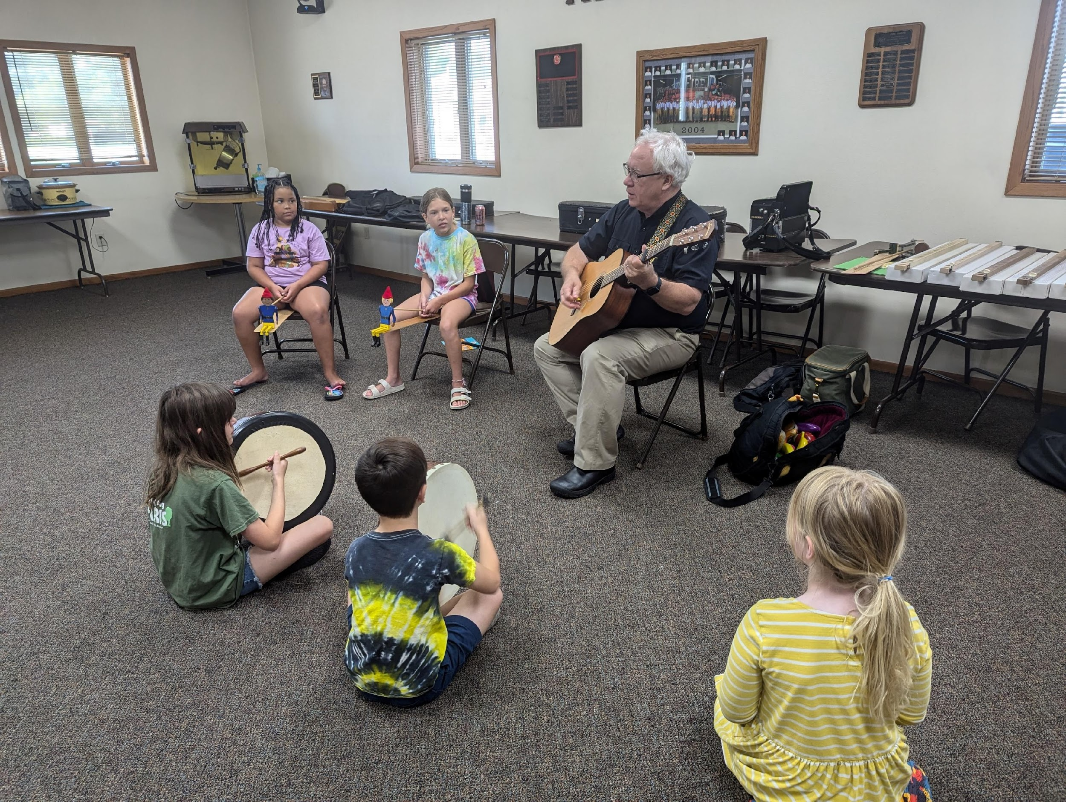
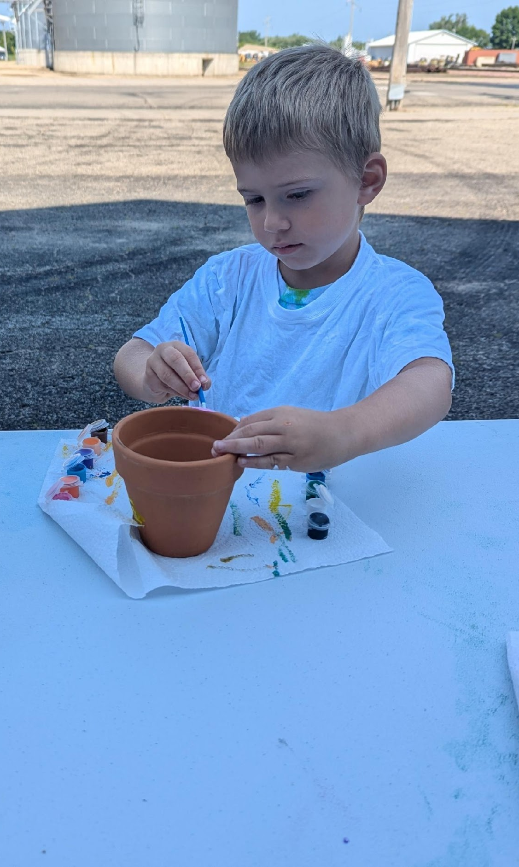
Calling All Campers!-
How to plan your own camp

Slide 5

Step 1: Choose a theme
Use a pre-made curriculum
  iRead
  CLiC
Create a curriculum
  What is popular in your community?
  What is your budget?
  Who will lead it?

Slide 6
Suggested themes
Reading Can Take you Places
Day 1: Cars
Day 2: Planes
Day 3: Trains
Day 4: Rockets
Day 5: Boats
Old Macdonald Had a Book
Day 1: Chickens
Day 2: Cows
Day 3: Sheep
Day 4: Pigs
Day 5: Horses
The Great Reading Adventure
Day 1: Camping
Day 2: Under the sea
Day 3: Outer Space
Day 4: The past (dinosaurs)
Day 5: Tiny world (bugs or miniatures)

Slide 7
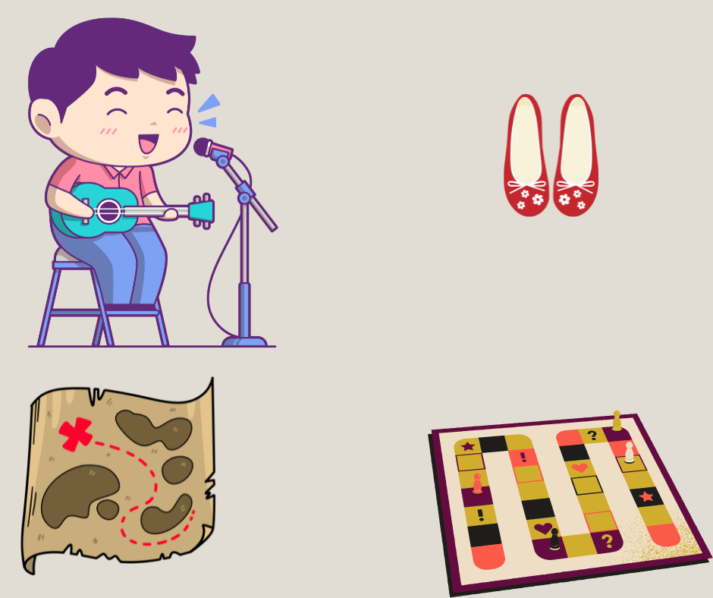
Step 2 – Plan the activities
Choose sub-theme for each day.
  Example: Day 1 of our sample camp has a sub-theme of red.
  All crafts, snacks and activities follow this sub-theme
Can plan simple activities or complex
  Simple = craft, board games, songs & rhymes
  Complex or in-depth = create a TV commercial, go on a scavenger hunt
Things to remember
  Age of participants
  Budget
  Ability of participants

Slide 8

Step 3 – Choose the stories
Recommend using picture books
  Big kids like stories too
  Inclusive and diverse
  Wide variety
How do I find books?
  Search locally
  Google search
  Goodreads

Slide 9

Step 3 – Choose the stories
Purchase new titles, borrow from others, or use what you have
  Use a small portion of children’s collection budget
  Use titles you already own
  Order titles you need through ILL
  Ask patrons to donate specific titles for your program
Things to keep in mind
  Do your stories fit your overall theme?
  Will your choices create unwanted controversy?
  What is the “expiration date” of your choices?

Slide 10
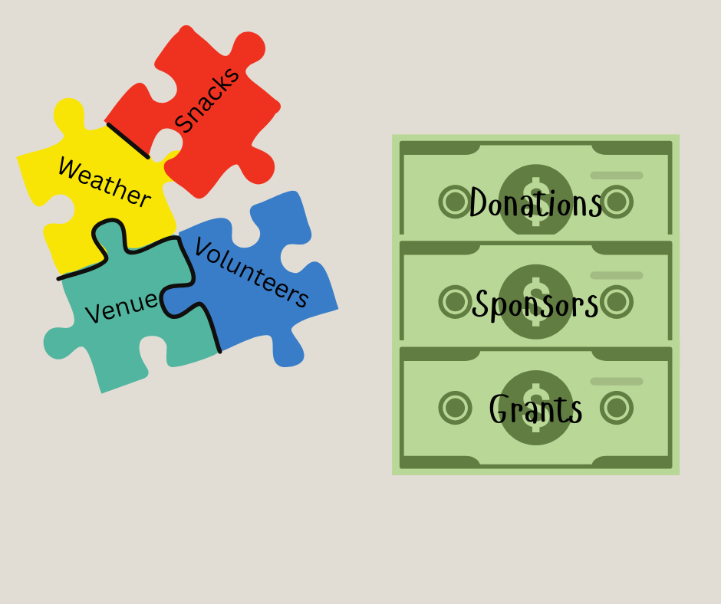
Other details
Helpers
  Volunteers, teachers, Friends, teens
  Background checks?
Snacks
  Allergen friendly
Weather
  Safety first
  Contact information for parents
Venue
  Bathrooms?
  Cost?

Slide 11
Step 4 – Find funding
Programming budget
Minimize supplies cost
Donations
Sponsors
Grants

Slide 12

Step 5 – Advertising
Schools
Newspaper, Local TV, public radio
Local churches and clubs
Hand out fliers & Hang Posters
Community calendar
Ask Friends
Window Display
Newsletter, website, & social media

Slide 13
What do I do when?
1 Year before Camp
  Theme, dates, venue, permission, supplemental programming
9 Months before Camp
  Activities, stories, funding, find volunteers/helpers,
6 Months before Camp
  Supplies list, sponsors, Save the Date announcement, plan curriculum

Slide 14
What do I do when?
3 Months before camp
  Order supplies / Ask for donations of supplies
  Finalize curriculum
  Schedule paid advertising
1 Month before camp
  Start registering campers
  Advertise
  Confirm supplementary programming details
  Itemize supplies inventory – Make sure you have everything you need

Slide 15
What do I do when?
2 Weeks before Camp
  Print off student lists
  Volunteer training
1 Week before Camp
  Organize supplies
  Print off curriculum sheets
  Make example crafts

Slide 16
Questions? Contact me
Shelly Finzen
Tyler Public Library
PO Box L, 230 N Tyler St.
Tyler, MN 56178
(507) 247-5556,
press 1 for City Office departments and press 1 again for Library
tylerlib@plumcreeklibrary.net

