Slide 1

Minnesota Libraries professional development opportunities
Ann Kaste, Outreach and Instruction Librarian, Minitex
Notes:
Template Notes:
Heading font: Montserrat
Body font: Lato
Minitex blue (#0E76BC) on white (#FFFFFF) contrast ratio: 4.84:1
Black body font color (#424242) on white: 10.04:1
The Minitex logo with the word “Minitex” appears on this slide.
We have added a note about this because the logo in this template is part of the “master slide,” Alt text would not be read off by a screen reader in this case, so we took the extra step to add it to the notes.
You can address this a few ways:
Add a description of the image in the notes, as we have done here
Add an image to the slide that blends in with the background and add the Alt text for the Minitex logo there.
Choose not to use images or graphics on the master slide template. Add them directly to the slide and you will not need to take these extra steps (assuming the image already has Alt text).
Note: If you have something like a logo appear as part of the master template on every slide, you do not need to add alt text to every instance of the logo as it would be considered decorative and not necessary. Having alt text on the first slide would suffice.

Slide 2
What is library professional development?
Tuition-based learning : MCTC, St. Kate’s, SCSU, MN State Mankato
In-person training
Online training with an instructor
Book clubs/cohorts/conversations
Webinars
Self paced online courses
And more!
https://z.umn.edu/mnpalsmlln

Slide 3
Who offers free library professional learning in MN?
Minitex
Multicounty Multitype Library Systems
Regional Public Library Systems
State Library Services
Minnesota Library Association
Individual organizations (MnPALS, Minitex, MALF, etc)
Open access webinars/training from around the nation via ICOLC Professional Development Alliance

Slide 4


ICOLC Professional Development Alliance
The PDA makes professional learning for school, public, academic library workers available to everyone in Minnesota. Members include:
LOUIS (Louisiana)
CARLI (Illinois)
NC LIVE (North Carolina)
NJ LINK (New Jersey)
FLVC (Florida)
SEFLIN (Florida)
BLC (Boston)
HELIN (Higher Education Learning Information Network)
ATLA

Slide 5
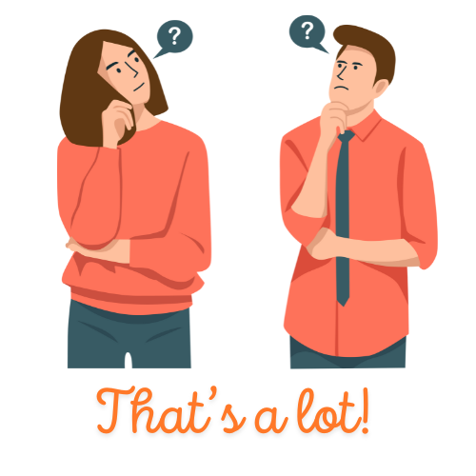
How to bring this all together?
All of these groups came together to decide how best to feature all of these opportunities and create new ones.
State Library Services
Multicounty Multitype Library Systems
Council of Regional Public Library System Administrators
Minitex
Minnesota Library Association
MNPALS
St. Catherine University MLIS program
Minneapolis College LIT program

Slide 6
The solution?
https://mlln.org
Notes:
Used to be called LevelUp, but it’s been updated and reinvigorated.

Slide 7
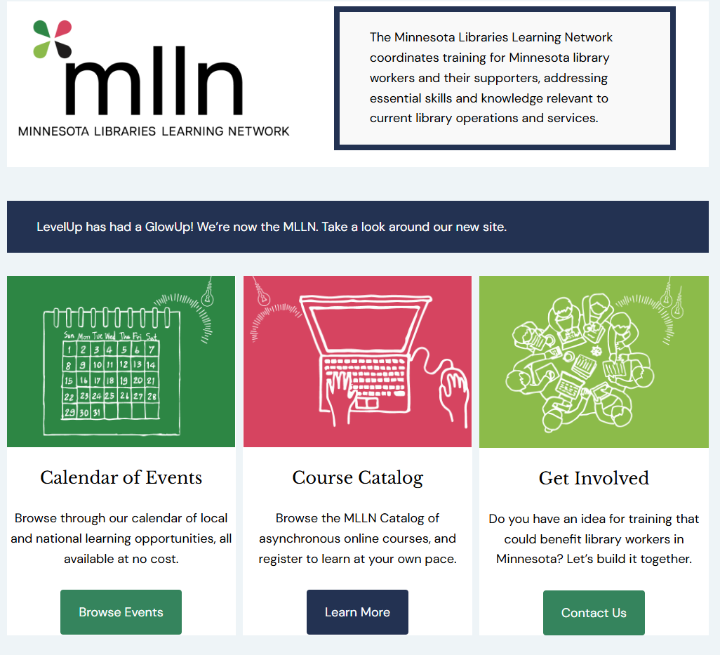
Minnesota Libraries Learning Network
https://mlln.org/
MLLN hosts a calendar that has events from ALL of these groups, as well as self paced learning in the course catalog

Slide 8
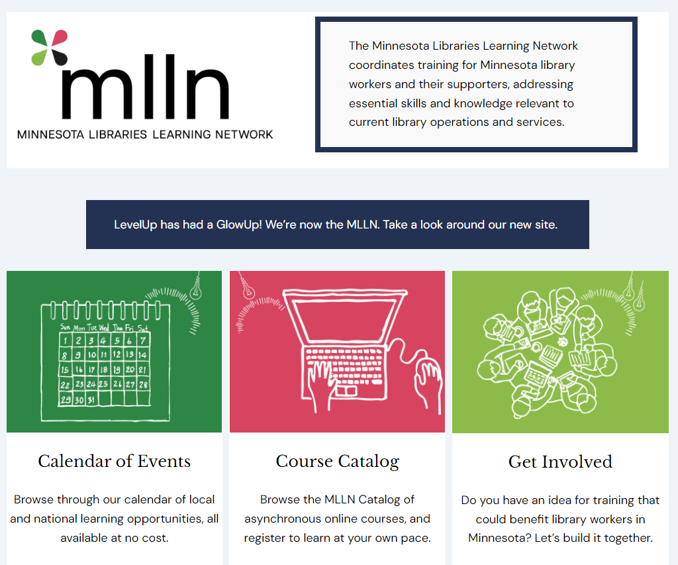

Demonstration
mlln.org
Notes:
DEMO- Ann 15 minutes

Slide 9
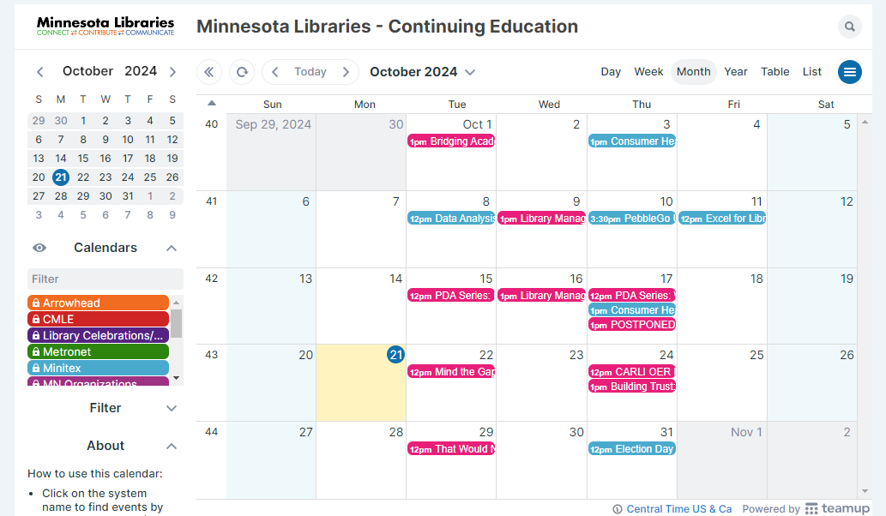
Calendar and Professional Development Alliance
mlln.org
Notes:
DEMO- Ann 15 minutes

Slide 10
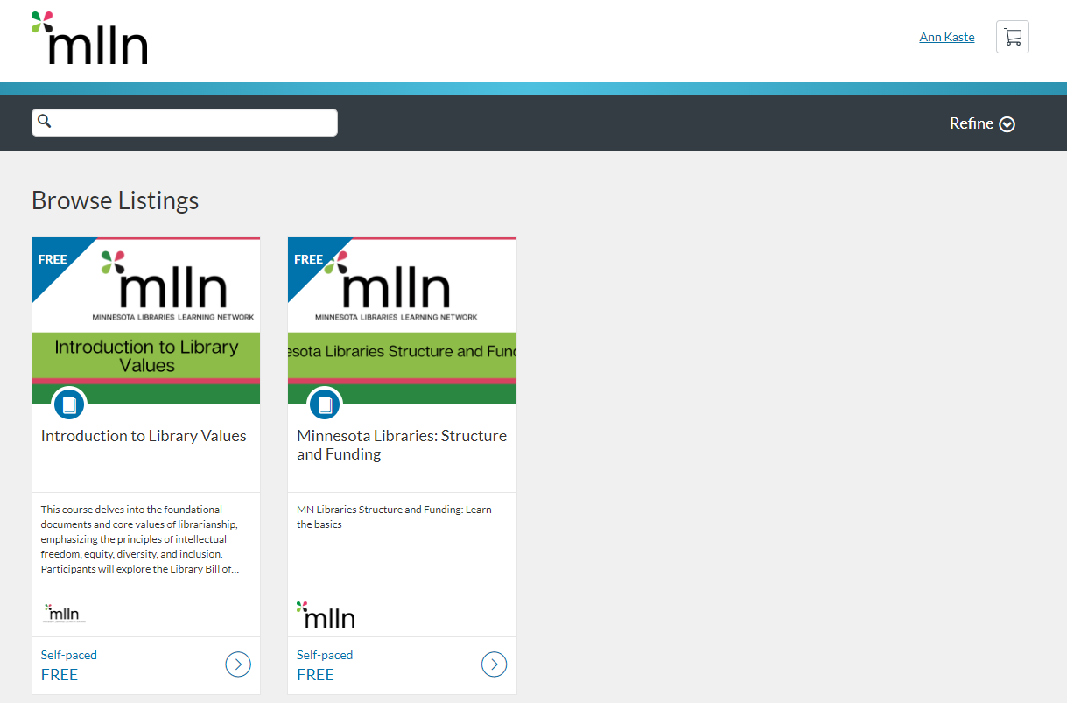
Home Catalog

Slide 11
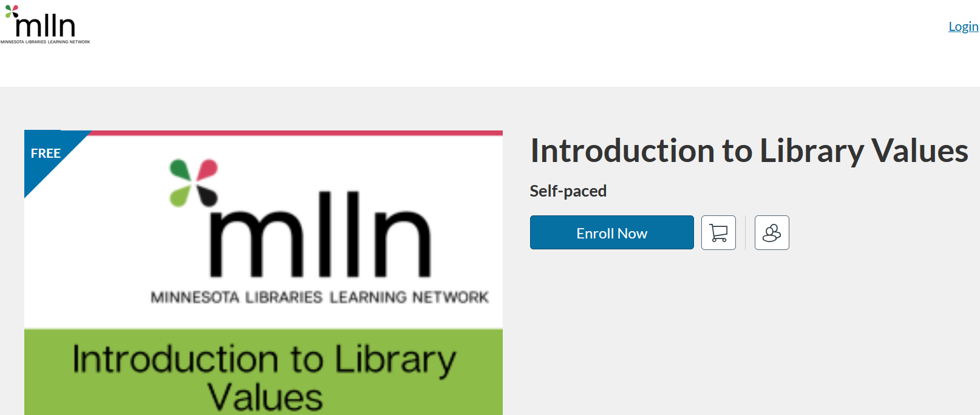
Select a Course and Enroll
Notes:
Ann

Slide 12
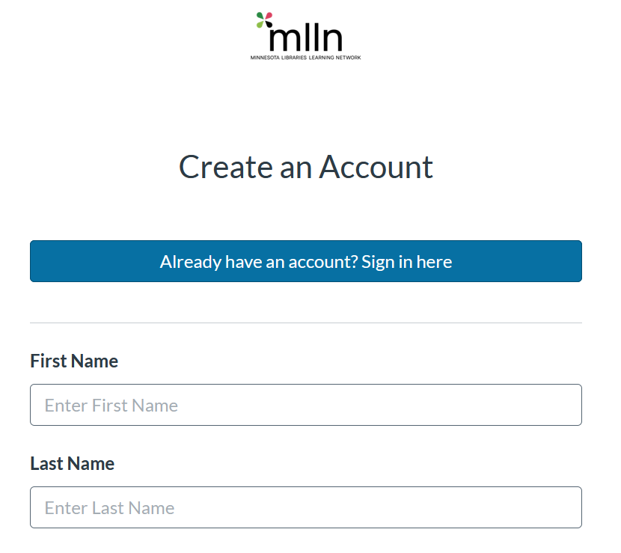
Login/Create Account
Notes:
Ann

Slide 13
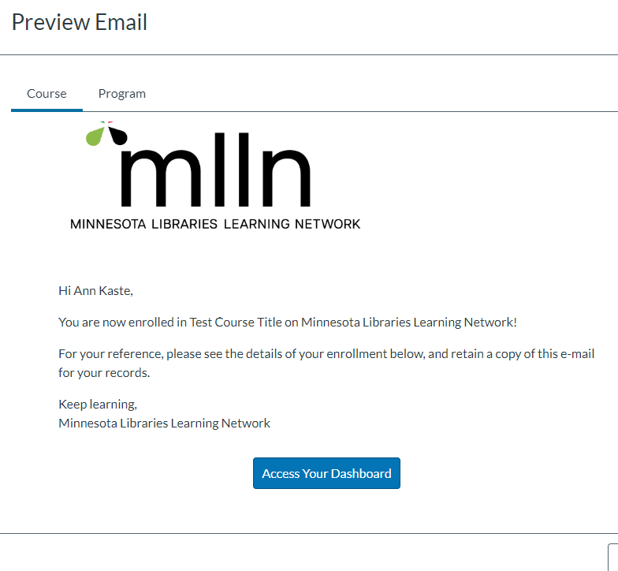
Confirmation Email with link to course
Notes:
Ann

Slide 14
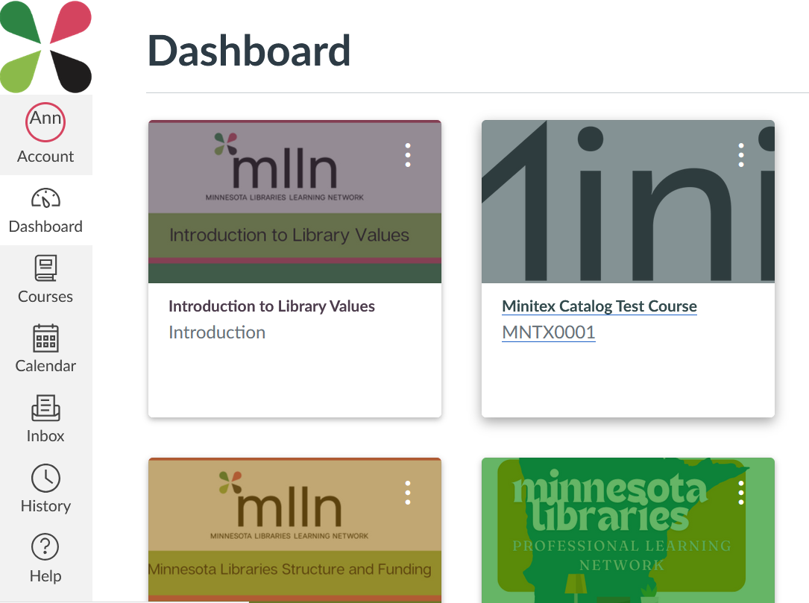
Go to Course, complete requirements
Notes:
Ann

Slide 15
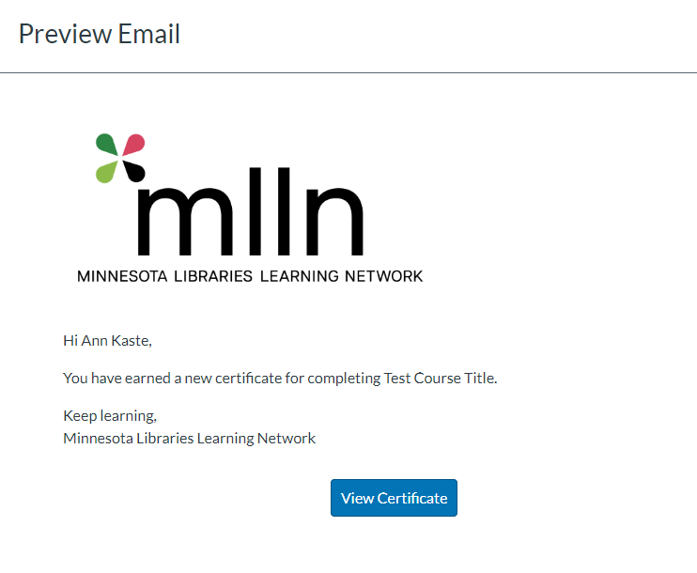
Upon Completion, Certificate Email
Notes:
Ann

Slide 16
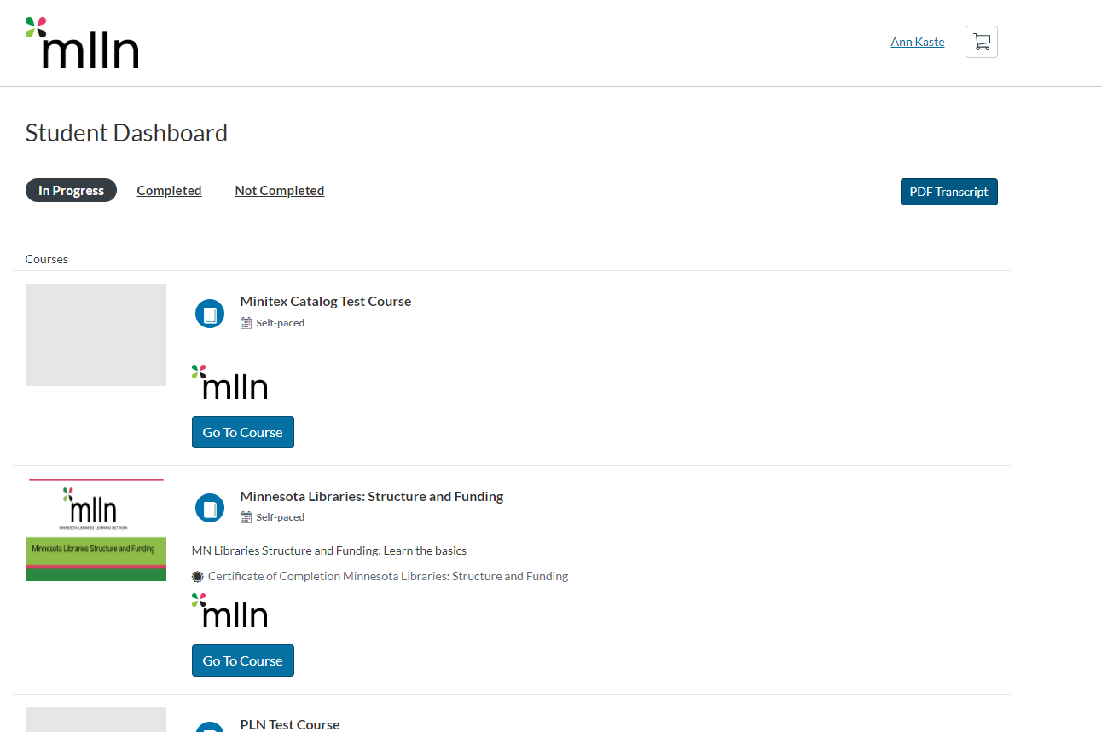
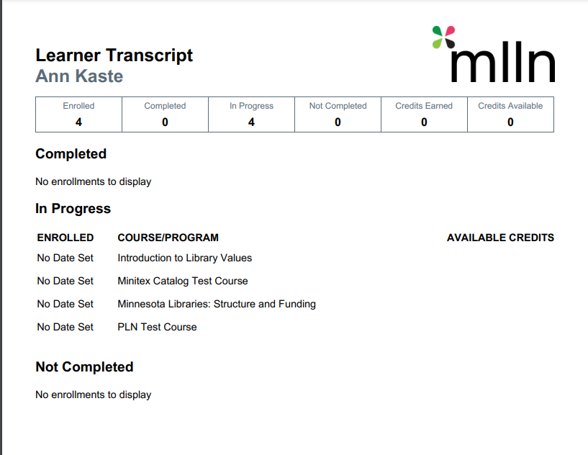
Student Dashboard
Notes:
Ann

Slide 17
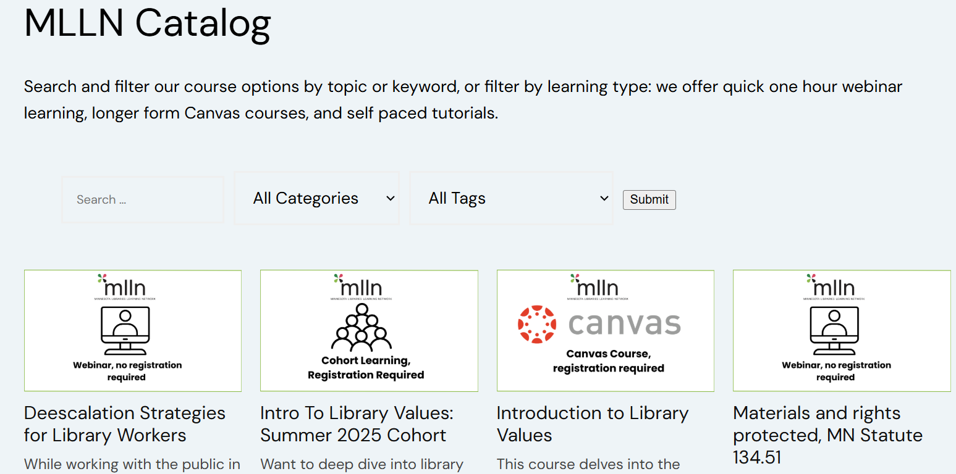
Coming Soon
Cohorts for Long Courses
One Shot Courses on mlln.org: No login, Webinar or tutorial, handouts, certificate of completion

Slide 18
How can you get involved?
mlln.org

Slide 19
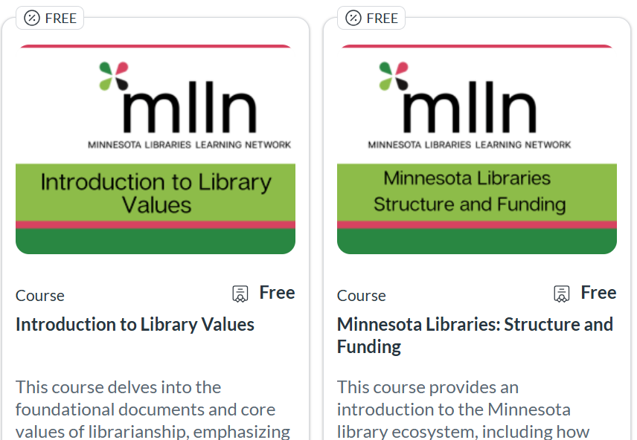
Sponsor a Cohort!

Slide 20
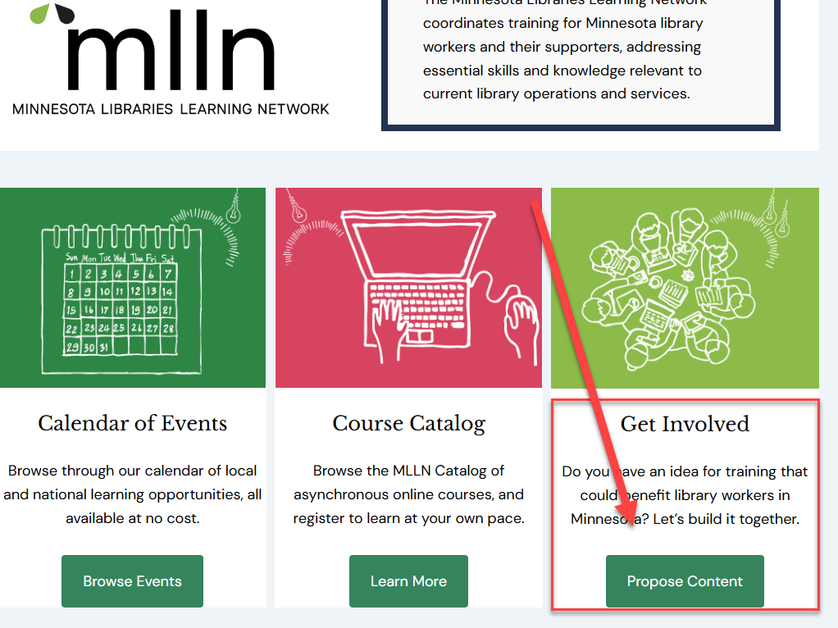
Submit a Proposal!

Slide 21
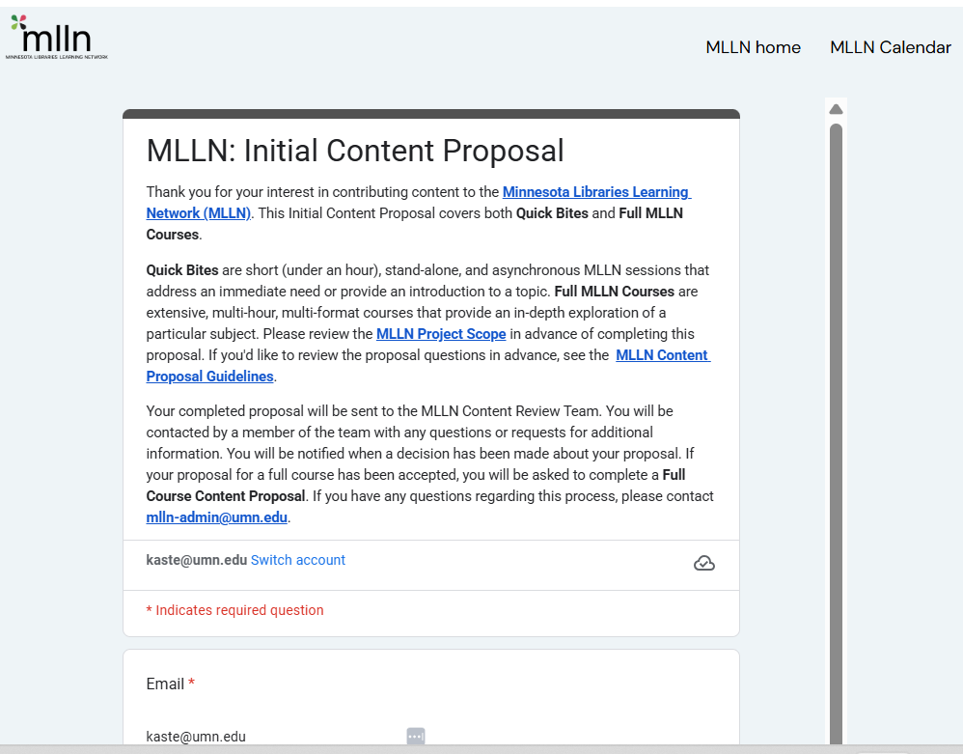
Submit a Proposal!

Slide 22
What topics do you have in mind and how will we decide what comes next?
mlln.org
Notes:
Maggie/All: SLS Early Childhood, Minitex/MCTC, Networking and Career development, other?

Slide 23

Add the MLLN Calendar to your own!
MLLN iCal Link
How to add iCal calendar to Google Calendar
How to add iCal calendar to Outlook calendar

Slide 24

Follow Newsletters and Updates
Minitex Messenger
State Library Services
Your local MCMT (MN)

Slide 25



Thank you!
Notes:
The Minitex logo with the word “Minitex” appears on this slide.
We have added a note about this because the logo in this template is part of the “master slide,” Alt text would not be read off by a screen reader in this case, so we took the extra step to add it to the notes.
You can address this a few ways:
Add a description of the image in the notes, as we have done here
Add an image to the slide that blends in with the background and add the Alt text for the Minitex logo there.
Choose not to use images or graphics on the master slide template. Add them directly to the slide and you will not need to take these extra steps (assuming the image already has Alt text).
Note: If you have something like a logo appear as part of the master template on every slide, you do not need to add alt text to every instance of the logo as it would be considered decorative and not necessary. Having alt text on the first slide would suffice.

