Slide 1



Port Cards:
A Library Card for Every Student
in the Duluth Public Schools
Sue Schumacher, Youth Services and Branch Supervisor
Heidi Harrison, Senior Library Technician for Youth Services
Jessica Bellini, Technical Services Librarian
Notes:
Maybe we can all introduce ourselves?
JESSICA will mention other people who were instrumental in the project, like
Byron Johnson, Head of Circulation
Jocelyn Baker, former Senior Library Technician for Public Relations
Marika Staloch, Youth Services Manager, St. Paul Public Library
Emily Kissane, Policy and Program Manager, Minnesota State Library Services
Jen Nelson, Director of Minnesota State Library Services
Tom Albright, Administrator at ISD 709
Tammi Wilkins, Library Media Specialist at ISD 709
Nathan Kinsey and Danielle Dorn, IT Specialists at ISD 709
Kelly Sobrino, our Polaris ILS Site Manager
Bill Walz, City of Duluth IT Project Manager

Slide 2
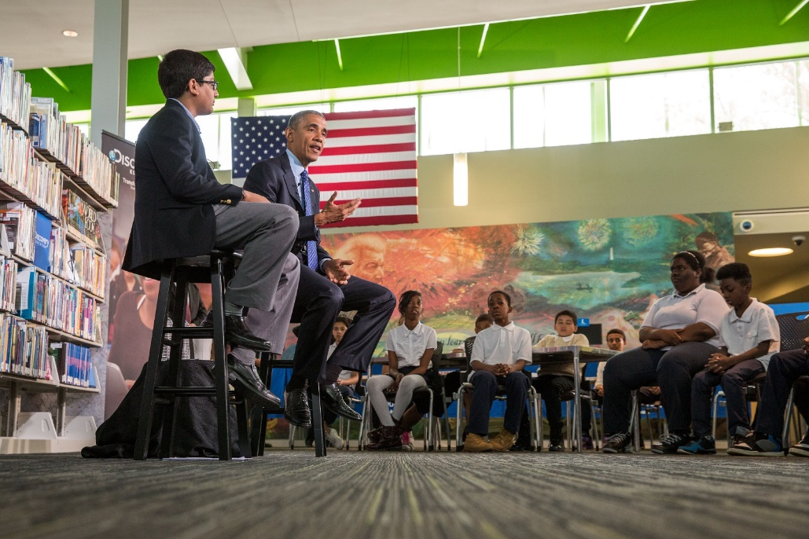

Where Did This Idea Come From?
ConnectED Library Challenge in 2015- Obama Administration Initiative
St. Paul Public Library Go- MLA Presentation
State Library Services support and encouragement
Notes:
[HEIDI]
The ConnectED Library Challenge in 2015 was a commitment by more than 30 communities to put a library card into every student’s hand so they will have access to the learning resources and books they can read for pleasure, all available in America’s libraries.
Library Go is Saint Paul's unique initiative to achieve the goals set forth by the ConnectED Challenge. They and other MN libraries, also starting their own virtual library card programs, presented their ideas in an MLA session that Sue, myself, and Carrie B, all were able to attend. We were inspired and excited!
State Library Services is on board with spreading the idea of getting a library card in every students hand in Minnesota. They assisted and supported us in getting into contact with St Paul Public to pick their brains on the initiative and how they went about setting up the Library Go initiative with the schools.

Slide 3




What is a Port Card?
No physical card that can be lost – uses the student’s school ID number
Allows ISD 709 students to check out 5 physical items at a time with no fines
Allows access to all the digital resources of a Duluth Public Library Card
Staff of ISD 709 can apply for an Educator’s Port Card
  Digital access only
Notes:
[Heidi]
Databases
E-books
Homework Help
Audio book downloads & more!

Slide 4

Notes:
[Heidi]

Slide 5
Why?
School partnerships
Providing resources for the kids that need it most
Some students do not have the ability to come to the library or get a library card
Positive connections between the community and the public library!
Notes:
[HEIDI]
~Increase our collaboration with the Duluth School District. By collaborating on this project we have already developed relationships that can continue for years to come.
~For many, libraries are the only source of free Internet access in the neighborhood, making them a lifeline for American families that lack home Internet access. More than 60 percent of low-income first graders don’t have a library card. Kids that age should be exposed to reading as much as possible, as just 10-20 minutes of reading each night can have an extraordinary impact on a child’s learning.
~ According the US Census Bureau in 2016 28.6% of the children under 18 in Duluth are living in households with SSI (Supplemental Security Income), Cash Public Assistance, or food stamp benefits.
~Some students don’t have a caregiver that can or is willing to get a library card for the child.
~Some kids have fines or fees from adults using their card or adults never clearing the fines or fees for the child’s card.
~Teens many times don’t have picture ID or proof of address and/or a caregiver with them to obtain a library card.
~ We will be creating positive relationships with the community and encouraging lifelong learning and library use.
~This is a way of testing out the Fine free model on a small population.
~When students graduate they will be encouraged to come to the library and get a library card and continue their use of the library as adults.

Slide 6

Who Gets a Port Card and How Do They Get It?
All 9,000+ students enrolled in ISD 709
Students can have two cards—a Port Card and a regular library card
For students, data is transferred from ISD 709 to DPL
Educators must request a card
Notes:
[JESSICA]
~Currently, about 9,600 ISD 709 students have Port Cards
~This includes kids in ECFE, the Early Childhood and Family Education Program, and students in the online alternative high school program
~Students can have two cards—a Library Port Card and a regular library card issued according to standard policies and standard library policies regarding fees and fines apply.
~Port Card is a virtual library card, not a physical plastic card.
~We get the student information that we need to make the Port Cards from the school district. Sue will talk about the legal details of our data sharing agreement on the next slide. Then, I’ll discuss the technical details.
~Parents have the option to opt out of the program when they enroll their child in school or at the beginning of the new school year.
~Educators employed by ISD 709 can get virtual Educator’s Library Port Card.
~Fillable Google Form accessible with only an ISD 709 staff account.
~Circulation at Main will create cards and communicate with educators.

Slide 7

Legal Aspects
Legal considerations for implementing virtual library cards
Memorandum of understanding
Data sharing agreement between the City of Duluth and ISD709
Notes:
[SUE]
~Creating a new legal agreement can seem daunting at first.
~Jen and Emily at MN State Library Services emphasized that City leadership and school district officials must support your virtual cards project, and be willing to collaborate with each other and the library in order for the project to succeed.
~If you have enthusiasm and facts, it’s pretty easy to convince people!
~Sharing directory information vs. private data, and MN Stat. Ch. 13 – MN Data Practices Act
~The majority of the information ISD 709 is sharing with us is public information (directory information) and can be shared freely.
~The rest of the information is private data that is allowed to be shared with libraries as a result to changes to Minnesota law.
~Memorandum of understanding – this is the document created by St. Paul Public Library and the school district to allow sharing student data.
~We based our data sharing agreement on this memorandum of understanding.
~Data Sharing Agreement between the City of Duluth and ISD 709 was signed by the Superintendent of the Duluth Public Schools (ISD 709), Bill Gronseth, and approved by the City Council and Mayor Emily Larson.

Slide 8



Technical Aspects
Tools Jessica found helpful for making virtual student cards:
  A good relationship with school district IT staff
  Filezilla
  Polaris ILS (other libraries use Sierra, Horizon, and others)
  Your ILS customer support team
  Microsoft Excel and some knowledge of VBA
  AutoHotKey
Notes:
[JESSICA]
To make the Port Card project work, we need automated student record creation. We simply couldn’t make 8,000+ patron records, one by one.
How do we do the data transfer and make patron records in bulk? In a nutshell:
Nathan at ISD 709 exports a CSV file of student data from their database, which is called Infinite Campus, and drops it in FileZilla.
I fetch the file once a week, usually on Monday, and then my computer edits and saves it for me thanks to AutoHotKey and Microsoft Excel.
I upload the file into our ILS – we have Polaris.
Polaris creates a patron record for each new student. It finds duplicates and overlays any new information on those duplicate records.
We did an initial import of ~8,000 students in September 2018. That took about an hour and a half.
Since then, I do weekly maintenance of records. It takes about 45 min start to finish, but I don’t do much because the process is automated.
Yearly maintenance of records will occur every summer (deleting graduated seniors) – I will do this in July. We will not delete students that have items out.
The data sharing and patron record creation process:
Get student data file from ISD709 via FileZilla
Bulk change in Excel using VBA macros
Convert to TRN file – Notepad
Upload to Polaris
Resolve records with verify patron block
Brand new records vs. changed records
If anyone would like to discuss the process in more detail, please find me later this afternoon or contact me anytime.

Slide 9
Circulation and Port Cards:
How can Students Use their Port Card?
Students need to know two things:
  School ID number
  Date of Birth
Barcode based on their unique student ID number
  21256600XXXXXX, with XXXXXX being student’s ID number
    21256 =Duluth’s unique prefix
    600=Student virtual card indicator
    XXXXXX=Student’s 5 or 6 digit ID number
Student data privacy
Digital access for Library Port cardholders is done at LibraryPort.org.
  No need to navigate through the DPL website!
Notes:
[JESSICA]
Since this is a virtual card, the student only needs to know two things to check out items and log on to the databases.
Their school ID. This is used regularly in school for school lunches, checking out items from the media center, etc. Most students call their student ID number their “lunch number.”
Their date of birth – the student’s 6-digit DOB becomes their password.
When a student’s record is imported into Polaris, the ILS creates a conforming 14-digit library barcode by assigning the prefix 21256600, and the last 5-6 digits will be the student ID number. Our regular cards begin, “2125600.”
In retrospect, we should have used a fifth digit that looks less like a Zero because it’s difficult to recognize the student patron records in a quick glance – 0 looks like 6. Maybe should have used the number 7.
If a student wants to check out items using their virtual card, they will:
Provide their school ID number, date of birth, and name.
ISD 709 staff are just as concerned about student privacy as we are about our patrons’ privacy.
As a result, they do not want students to be required to say their school ID number out loud.
We have keypads at all circ stations
Circ staff use the keypad to have students type in their number
5-digit student IDs will need an added zero at the beginning of the number to make them 6-digit
Parents cannot use their child’s Library Port Card.
If the child is young, a parent may assist their child in providing the required information for check-out. The child must be present at check-out in order to do this.

Slide 10
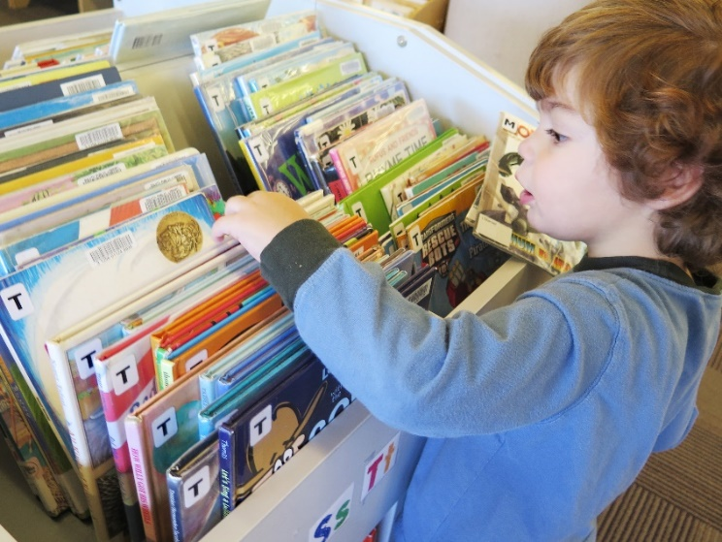
Circulation and Port Cards:
Check Out limits, Fines, and Fees
Up to five physical items checked out
  This includes Interlibrary Loan materials
Items checked out on a Port Card are fine free
  Overdue items do not block check-out, only number of items on account prevents check-out
The fine free model changes the conversation with kids
  Not punitive but a privilege
Items lost or damaged will be charged to
student’s account
Notes:
[JESSICA]
Up to five physical items out on a card at one time. Students must return items to check out more.
For example, if a student checks out five items on October 1 and only returns two items on October 8 they will only be able to check out two items on October 8.
We allow Interlibrary Loans with Port Cards. Up to five items may be checked out on a Port Card. Staff must check the student’s MNLINK and Polaris account to determine how many ILL items they can request.
Items checked out on a Library Port Card are fine free.
Overdue items do not block check-out.
Students will not be sent bills.
Items overdue for six weeks will not be automatically billed to student’s accounts. The only time items will be billed to a student’s account are if the student damages an item or notifies us that an item is lost.
Items checked out on a student’s regular library card are NOT fine free. Standard fine and fee policy applies to regular cards.
This model changes the conversation we have with kids regarding library materials. We are not punishing students monetarily or restricting their access to the library because of fines. We are asking them to be responsible for their items and return them so that they can continue to check out items from the library. Not punitive, but a privilege.
If Library Port Card students have lost or damaged items on their record, they will not be prevented from checking out. The number of items they will be able to check out will be reduced accordingly until the issue is resolved.
We will still send bills for lost or damaged items.
We will work with children and families that have replacement charges, to set up a payment plan or make other arrangements.
One idea: Read down lost/damaged fees.

Slide 11

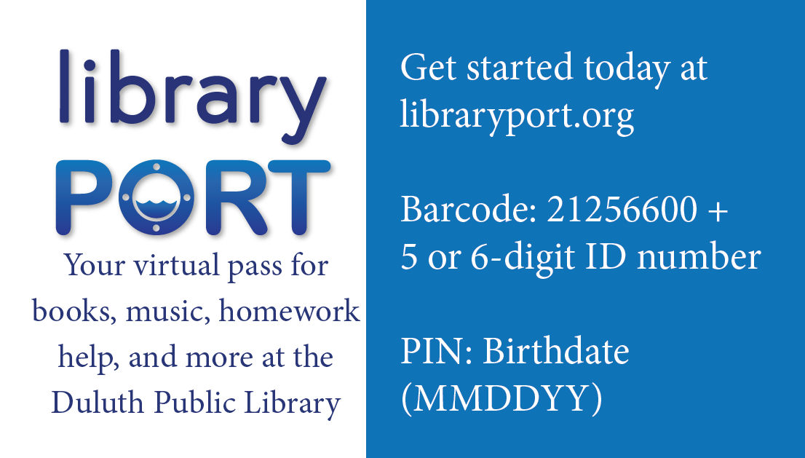
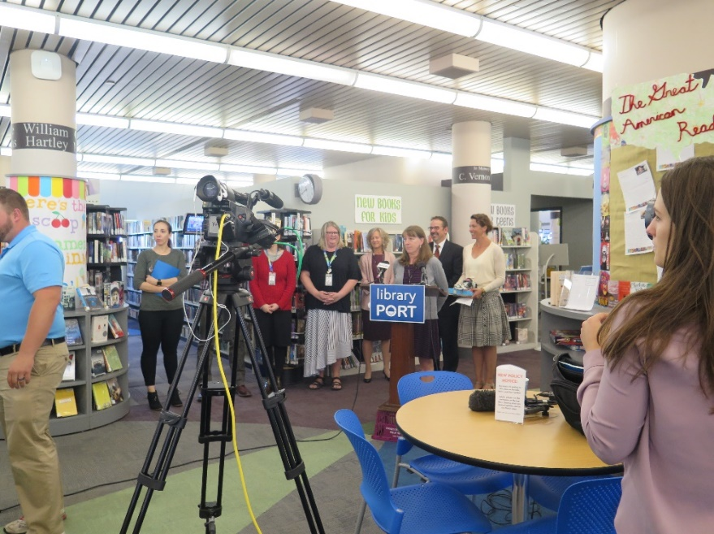
Advertising and Outreach
Notes:
SUE
Web page
PR made business cards with the prefix information so students will know how to log in. It will be like a “Library card” for the students but it will not have any identifying information on it.
Heidi had PR print a supply of 2,000 Port Card business cards for us to pass out at schools and service desks.
PR created 2 posters for the launch last fall—one for schools with younger students and one for schools with teens. The posters have a slot for the Port Card business cards. Forty posters were sent to Tammi Wilkins for distribution.
Press conference
Heidi will talk to Tammi Wilkins about the library (HH) going out and promoting Port Cards at individual schools. Once Heidi as talked to Tammi, she would like to start by talking to Colleen Knettel at Laura MacArthur and Myers Wilkins.
Byron talked to Reading Corps tutors about Port Cards on Feb. 20.
Heidi will be working on putting together Port Card information packets for library staff to share with families at outreach events.
Sue suggested we talk to Laura S. about having Port Card information as one of the rotating features for a while on the digital display monitors after the branch monitors are installed.
The 9/5/2018 press conference at the library reached many in the community.
Sue used the press packet to talk to the FIT teachers.
Port cards were also featured on public radio.
Byron had some conversations with Hennepin County library system after they contacted us to learn more about our program.
Other ideas to get the word out to schools:
Open House at the library for Parents, ISD 709 employees and volunteers?
Info in news letters sent home to parents, where do teachers get their information? Can we tap into that?
After school demos in school media centers? Handouts and resources available?
This would be a better fit at teacher in-services
Important to include Para professionals and volunteers who work one on one with kids since they may be able to really show the kids how to use the Port Cards
High schools- getting word to the teens may be as important as the teachers
Individual schools’ open houses
School staff meetings
Work with media specialists to promote

Slide 12

Evaluation
9,633 Port Cards currently in our system
2018 | 2019 | Total; 09/2018 – 06/01/2019
216 items checked out to 36 students | 1,247 items checked out to 262 students | 1,463 items checked out to 298 students
At this moment, we have 341 items checked out to 131 students
  Total number of overdue items: 188 to 83 students
    Total number of long overdue items (overdue at least 6 weeks): 81 to 38 students
From the beginning of the program thru June 1st:
  155 Port Card users have just the
  143 Port Card users also have
    But 41 of these students have blocked accounts
      4 students can’t use their Port Card or their regular card
Notes:
[JESSICA]
Since beginning of the Port Card project, 1,463 items checked out to 298 students.
This year (2019), 1,247 items checked out to 262 students.
In 2018, 216 items checked out to 36 students.
Total number of overdue items: 188 to 83 students
Lost: Total number of long overdue items (overdue at least 6 weeks): 81 to 38 students
From the beginning of the program thru June 1st:
155 students who checked out items with their Port Cards do not have a regular library card.
102 students who checked out items with their Port Card also have a regular library card, and both are in good standing.
37 students who checked out items with their Port Card have a regular card that is blocked due to fines and/or lost or damaged items.
4 students who checked out items with their Port Cards also have a regular card, and at this time they cannot use either card.
We’re still working on database use stats.

Slide 13
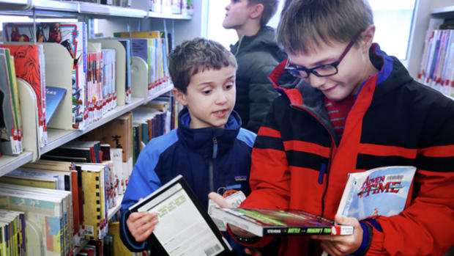

Port Card Successes
Notes:
Anecdotes -- We could all say a little something here
Heidi: I had an after school group come to the library and I overheard a girl saying that she really wanted to check out a graphic novel but the leader told her that she needed to have a library card to do that. This was where I could jump in and tell them that she does have a library card. She was so excited to be able to leave with a book in hand that she could read that night. The group leader also offered to help with making sure that the book got back to the library the next time they came down. Now that’s a great feeling!
Sue:
Jessica: I have had a good experience working with ISD 709 IT staff. We’re resolved several issues together, including problems with a new firewall on the school district network, and refinements to the student data file, among others. I find Nathan and Danielle helpful, prompt, and kind.
And last week I took a call from a young girl who was checking to see if her ILL book was in yet. She reserved it using her Port Card. She sounded really happy and excited for her book to come in, and the book was about science fair projects, so overall this interaction made me smile.

Slide 14

Port Card Challenges
ISD 709 liaison
Promoting Port Cards to teachers and families
Database adjustment at DPL
ISD 709 Port Card opt-out process
Preschool parents and student ID numbers
A challenging time for DPL:
Superior Street reconstruction, summer 2018.
Notes:
Sue
Reached out to school district to make sure we had a new liaison person
Getting word out for teachers and parent and kids
Database adjustment at DPL
The ISD 709 opt-out process for 2019.
Preschool parents getting the number for their children

Slide 15
Future Plans and Possibilities
Students can “read down” their fees for lost or damaged items
Book deliveries between the schools and the Main Library
Expanding Port Cards to charter and private schools
Notes:
[JESSICA]
Read-downs--how are other libraries handling them? We love this idea and continue to think about the implementation.
Can we develop a process for kids to return DPL materials to school media centers / deliver holds to them at school?
We’d love to expand the project. It can be tricky to bring in schools because they must sign our data sharing agreement, and they must be able to share a CSV file with all necessary student data via FTP.

Slide 16
For More Information…
Sue Schumacher, Youth Services and Branch Supervisor
  sschumacher@duluthmn.gov
Byron Johnson, Head of Circulation
  bfjohnson@duluthmn.gov
Heidi Harrison, Senior Library Technician for Youth Services
  hharrison@duluthmn.gov
Jessica Bellini, Technical Services Librarian
  jbellini@duluthmn.gov
www.libraryport.org

