Slide 1

Librarianship in and Out of Prison
Minnesota state law library

Slide 2
Bounds v. Smith 430 US 817 (1977)
“We hold, therefore, that the fundamental constitutional right of access to the courts requires prison authorities to assist inmates in the preparation and filing of meaningful legal papers by providing prisoners with adequate law libraries or adequate assistance from persons trained in the law.” Justice Marshall

Slide 3
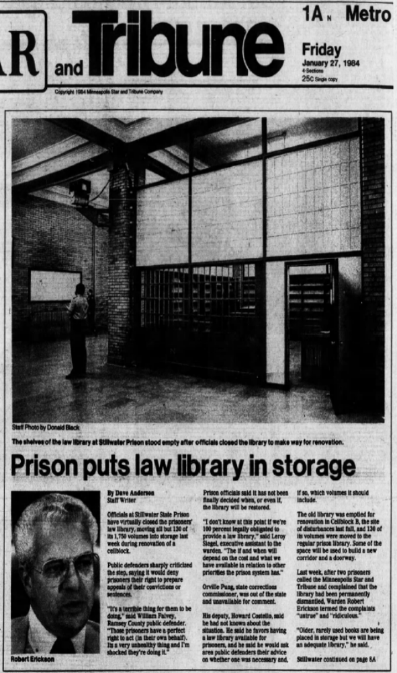
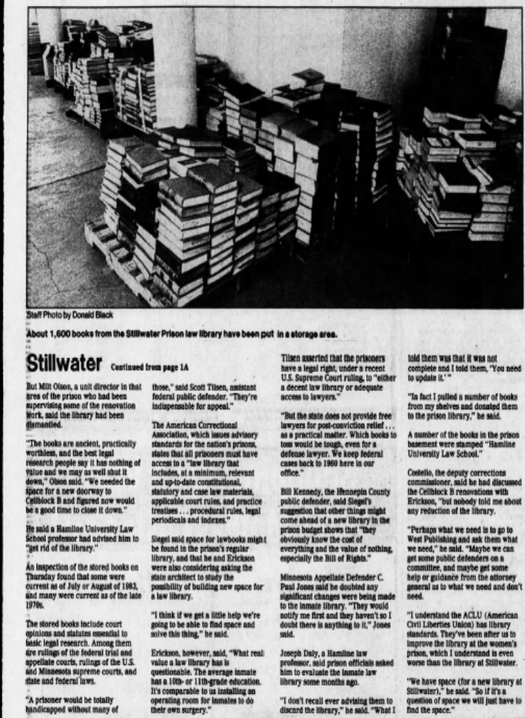

Slide 4
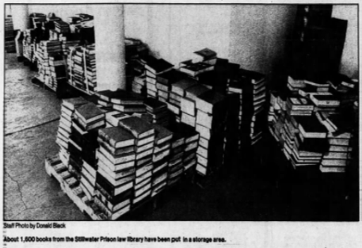
Erickson said: “What real value a law library has is questionable. The average inmate has a 10th or 11th grade education. It is comparable to installing an operating room for inmates to do their own surgery.”

Slide 5
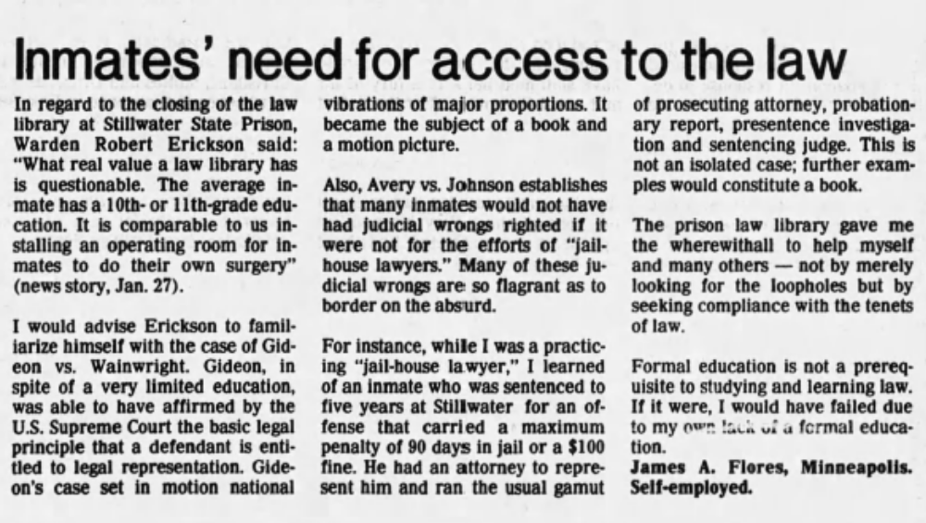
Star Tribune Letter to the Editor 02/11/1984

Slide 6
Star Tribune Letter to the Editor 02/11/1984
“The prison library gave me the wherewithal to help myself and many others – not by merely looking for the loopholes but by seeking compliance with the tenants of the law.”

Slide 7
Lewis v. Casey 518 US 343 (1996)
Arizona case
NO Absolute right to law library
Required showing of “actual injury” – lack of library access did not allow pursuing case

Slide 8
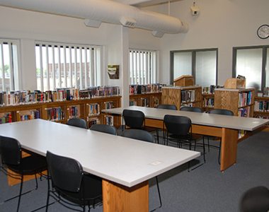
Oak Park Heights Prison Library

Slide 9
Law Library Service to Prisoners
Founded in 1984
Interagency agreement between the State Law Library and the Department of Corrections
NOT TAXPAYER FUNDED
Curate a Core Collection of Legal Materials

Slide 10
Core Collection of Legal Materials for Prison Libraries
~ Effective July 1, 2018 ~
Research and Writing
Title/Edition | Author/Editor | Publisher | Most Recent Edition | Available at MCF Library
Black’s Law Dictionary | Garner, Bryan Editor | West Group | 10th edition 2014 | Any edition
Legal Research: How to Find and Understand the Law | Elias, Stephen and Levinkind, Susan | Nolo Press | 17th edition 2015 | Current edition only
Legal Writing: Process, Analysis, and Organization | Edwards, Linda | Aspen Publishers | 7th edition 2018 | 6th edition or newer
Primary Resources
Title/Edition | Author/Editor | Publisher | Most Recent Edition | Available at MCF Library
Department of Corrections Policy Manual | MNDOC | MNDOC | Updated monthly | Current policies on offender network
Minnesota Statutes | ----------- | Revisor of Statutes, State of Minnesota | 2016 | Current set only
Minnesota Rules | ------------ | Revisor of Statutes, State of Minnesota | 2017 | Current set only
Laws of Minnesota (MN Session Laws) | ------------ | Revisor of Statutes, State of Minnesota | 2017 | Current set only
Minnesota Rules of Court: State | ------------ | West Group | 2018 | Current volume only
Minnesota Rules of Court: Federal | ------------ | West Group | 2018 | Current volume only
Federal Civil Judicial Procedure and Rules | ------------ | West Group | 2018 | Current volume only
Federal Criminal Code and Rules | ------------ | West Group | 2018 | Current volume only

Slide 11
Finding Tools
Title/Edition | Author/Editor | Publisher | Most Recent Edition | Available at MCF Library
Minnesota Legislative Manual | Minnesota Secretary of State | MN Secretary of State Office | 2017-2018 | Current edition only
Minnesota Judges’ Criminal Benchbook | ------------ | MN State Bar Assoc. Continuing Legal Education | 7th edition 2016 w/ 2018 updates | Current edition only, hard copy or pdf version
Protecting Your Health and Safety: A Litigation Guide for Inmates | Toone, Robert E. | Southern Poverty Law Center | 2009 2nd edition | Current edition only
Prisoners’ Guide to Survival | Belanger, L. Powell | PSI Publishing Company | 2001 | Current edition only
Lexis Advanced
Title | Provider
U.S. Supreme Court Cases United States Code Service, including annotations and archives Minnesota State and Federal Rules of Court, including archives United States Constitution Minnesota Supreme Court Cases from 1861 Minnesota Court of Appeals Cases from 1983 Minnesota Annotated Statutes, including archives Minnesota Annotated Constitution Minnesota Civil Practice Ballantine's Law Dictionary Constitutional Rights of Prisoners | LexisNexis

Slide 12
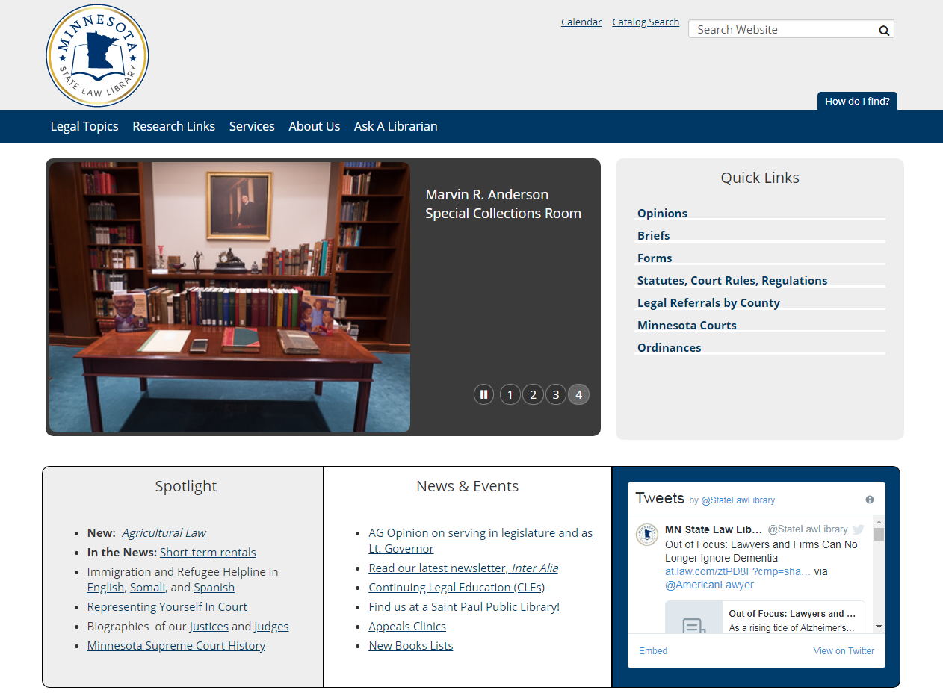

Slide 13
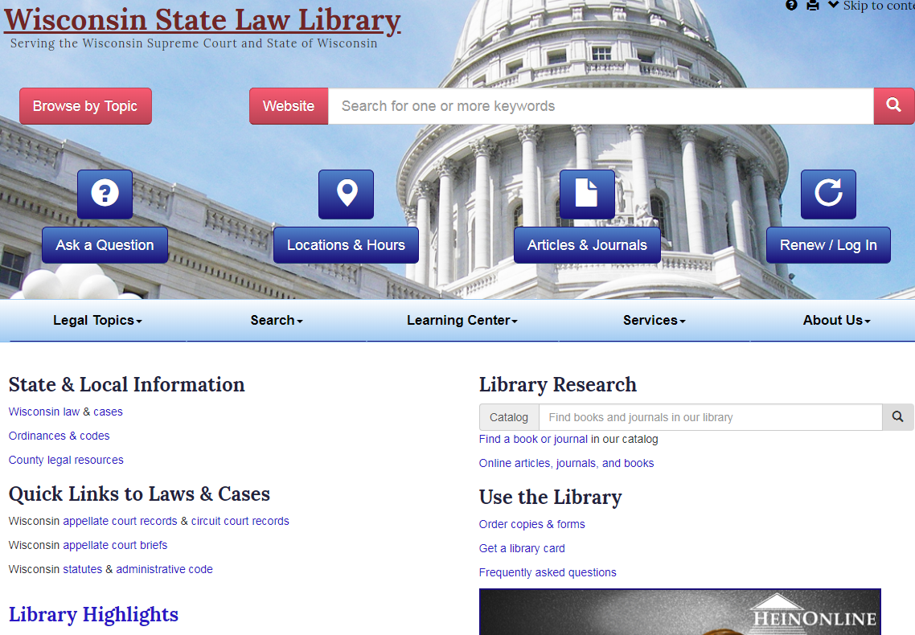

Slide 14
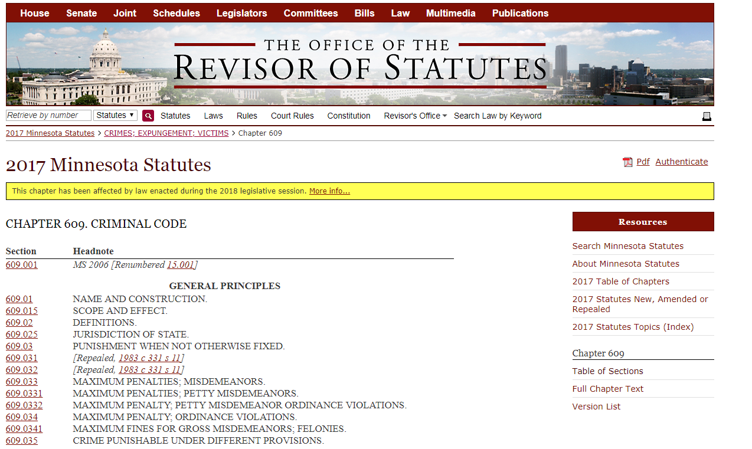

Slide 15
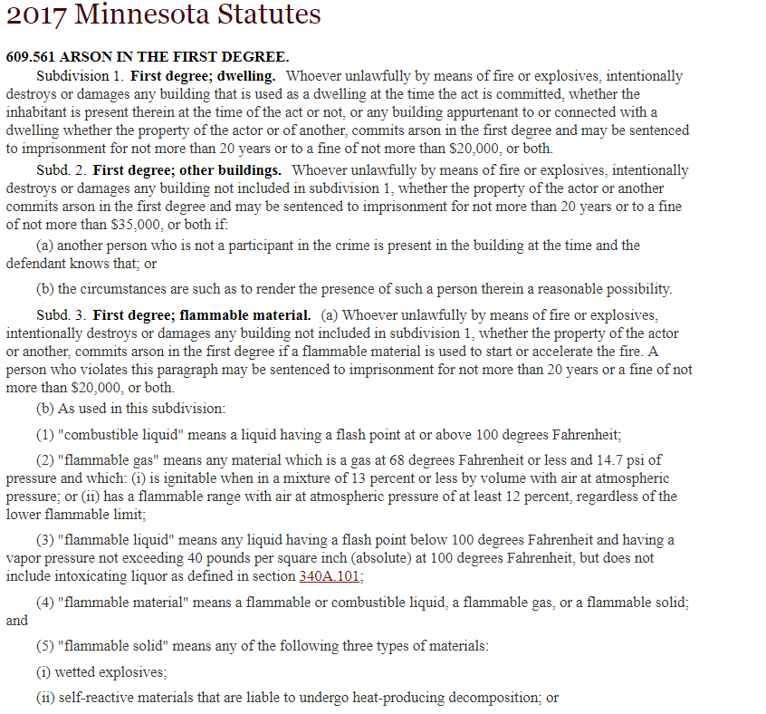

Slide 16
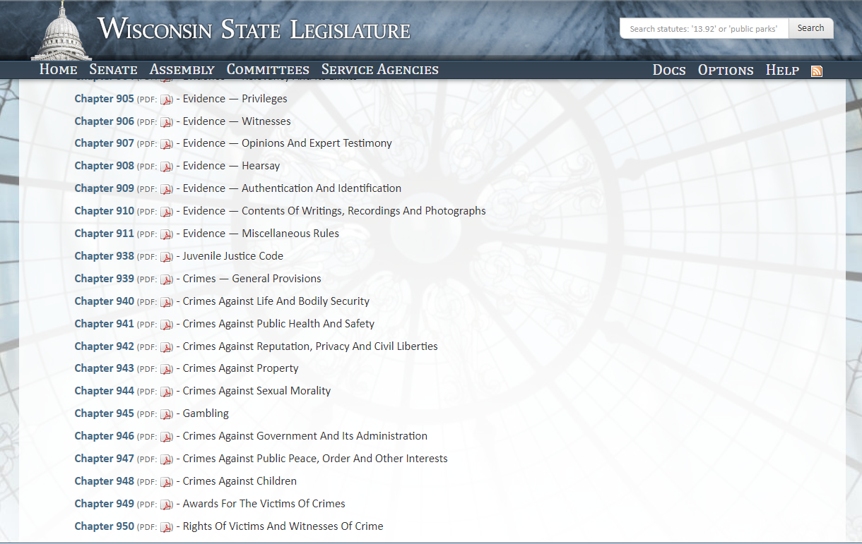

Slide 17
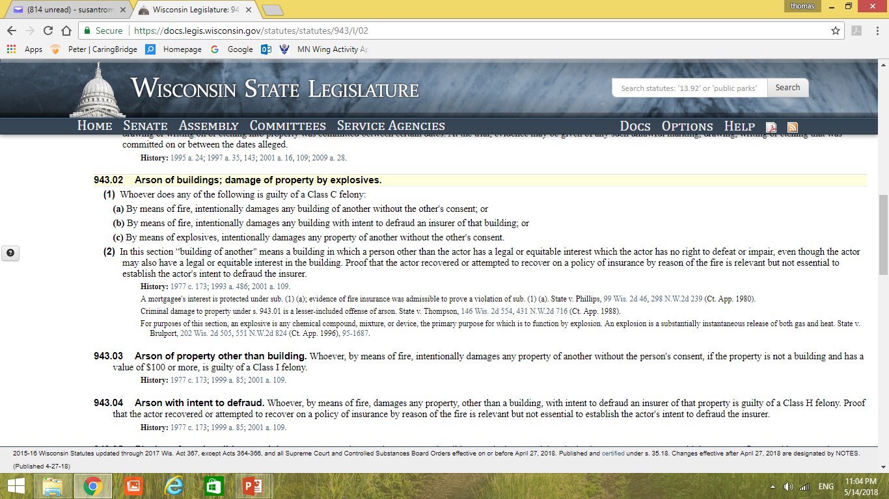

Slide 18
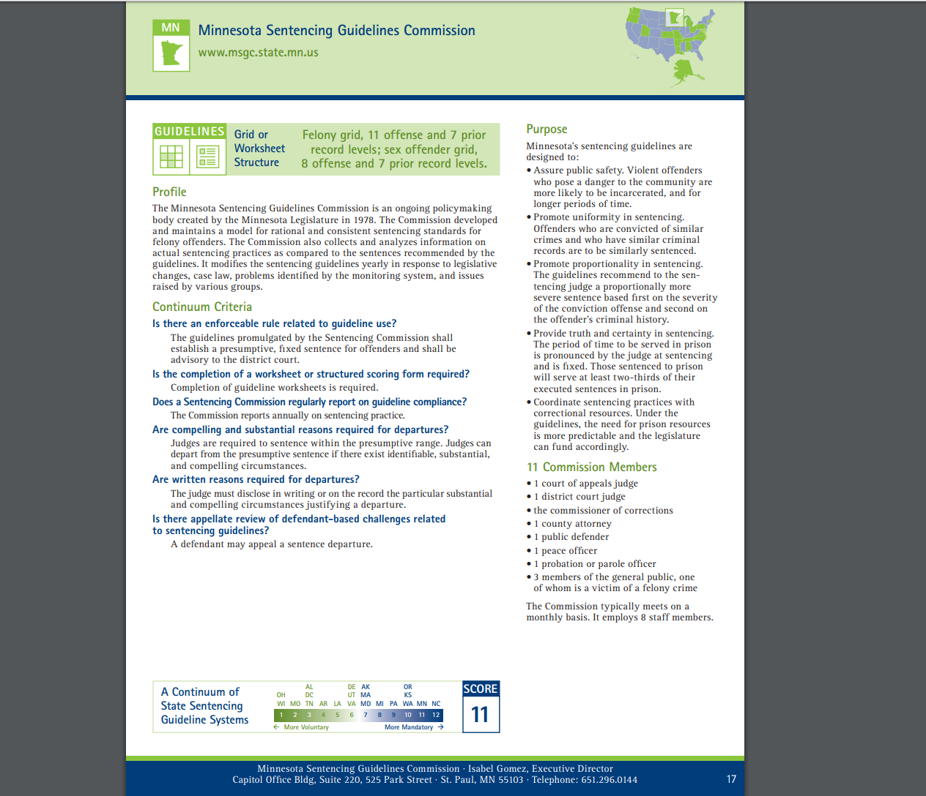

Slide 19
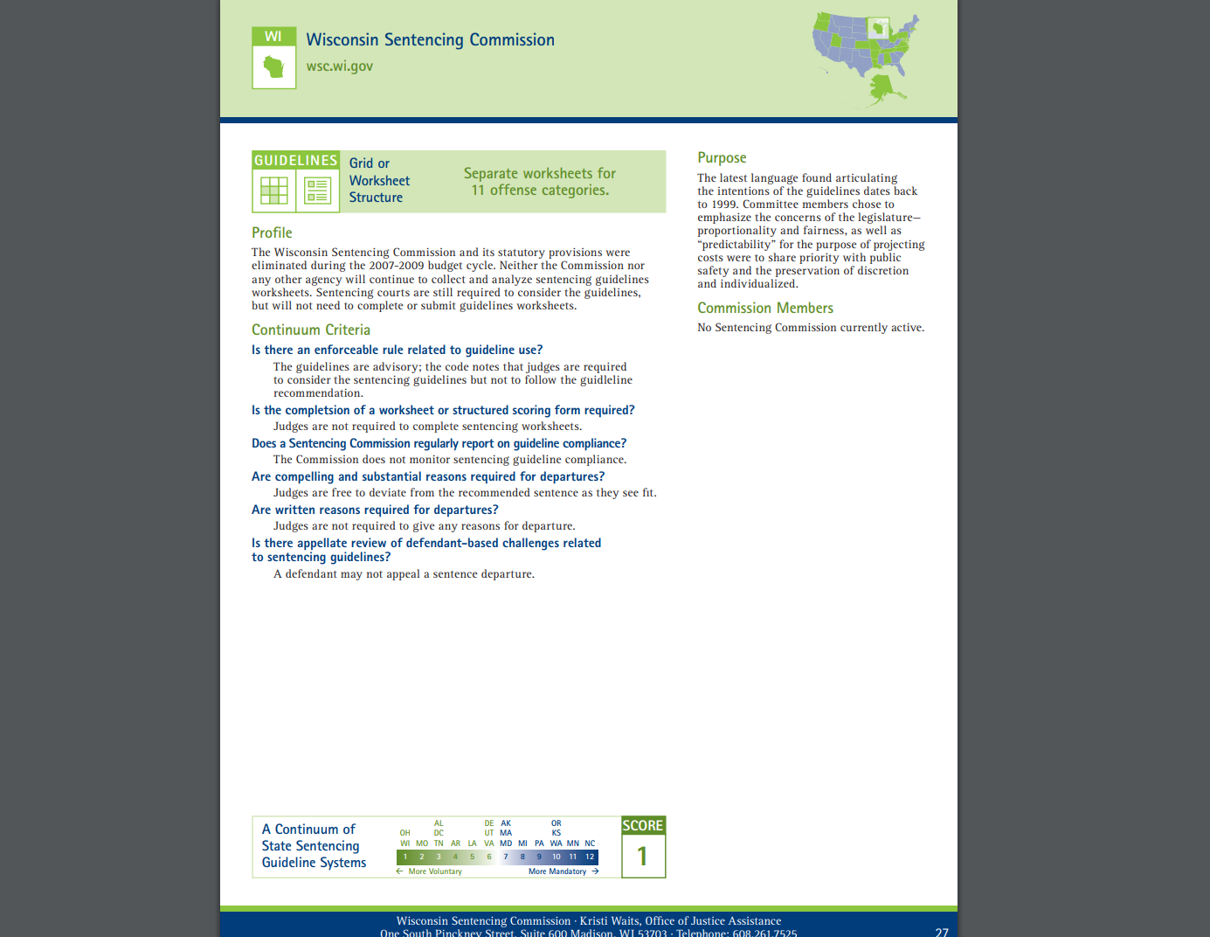

Slide 20

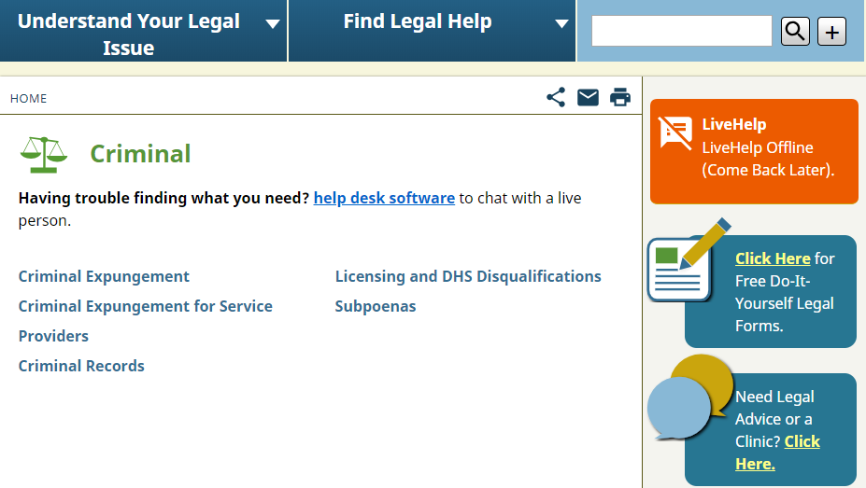

Slide 21
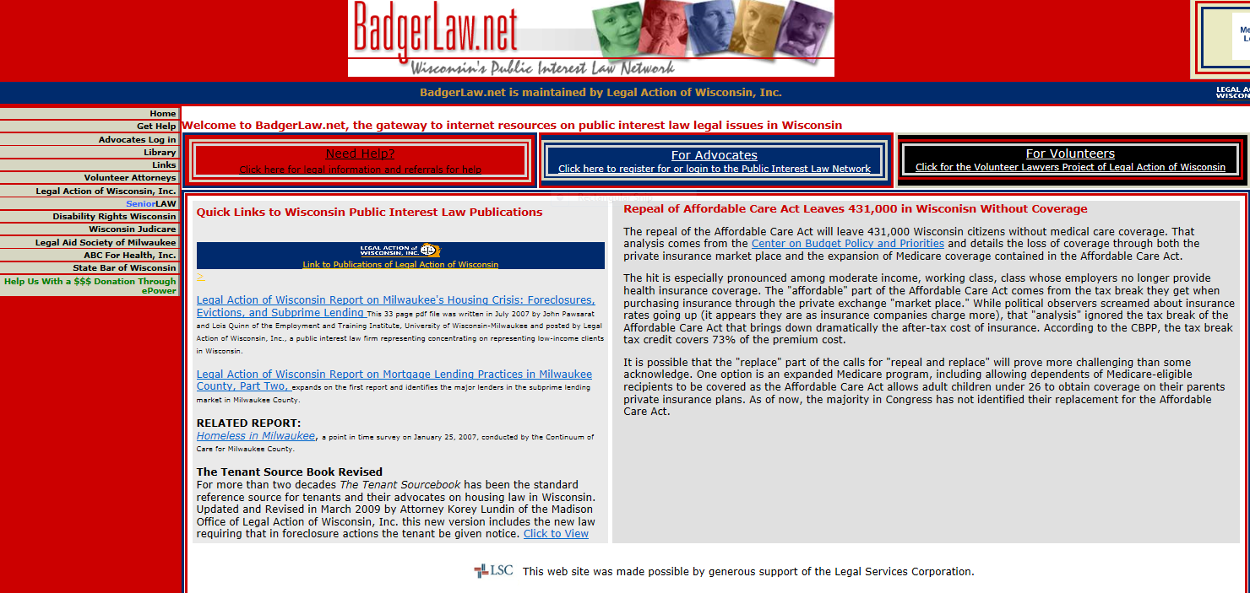

Slide 22
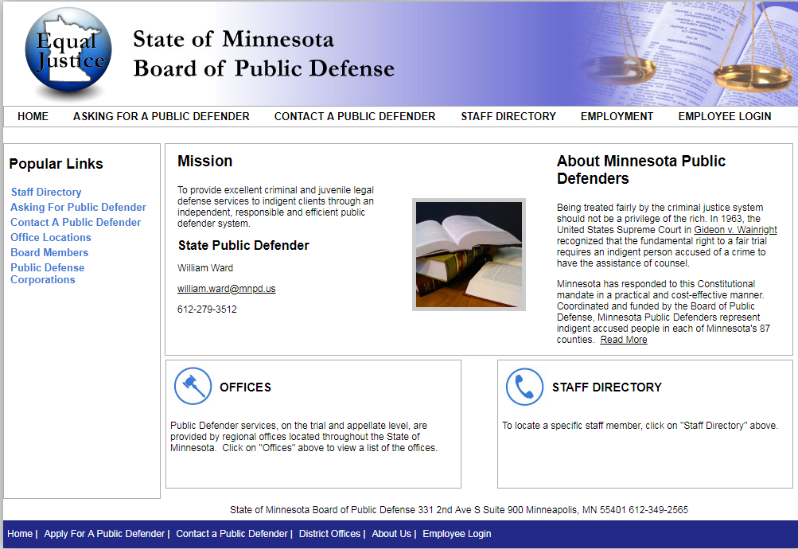

Slide 23
Wisconsin State Public Defender
APPELLATE AND TRIAL PRACTICE GUIDES
Resources and links from the Wisconsin State Public Defender's Office (SPD). Please note: some of the following links will take you to sites external to wispd.org.
Appeals and Postconviction Proceedings
SPD Appellate Division
Appeal Information for the SPD Trial Atty
Appellate Brief Filing Checklist
Example Motion for Stay Pending Appeal
Templates for Briefs and Petition for Review
Handbook - Appellate Practice & Procedure for SPD-Appointed Counsel
Attorney-Client Communications
Columbia Correction Call form
Providing High Quality Attorney-Client Communication
Case Summaries
How to find a brief in Appellate cases
On Point blog 2010 - present
Charging Practices
Consolidation of charging from multiple counties

Slide 24
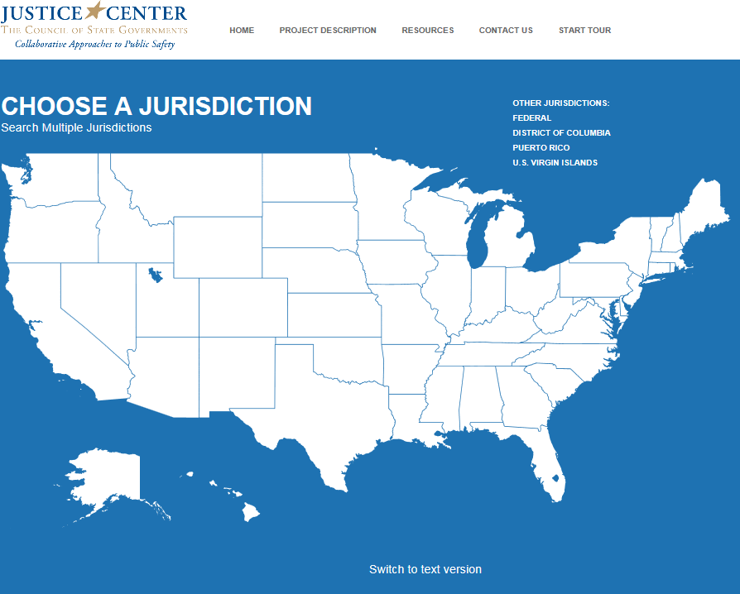

Slide 25
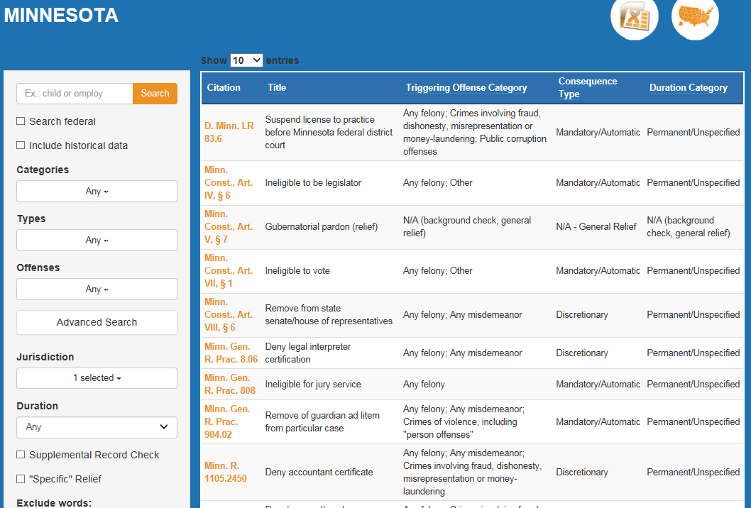

Slide 26
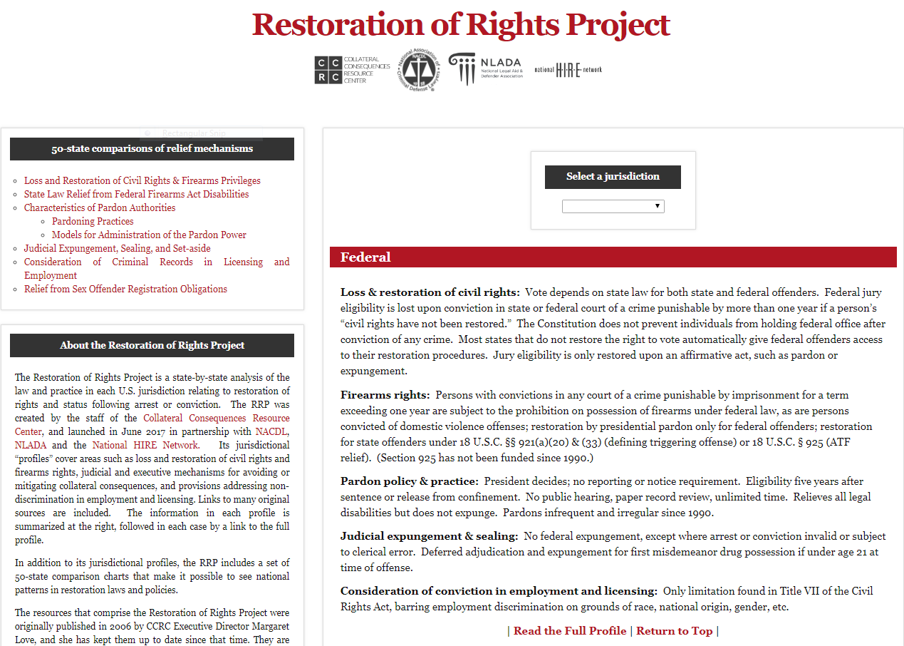

Slide 27
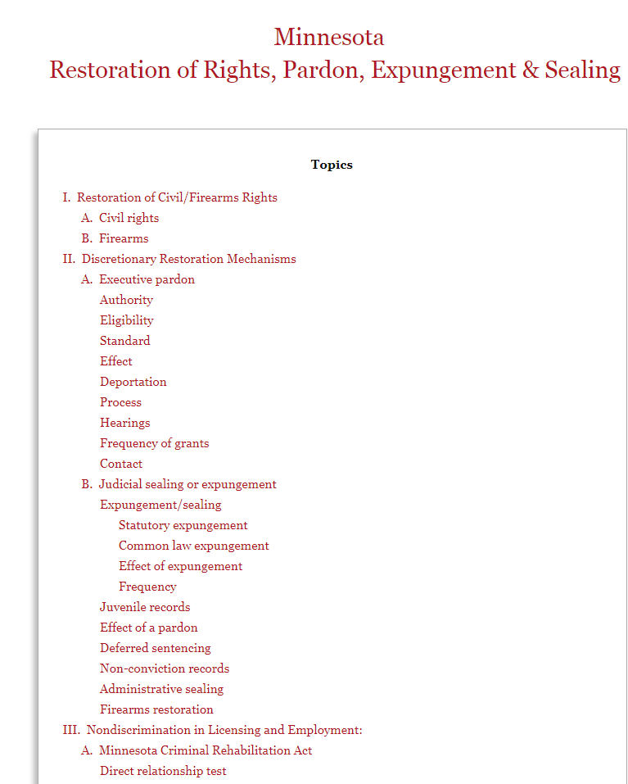

Slide 28
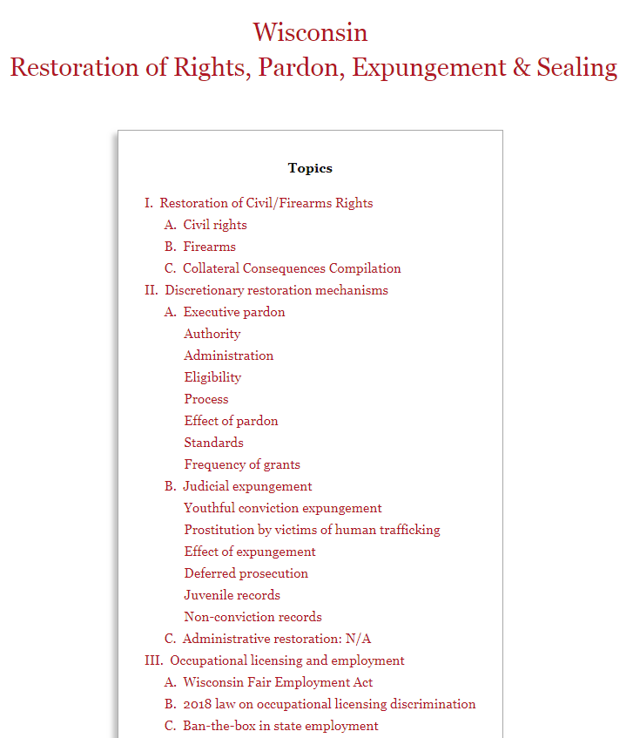

Slide 29
A Jailhouse Lawyer’s Manual, 11th Ed.
Title Page & Legal Disclaimer
Table of Contents
1. How to use the JLM
2. Introduction to Legal Research
3. Your Right to Learn the Law and Go to Court
4. How to Find a Lawyer
5. Choosing a Court and a Lawsuit: An Overview of the Options
6. An Introduction to Legal Documents
7. Freedom of Information
8. Obtaining Information to Prepare Your Case: The Process of Discovery
9. Appealing Your Conviction or Sentence
10. Applying for Re-Sentencing for Drug Offenses
11. Using Post-Conviction DNA Testing to Attack Your Conviction or Sentence
12. Appealing Your Conviction Based on Ineffective Assistance of Counsel
13. Federal Habeas Corpus
14. The Prison Litigation Reform Act
15. Inmate Grievance Procedures
16. Using 42 U.S.C. § 1983 and 28 U.S.C. § 1331 to Obtain Relief from Violations of Federal Law
17. The State’s Duty to Protect You and Your Property: Tort Actions
18. Your Rights at Prison Disciplinary Proceedings
19. Your Right to Communicate with the Outside World
20. Using Article 440 of the New York Criminal Procedure Law to Attack Your Unfair Conviction of Illegal Sentence
21. State Habeas Corpus: Florida, New York, and Michigan
22. How to Challenge Administrative Decisions Using Article 78 of the New York Civil Practice Law and Rules
23. Your Right to Adequate Medical Care
24. Your Right to be Free from Assault by Prison Guards and Other Prisoners
25. Your Right to be Free From Illegal Body Searches
26. Infectious Diseases: AIDS, Hepatitis, Tuberculosis, and MRSA in Prisons
27. Religious Freedom in Prison
28. Rights of Prisoners with Disabilities
29. Special Issues for Prisoners with Mental Illness
30. Special Information for Lesbian, Gay, Bisexual, and Transgender Prisoners
31. Security Classification and Gang Validation
32. Parole
33. Rights of Incarcerated Parents

Slide 30
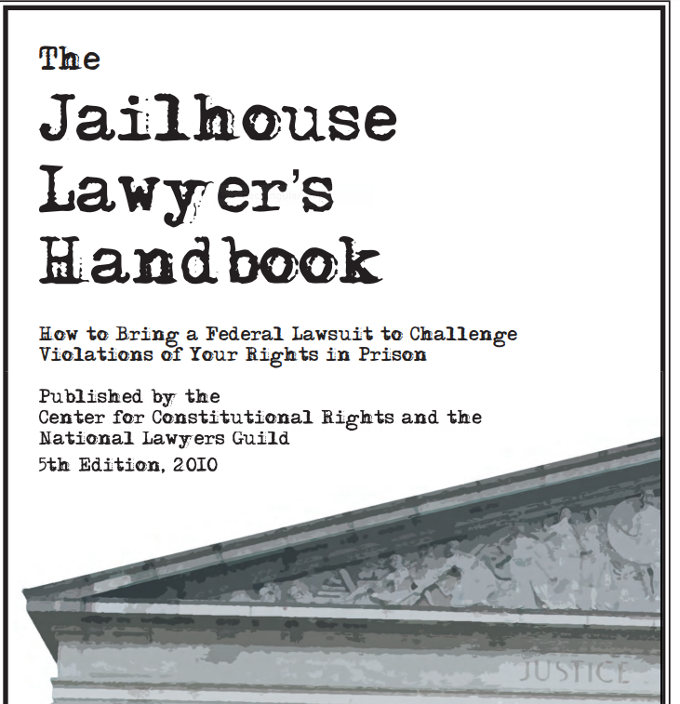

Slide 31
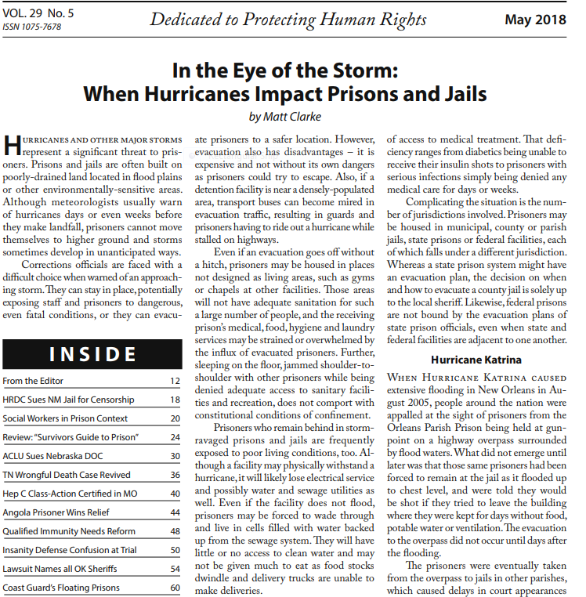
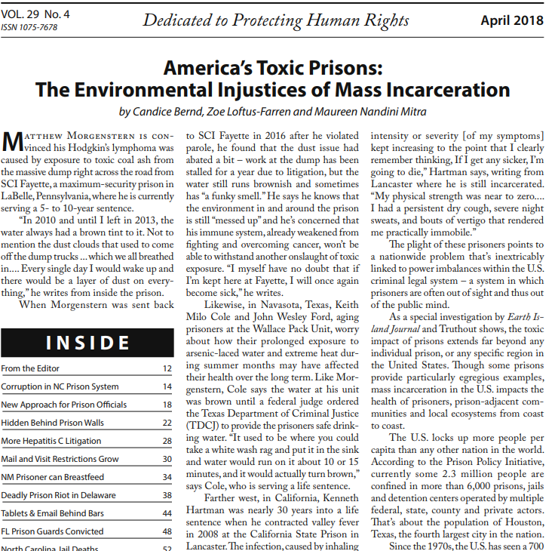
Prison Legal News

Slide 32
THE FEDERAL BONDING PROGRAM
U.S. DEPARTMENT OF LABOR
Started in 1966
Fidelity Bonds for “at-risk,” hard-to-place job seekers
The bonds cover first six months of employment
No cost to the job applicant or the employer

Slide 33
Offender locators
(or, is the person locked up?)
Department of Corrections
  State facilities
  Photo
VineLink
  Includes county jails
  Allows for notification of release
Bureau of Prisons
  Federal custody
Online Detainee Locator System
  Immigration (ICE) custody

Slide 34
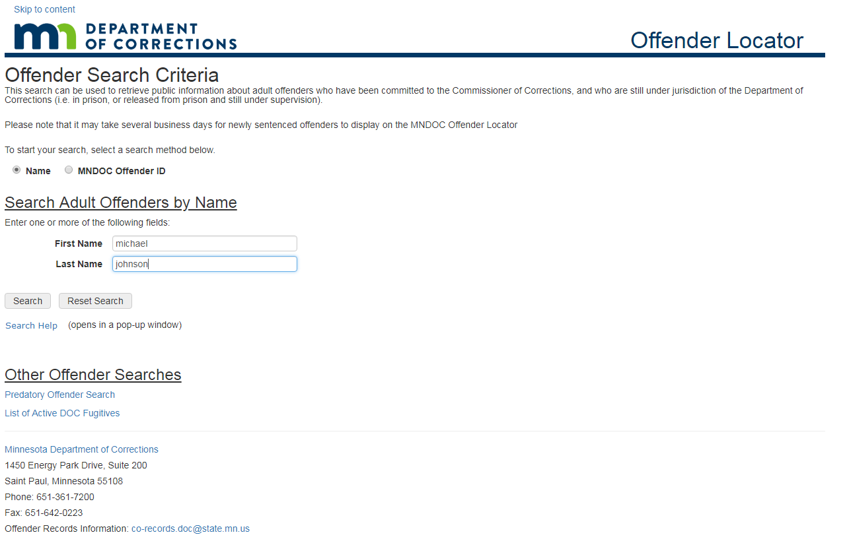

Slide 35
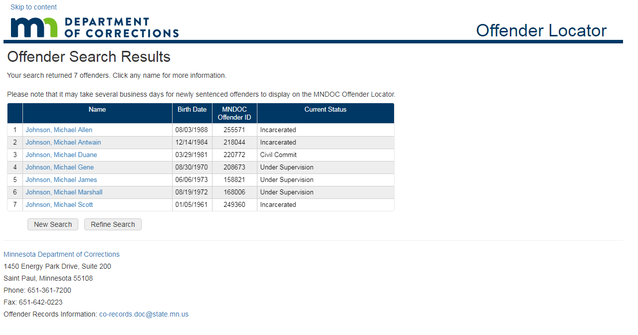

Slide 36
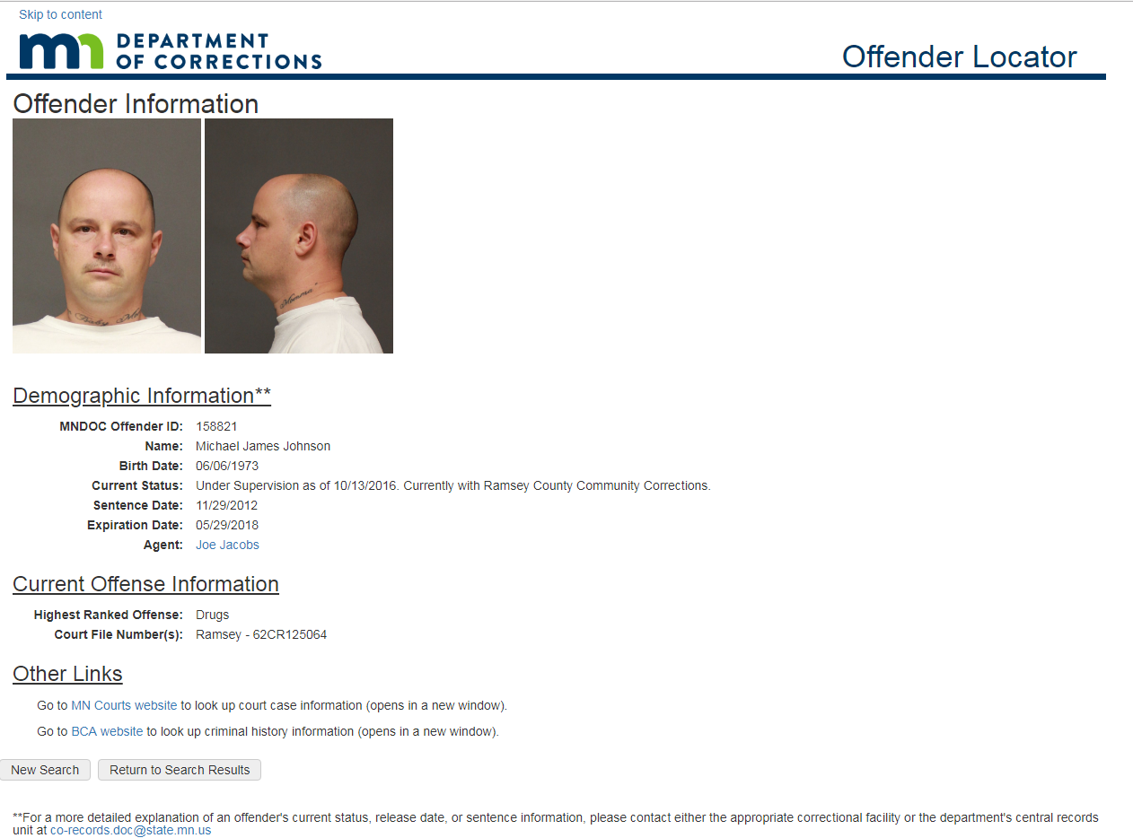

Slide 37
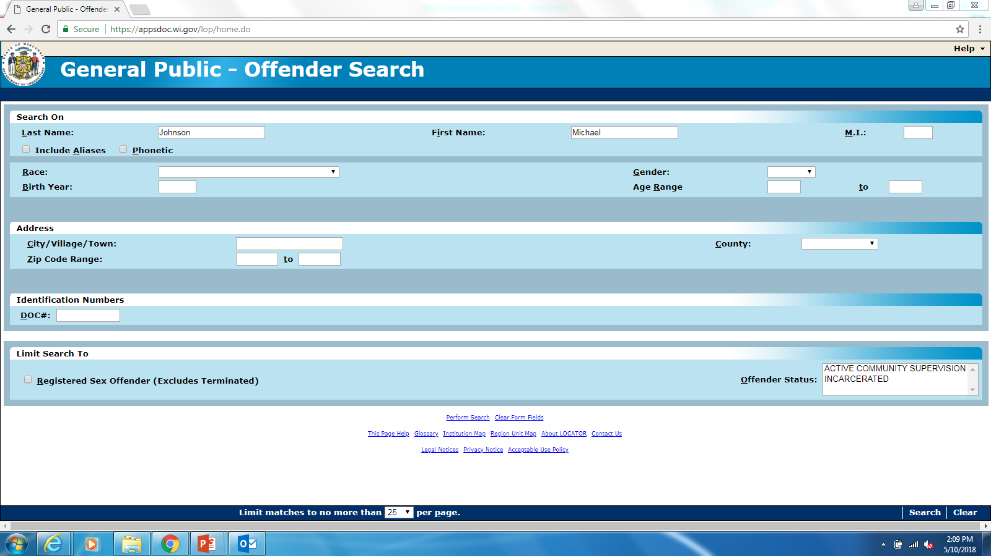

Slide 38
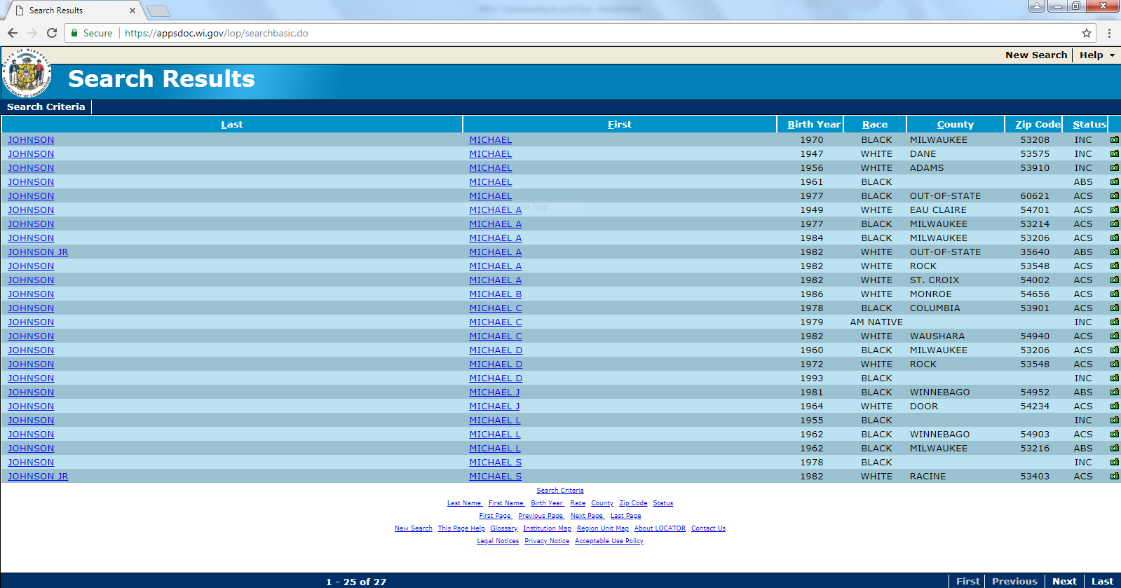

Slide 39
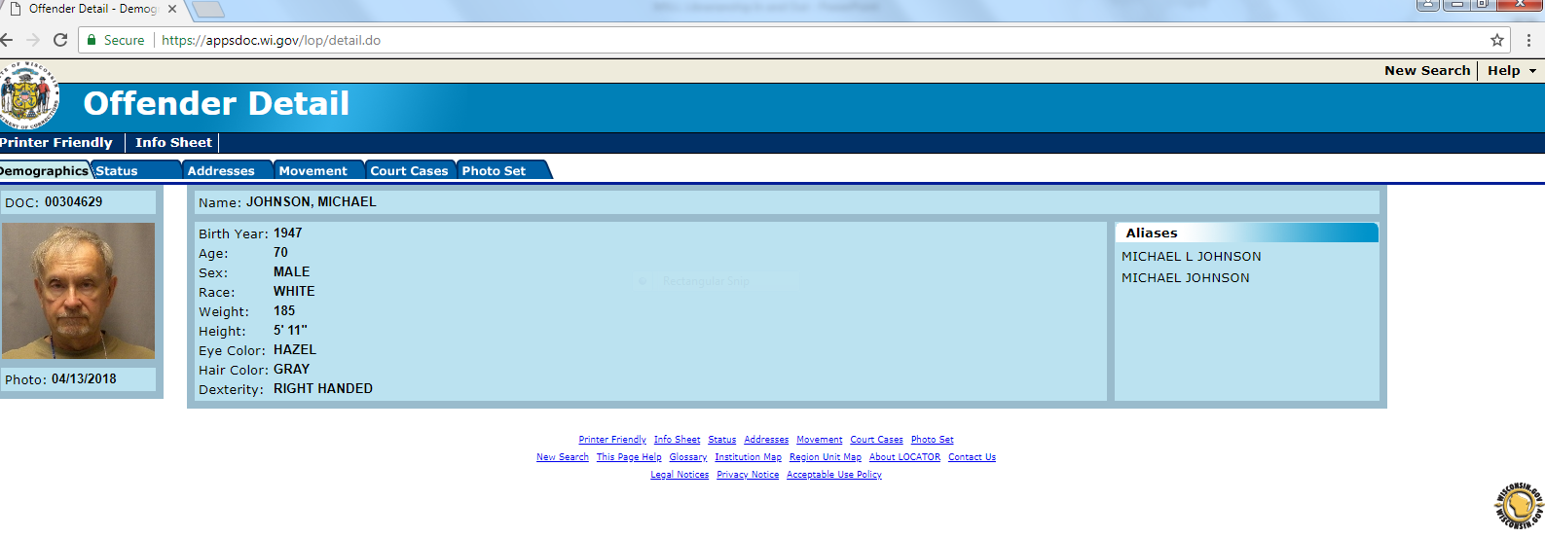

Slide 40
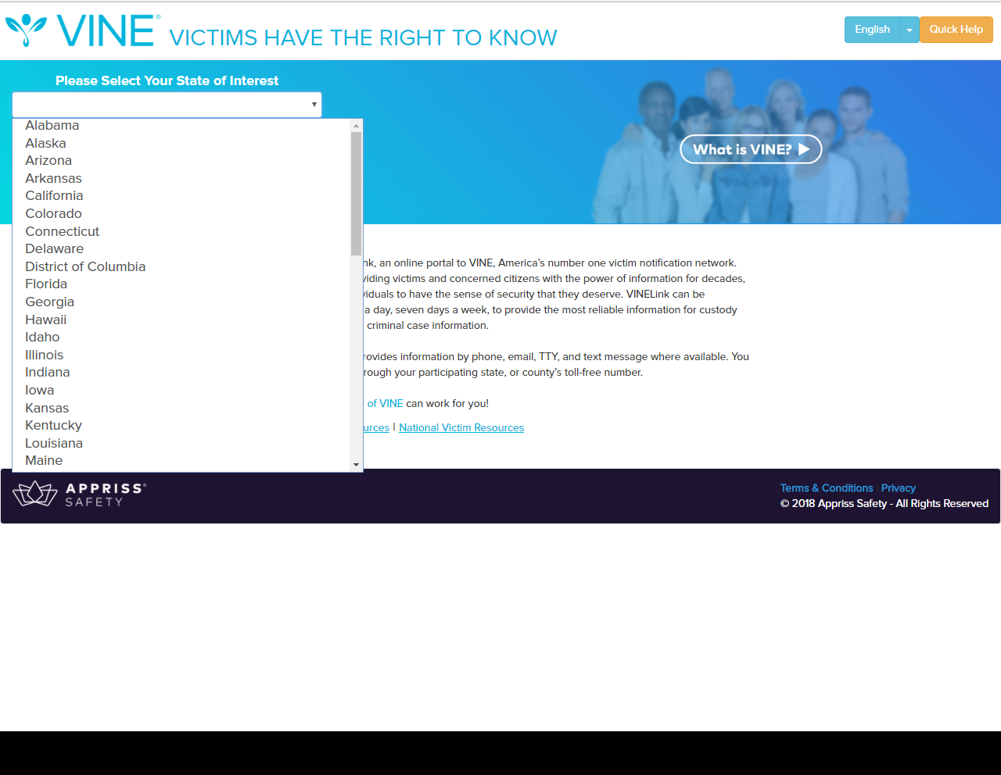

Slide 41
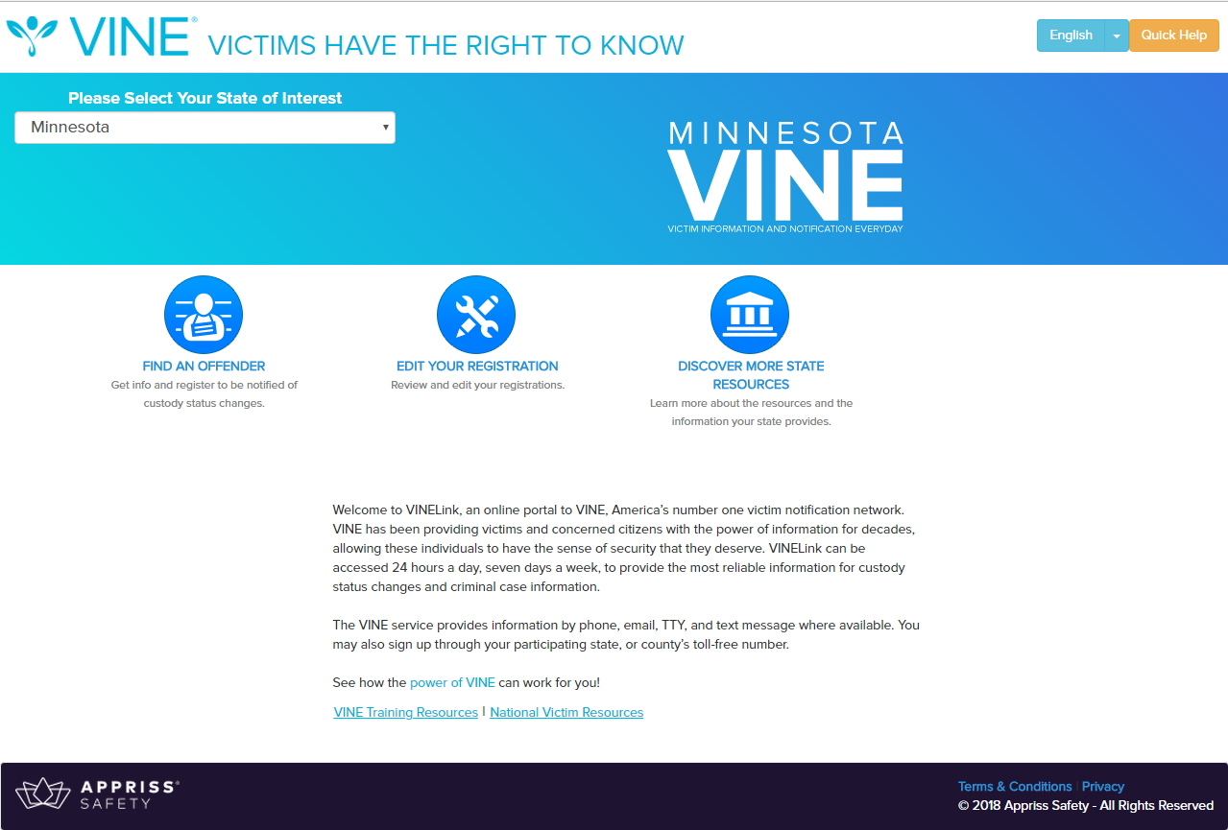

Slide 42
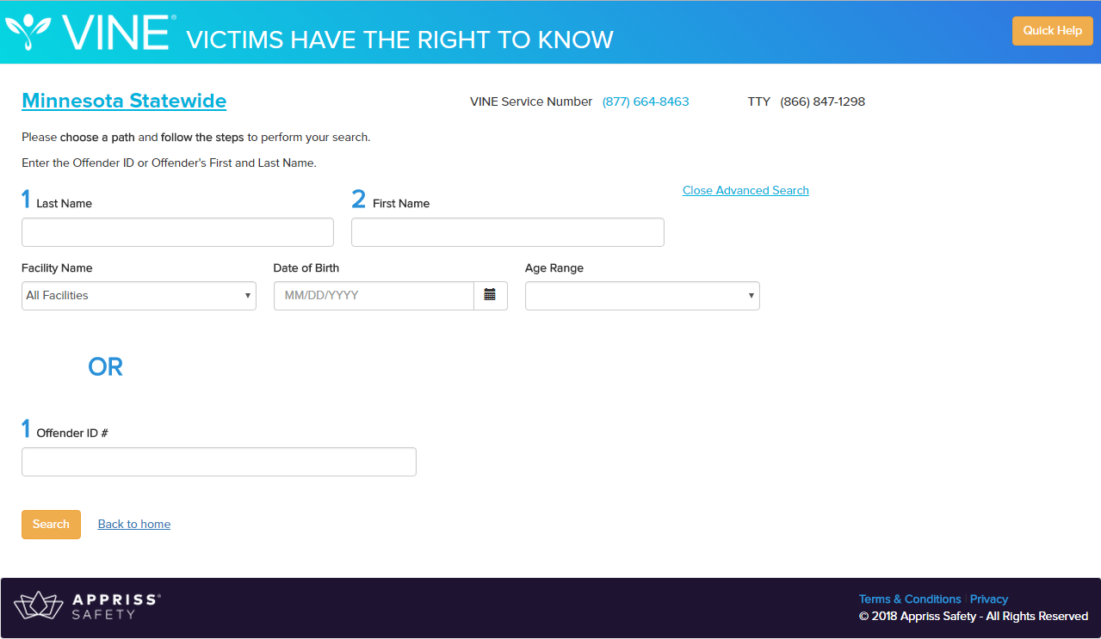

Slide 43
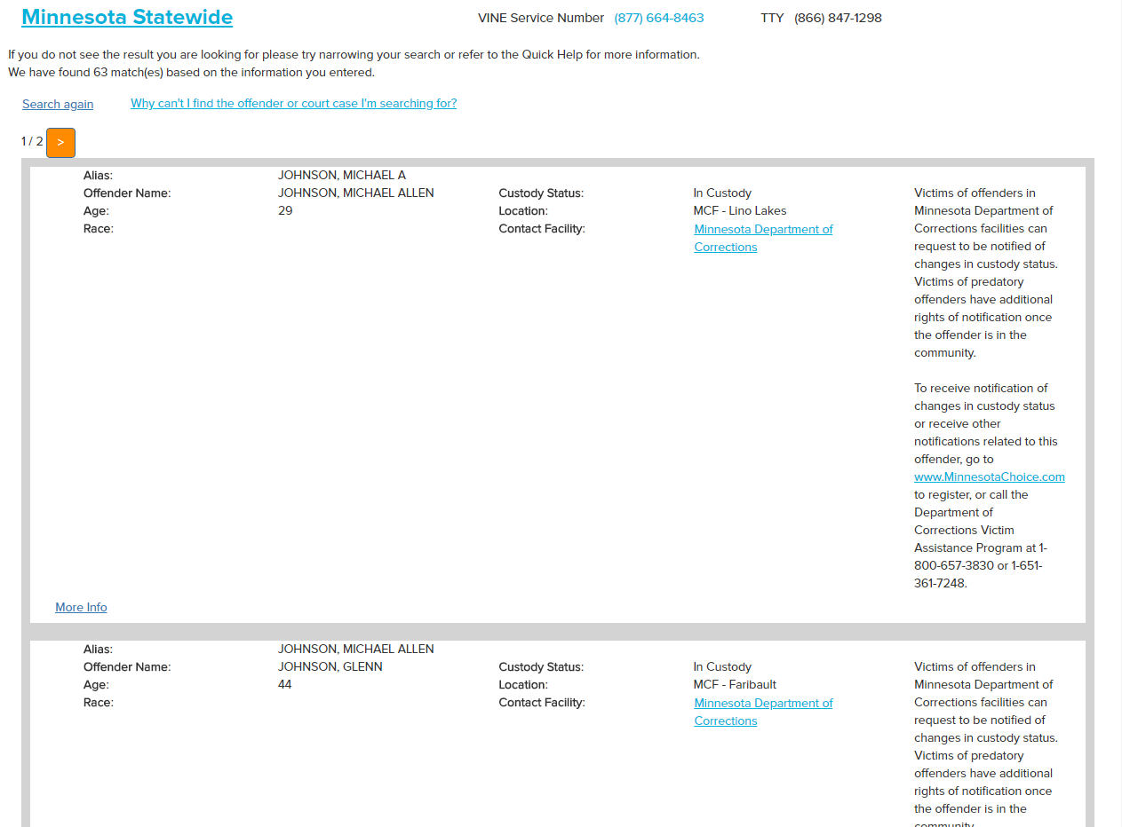

Slide 44
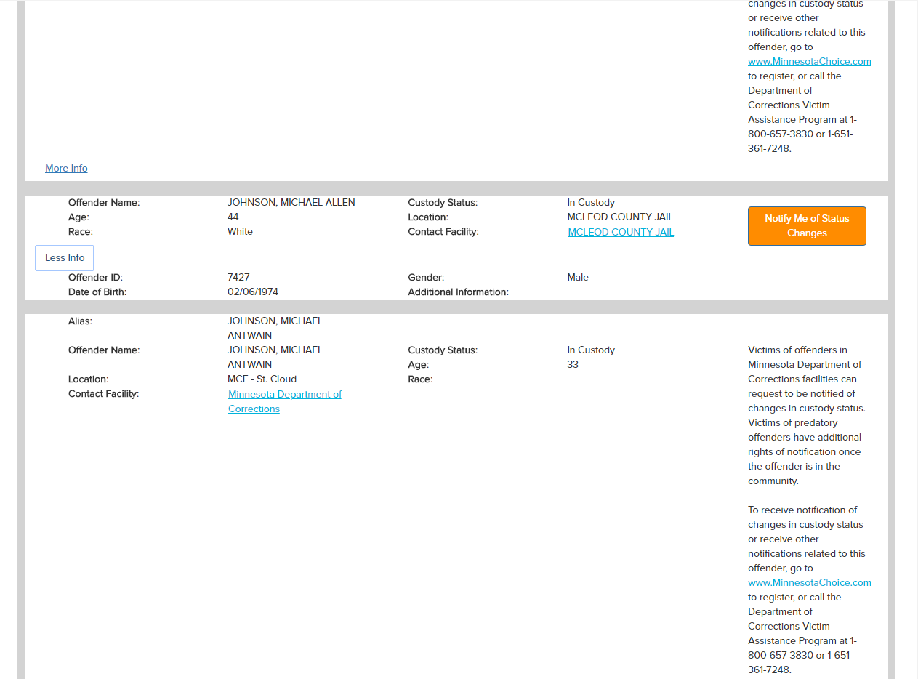

Slide 45
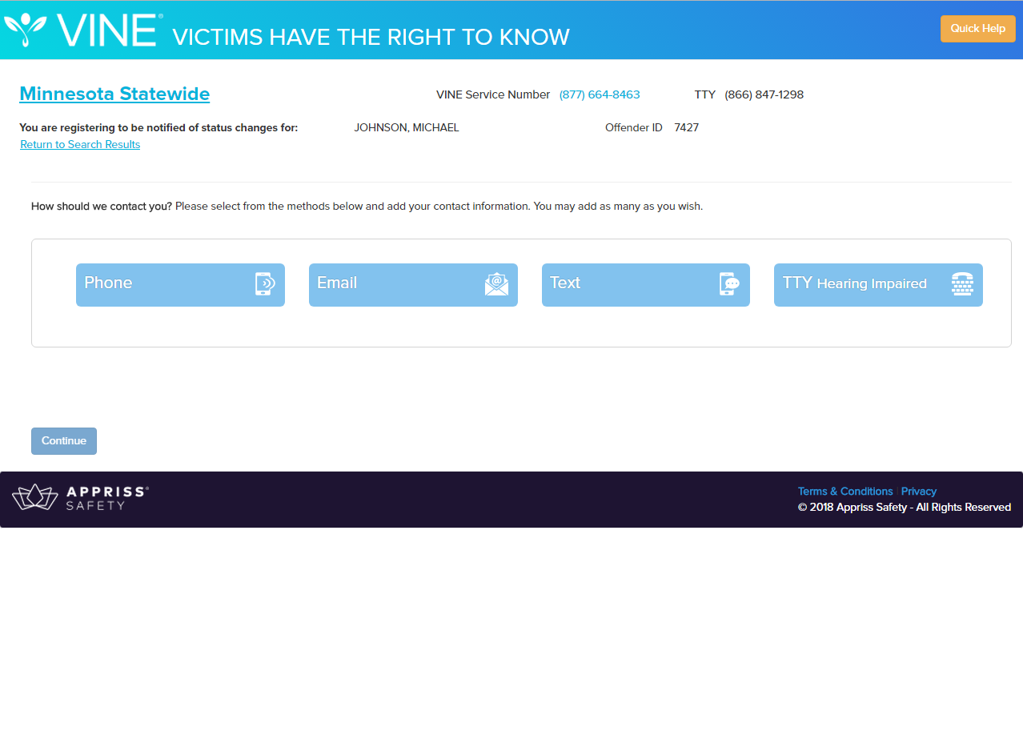

Slide 46
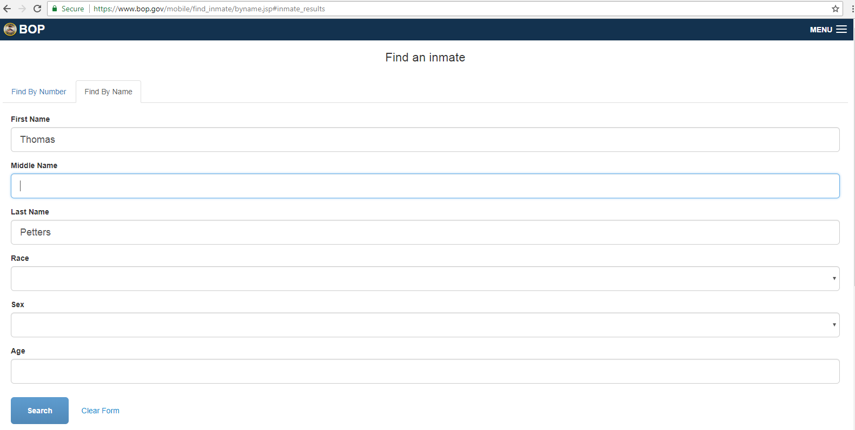

Slide 47


Slide 48
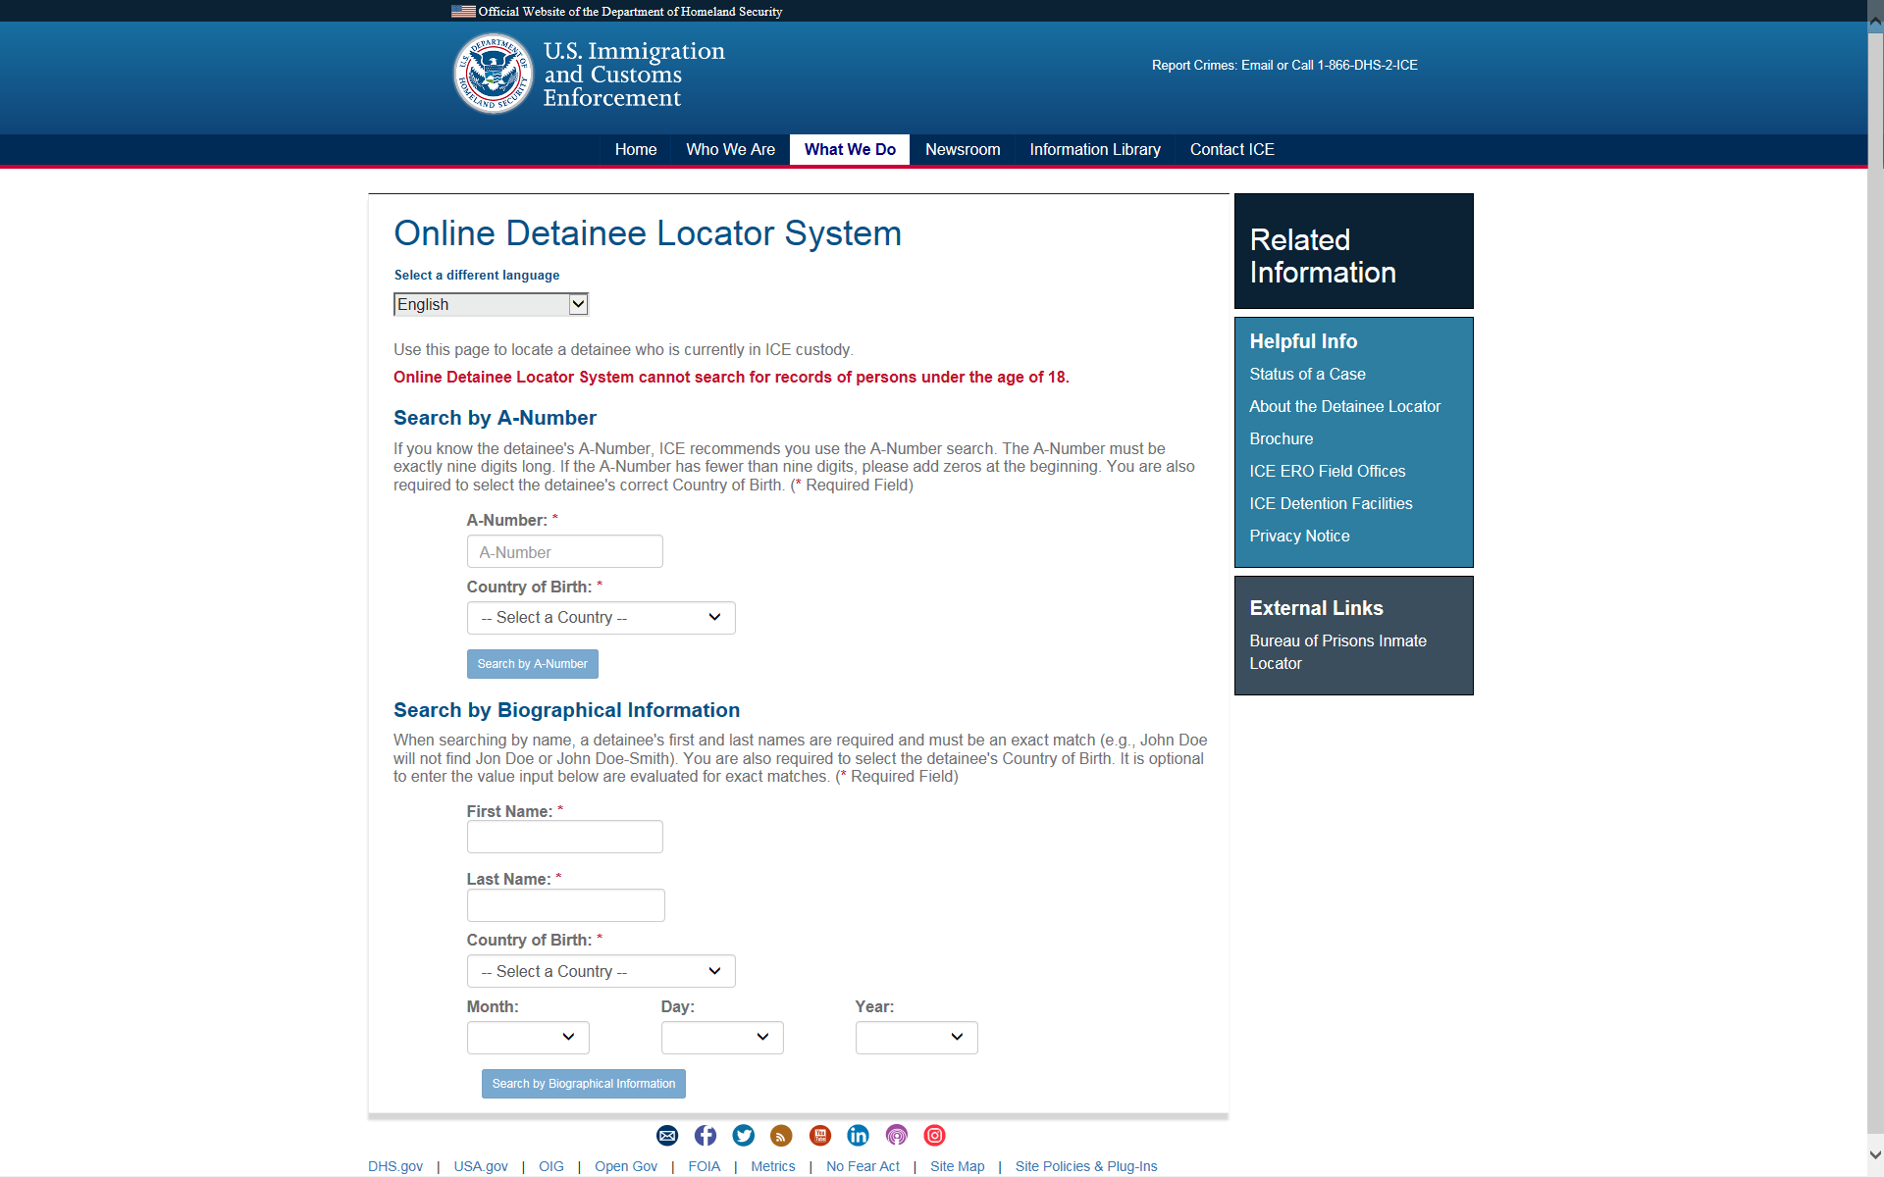

Slide 49
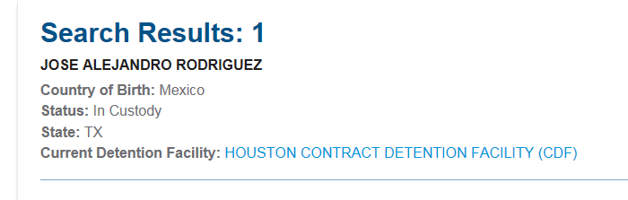

Slide 50
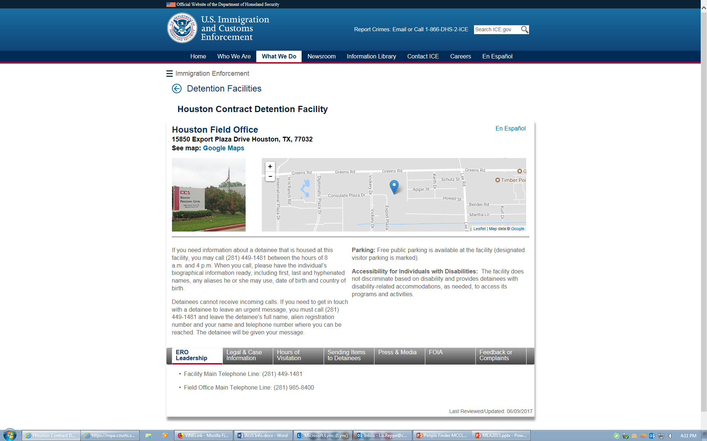

Slide 51
Services for MN Librarians
Reference help
Collection development guidance
Training for librarians
  (We will travel to you!)
Weeding guidance for legal materials
Referral for your patrons

Slide 52
Questions?
Contact us:
Website: mn.gov/law-library/
Susan Trombley, Outreach Librarian
Email: Susan.Trombley@courts.state.mn.us
Phone: (651) 297-7659

