Slide 1
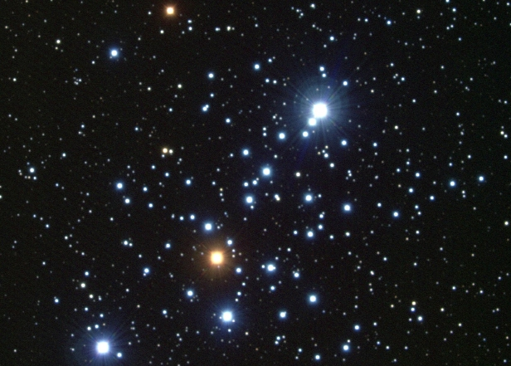


Minnesota Digital Library Explorations³
Advancing & Transforming Minnesota’s History
PRIMARY
SOURCE SETS
(inspired)
GEOSPATIAL
(motivated)
RIGHTS
(encouraged)
Jolie O. Graybill – Assistant Director – jog@umn.edu
Sara Ring – Continuing Education Librarian – ring089@umn.edu
Minnesota Digital Library – Minitex, University of Minnesota Libraries

Slide 2
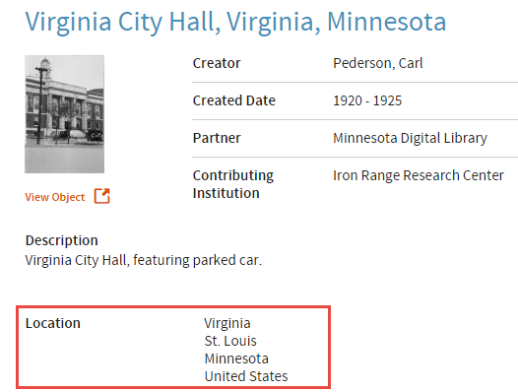
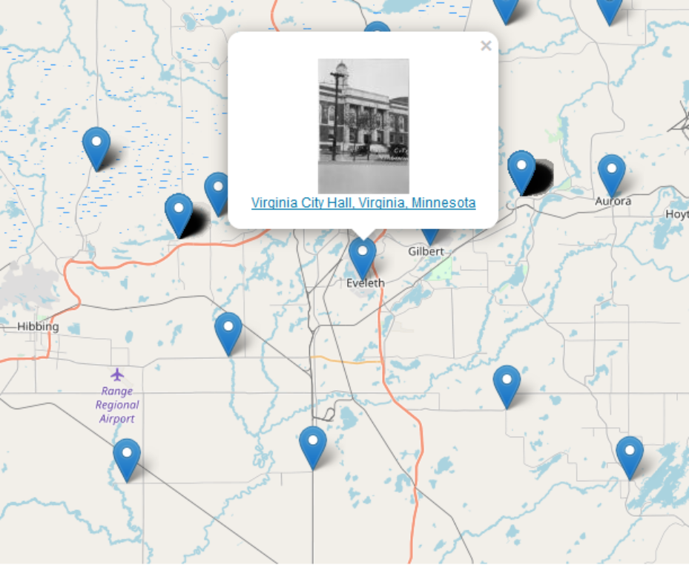
Minnesota Digital Library Explorations¹
GEOSPATIAL METADATA (motivated)
BEFORE AFTER
Notes:
Here are some of the problems with traditional Geospatial Metadata
Variation in Geographic Coordinate formats
Coordinates can be expressed in a variety of ways - including numbers (decimal vs. degrees, minutes and seconds) as well directions
Additionally, the placements of the coordinates are also not consistent (same field or different fields for latitude and longitude)
2. Placement of Latitude and Longitude coordinates
Same field? Different fields?
3. Variations in Field Mapping
Problems with what do you map to – DC Coverage, Spatial, or Subject???
Final problem:
4. Ambiguous Place Names
This example from the Minnesota Digital Library perfectly illustrates this problem. We have the Virginia City Hall. Located in the city of Virginia. In the state of Minnesota. And located in St. Louis County. So the DPLA record which pulls location reads: Virginia, St. Louis. Minnesota…. Not so clear!

Slide 3
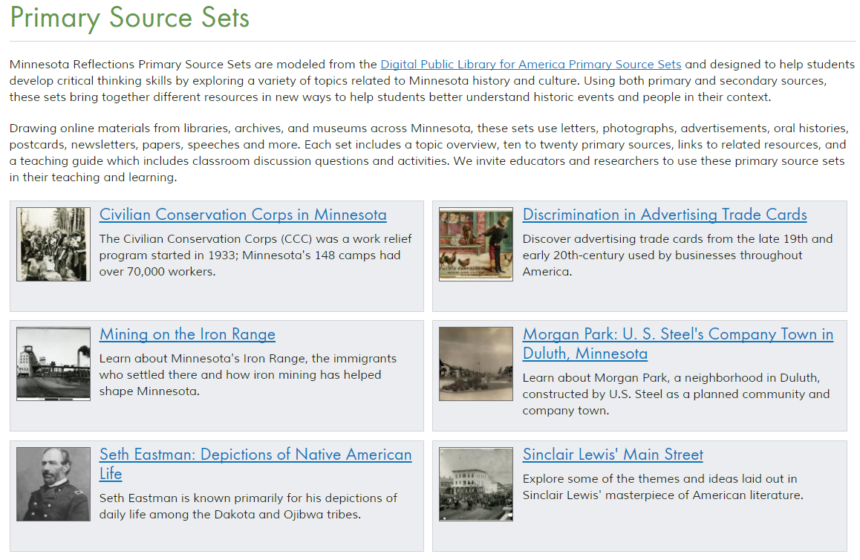
Minnesota Digital Library Explorations²
PRIMARY SOURCE SETS (inspired)
Notes:
Curated sets of primary sources on a Minnesota-specific topic.
Designed to help students develop critical thinking skills.
Encourages students to further research the topic.
Brings together Minnesota resources in new ways for researchers.
Provides educators with primary sources and tools for teaching them.
There are 19 primary source sets (more to come). Each includes:
Overview of the topic
10-25 primary sources (photos, postcards, letters, oral histories)
Links to additional resources (like ELM, and other books, articles, and websites)
A Teacher’s guide that includes classroom activities and discussion questions.
We’re looking for volunteers for guest authors (you can pick a subject based on your interests and what’s available in Reflections), but also people to serve on a review panel that will help authors select topics, edits content, and answer questions for the authors.

Slide 4
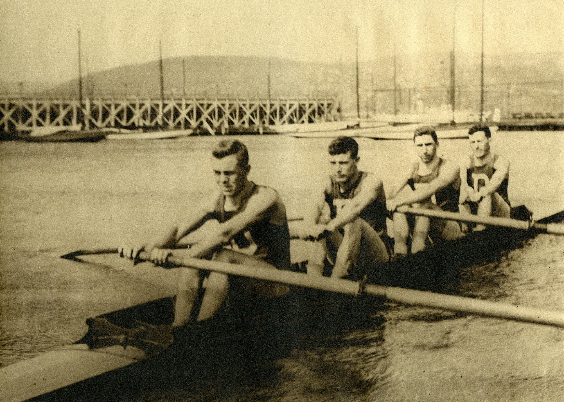
Minnesota Digital Library Explorations³
RIGHTS (encouraged)
Duluth Boat Club Junior Four, 1912, Duluth, Minnesota. 1912. University of Minnesota Duluth, Kathryn A. Martin Library, Northeast Minnesota Historical Collections, reflections.mndigital.org/catalog/nemhc:5915 Accessed 23 Feb. 2018.
Notes:
Jolie mentioned that we are undertaking implementing standardized rights statements at behest of DPLA, but it is a good thing to be doing anyway for our users.
To give you some additional background on why DPLA undertook this project, they looked at the DPLA aggregated records, and estimated over 80,000+ unique rights statements. This can be quite confusing to a user trying to figure out how they can use item. And, some of the statements were asserting rights that the organization didn’t actually have.
So, an international working group developed 12 standardized rights statements. These are high level summaries of the underlying rights statuses of the digital objects they apply to. There are statements to describe digital objects that are in copyright, out of copyright, and for other circumstances, such as when the copyright status cannot be determined.
They can be used by any cultural heritage institution
The rights statements have been designed with both human and machine users in mind
When we looked at Minnesota Reflections, we found we had approximately 300 different statements in the Rights field. That’s about one unique rights statement for every 134 records or so.
Like the image illustrates, MDL is now working on getting the nearly 190 MDL contributing organizations going forward in the same direction on rights. By adopting DPLA rights statements we are buying in and advocating for simplifying, harmonizing and maximizing the openness of rights in Digital Libraries around the World.

Slide 5
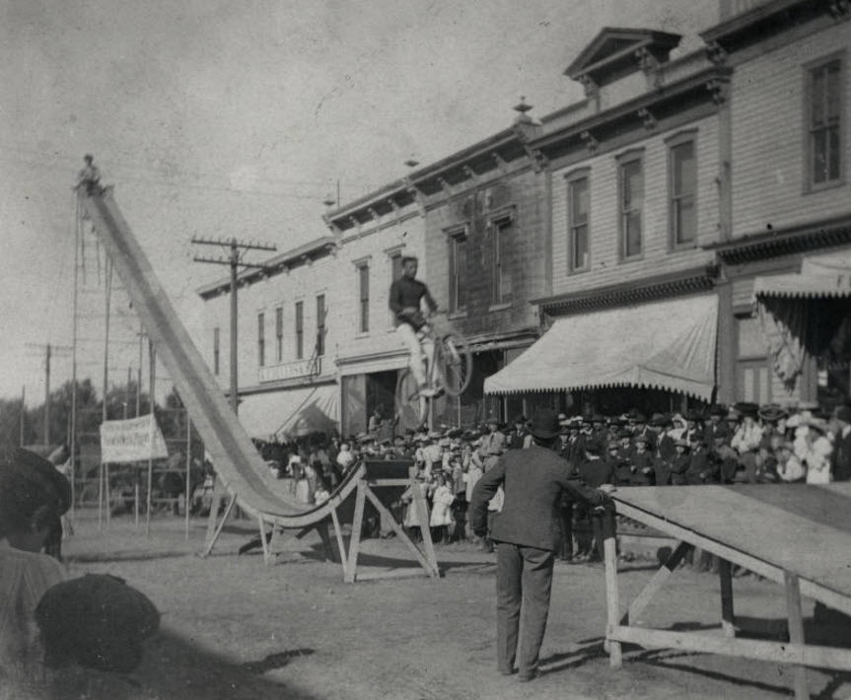
Minnesota Digital Library Explorations³
Pilot Participants
Hennepin County Library
Iron Range Research Center
Northfield Historical Society
Bethel University
Carleton College
Bicycle Stunt, Zumbrota. Goodhue County Historical Society
Notes:
How to begin? A pilot of course!
There’s a core group of staff leading the pilot, including Molly Huber, MDL Outreach Coordinator, Greta Bahnemann, MDL Metadata Librarian, myself, and Nancy Sims, University of Minnesota Copyright Program Librarian. We spent the first year or so just educating ourselves about copyright and the new rights statements, connecting with others around the country undertaking similar projects, and developing training materials.
In Feb. 2018 launched a pilot project with 5 contributors you can see on the slide here.
We had a full day of training, and 3 virtual sessions.
The pilot wrapped up in May.
Right now:
Reviewing feedback from our pilot participants
Adding new rights information in Minnesota Reflections and working on how to display the new information in Minnesota Reflections
Next phase:
Asked for volunteers again
Making decisions about how to approach roll out to all Minnesota Reflections contributors
Refining training materials

Slide 6
Minnesota Digital Library Explorations³
Advancing & Transforming Minnesota’s History
PRIMARY
SOURCE SETS
(inspired)
GEOSPATIAL
(motivated)
RIGHTS
(encouraged)
Jolie O. Graybill – Assistant Director – jog@umn.edu
Sara Ring – Continuing Education Librarian – ring089@umn.edu
Minnesota Digital Library – Minitex, University of Minnesota Libraries

