Slide 1
Clear the floor
LSLS Presentation June 8, 2018
Krista E. Clumpner (kclumpne@nmu.edu)

Slide 2

And she said…
“It looks like we can go forward with the renovation plans.”

Slide 3
And she said…
“You have one year. Clear the floor”

Slide 4
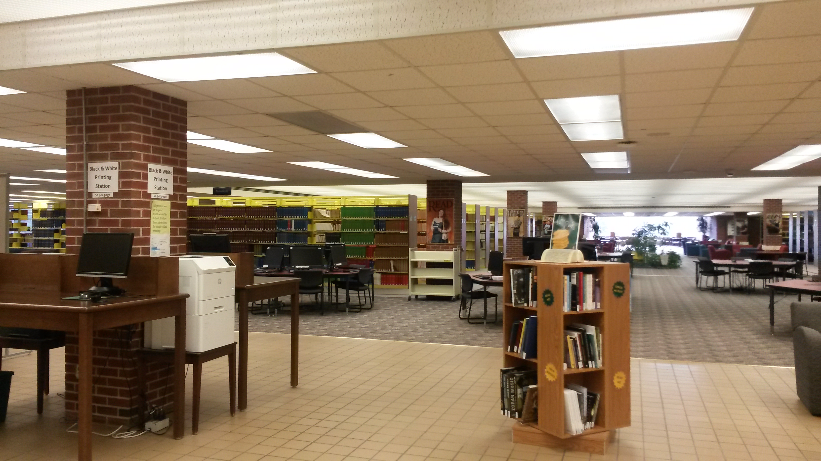

Slide 5
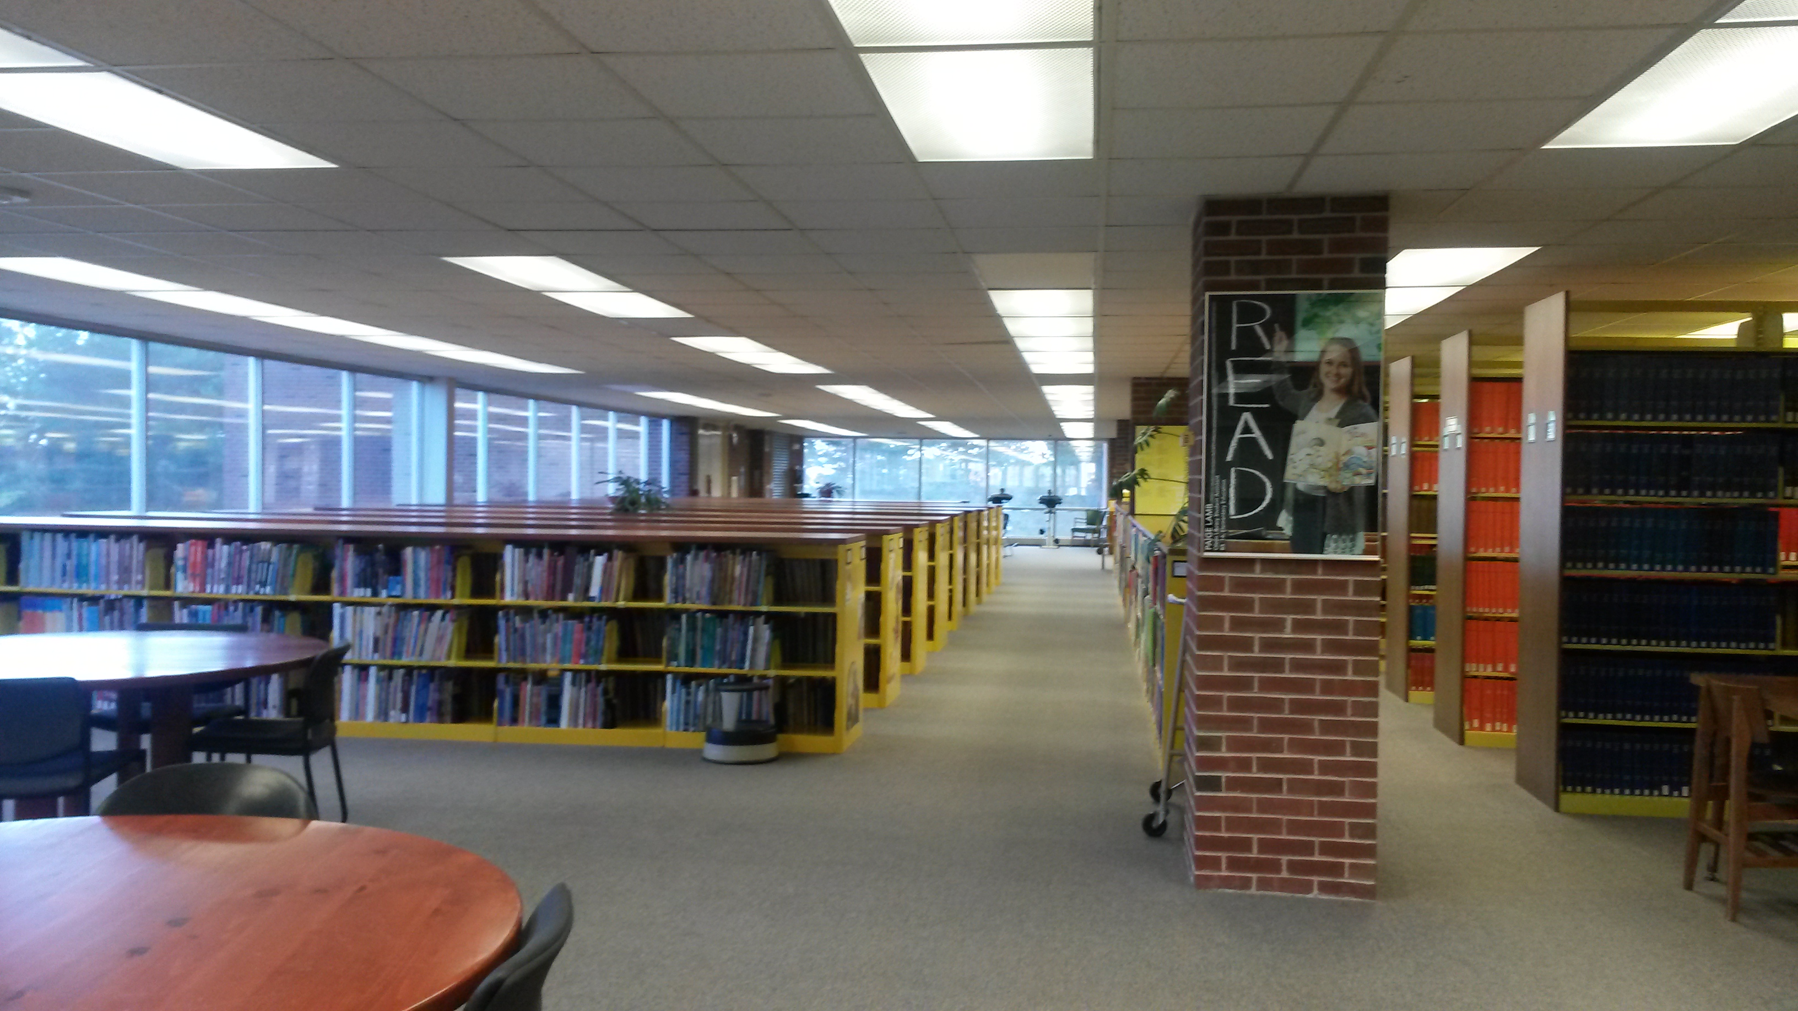

Slide 6
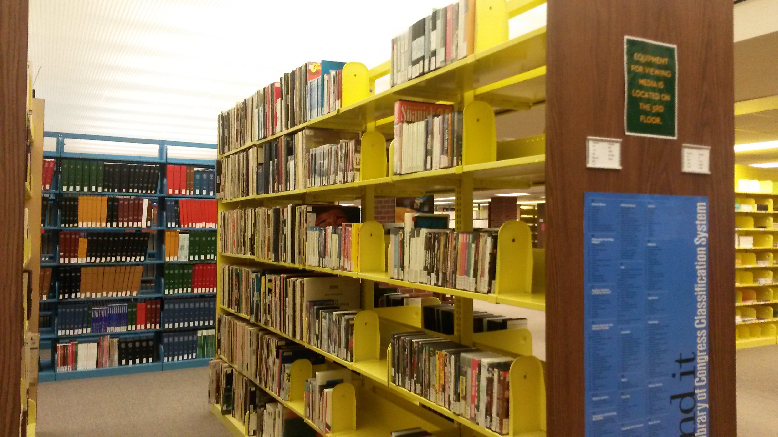

Slide 7
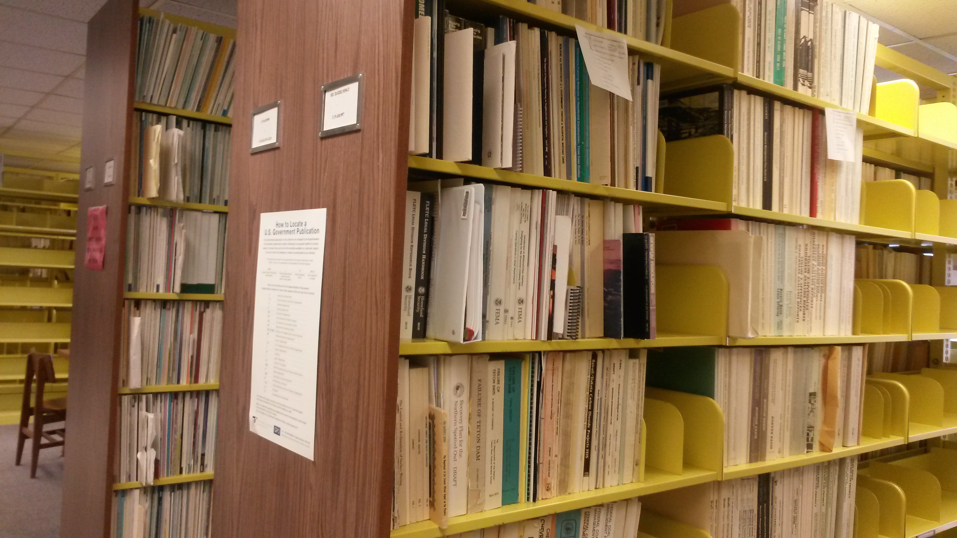

Slide 8
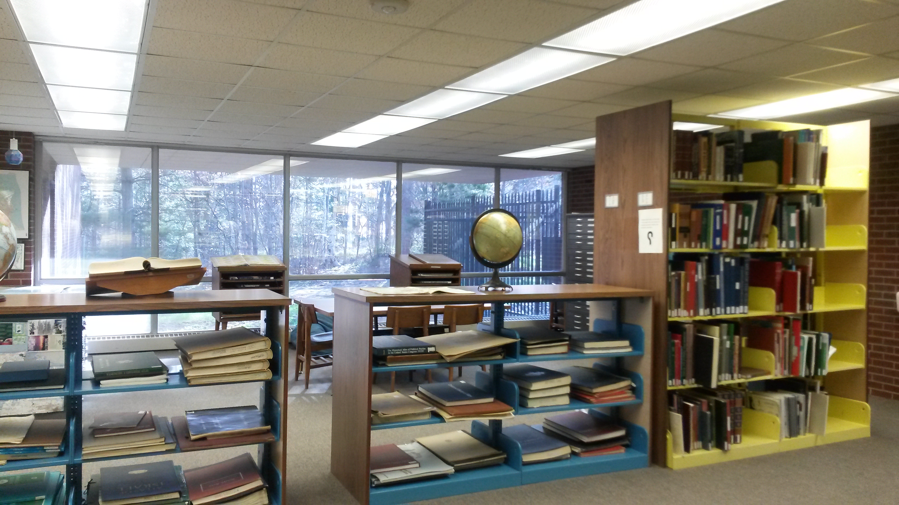

Slide 9
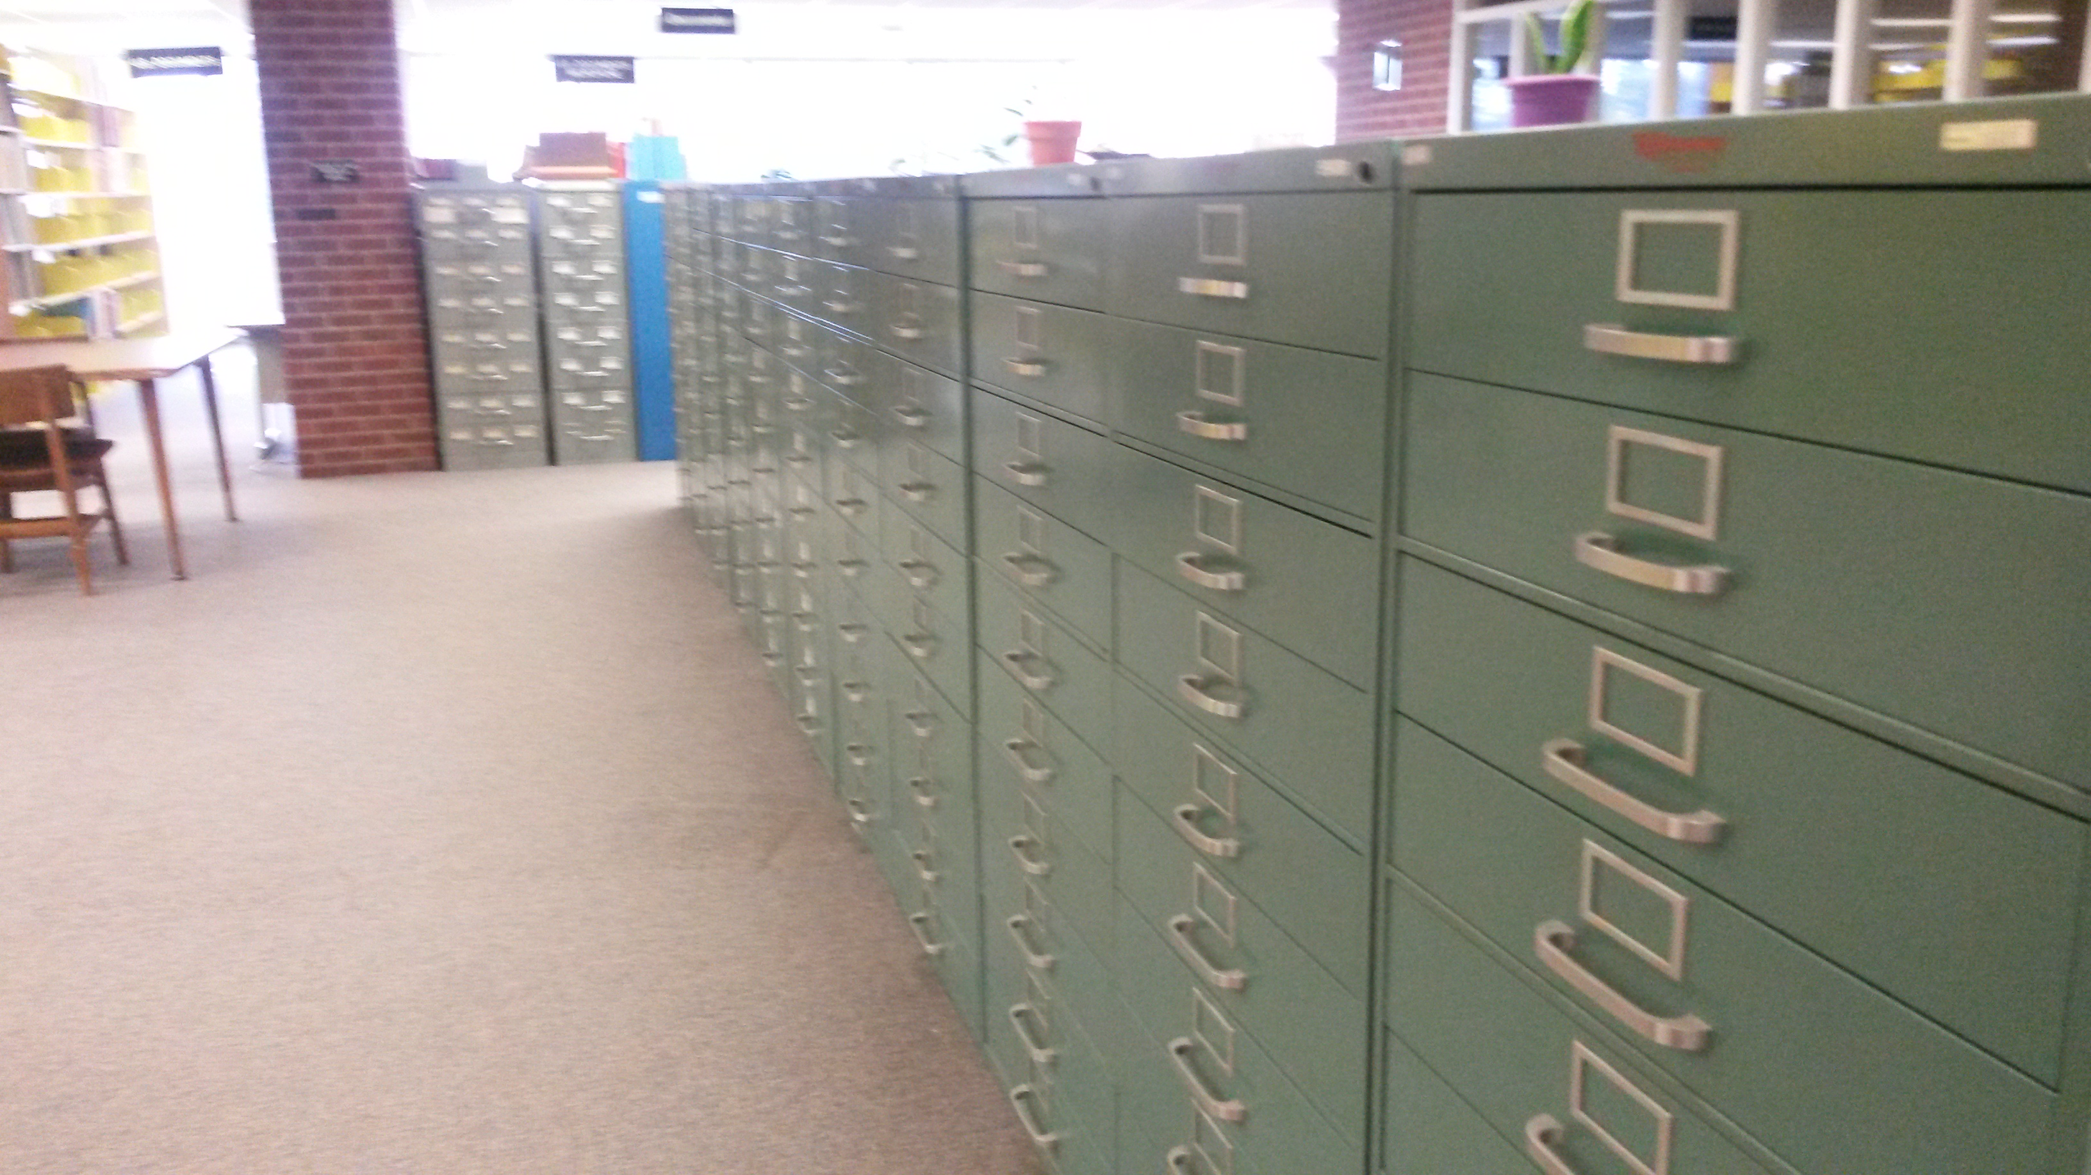

Slide 10
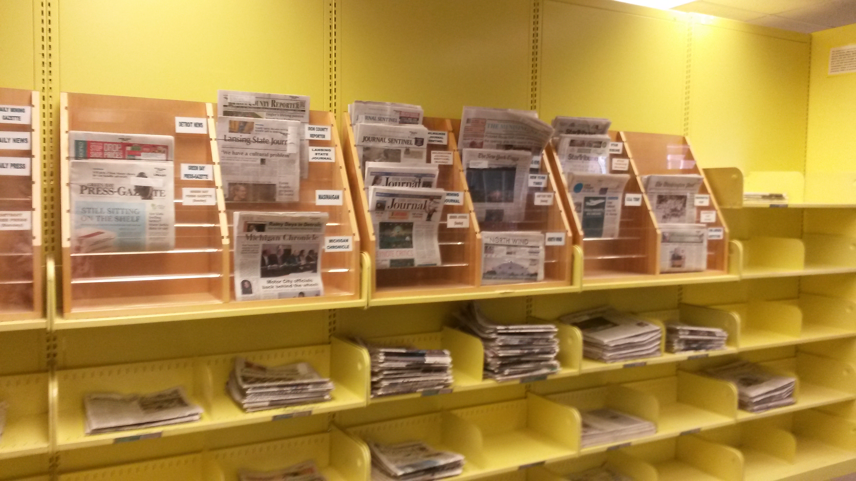

Slide 11
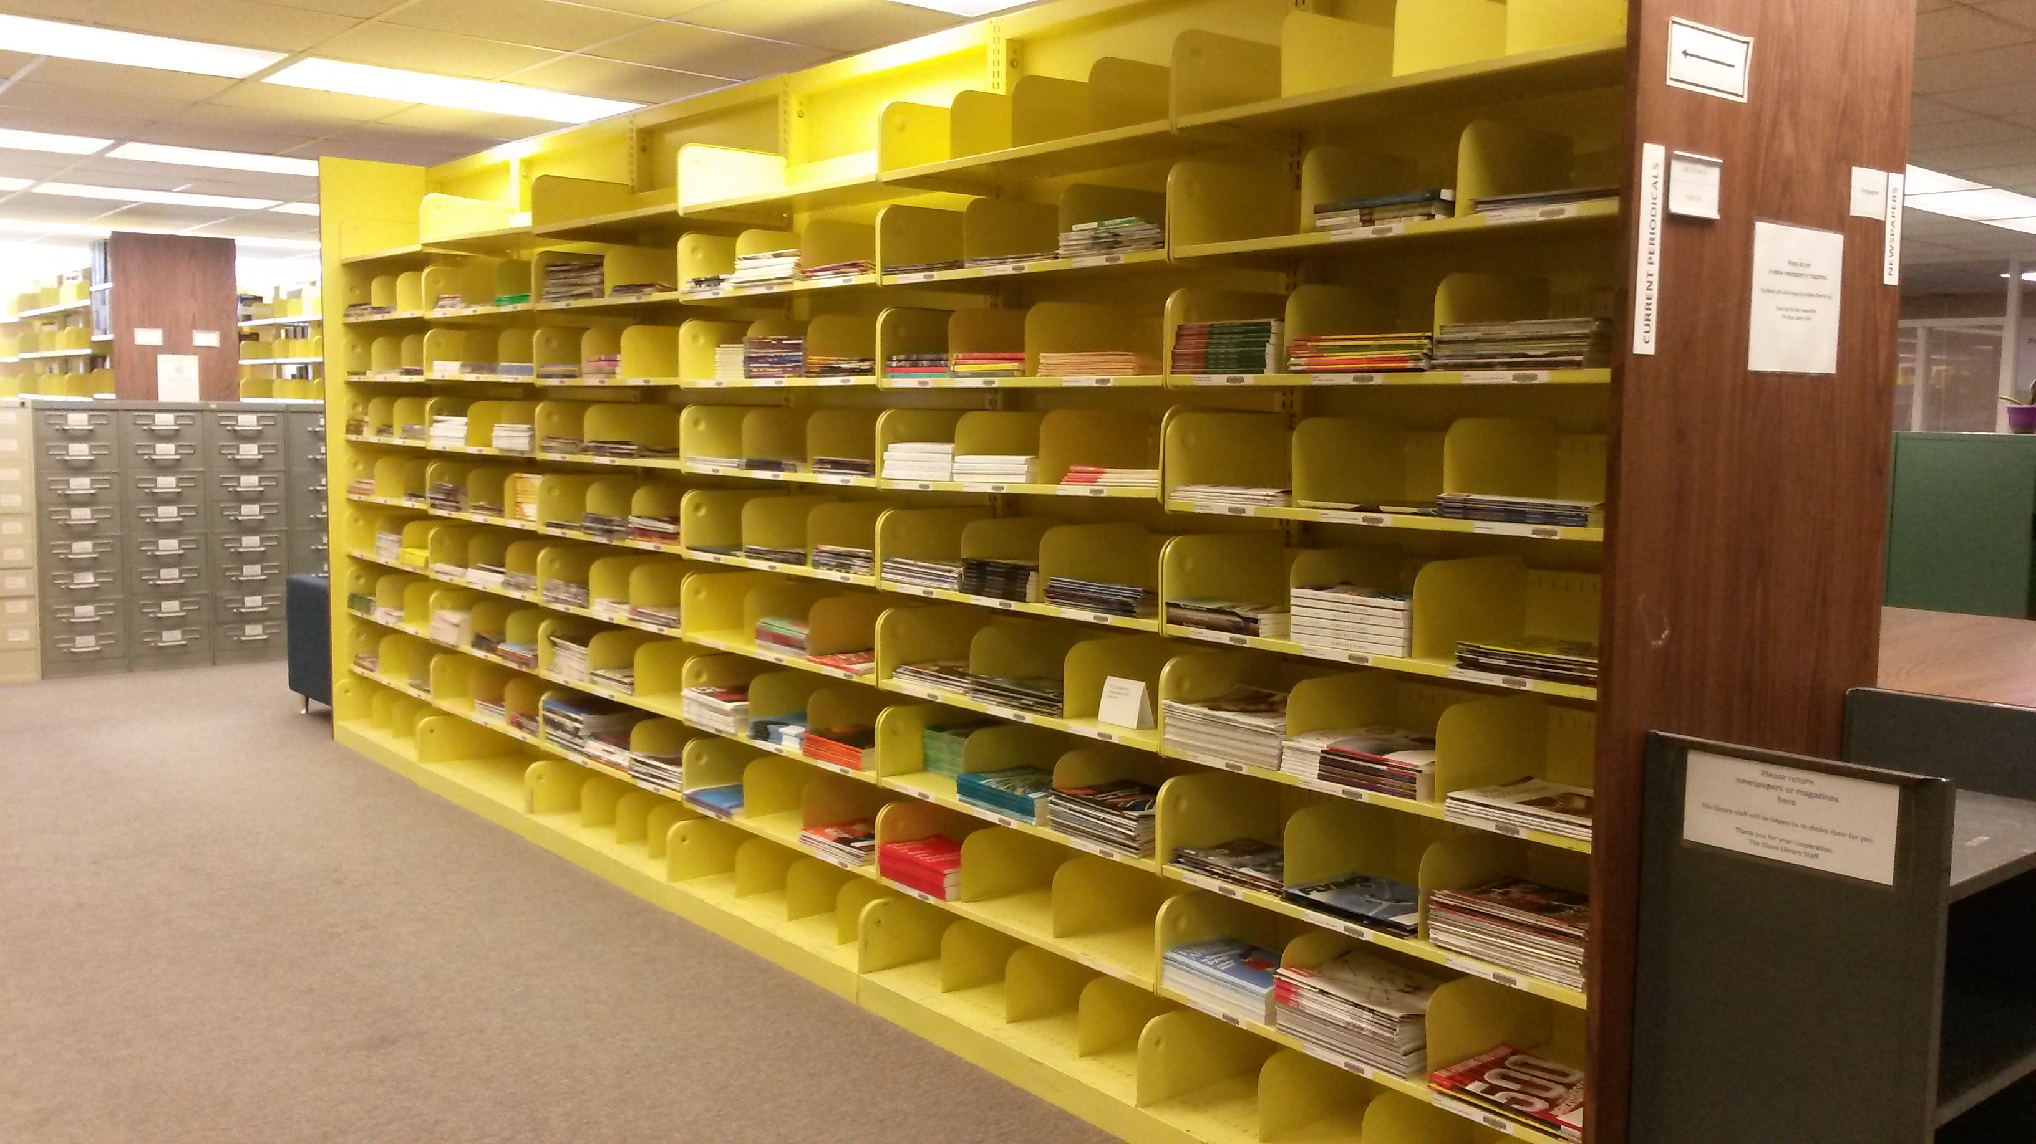

Slide 12
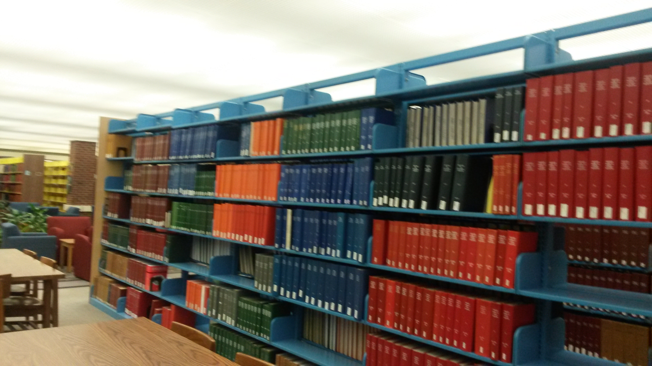

Slide 13

And she said…
“You have one year.
Clear the floor”

Slide 14
Pre-K through 12 collection

Slide 15
Pre-K through 12 collection: reprieved

Slide 16
Media collection
Replace VHS with DVD or Streaming
Remove slide sets, cassettes, etc.

Slide 17
Government Documents
State of Michigan Publications
Print
LC Classification
Relocate and incorporate

Slide 18
Government Documents
Federal Government (GPO)
Various formats
SuDoc Classification
Weed, reclass, relocate and incorporate

Slide 19
microforms
Sets: microcards, microfilm
Serials: microfilm

Slide 20
Periodicals – bound and current print
The main project

Slide 21
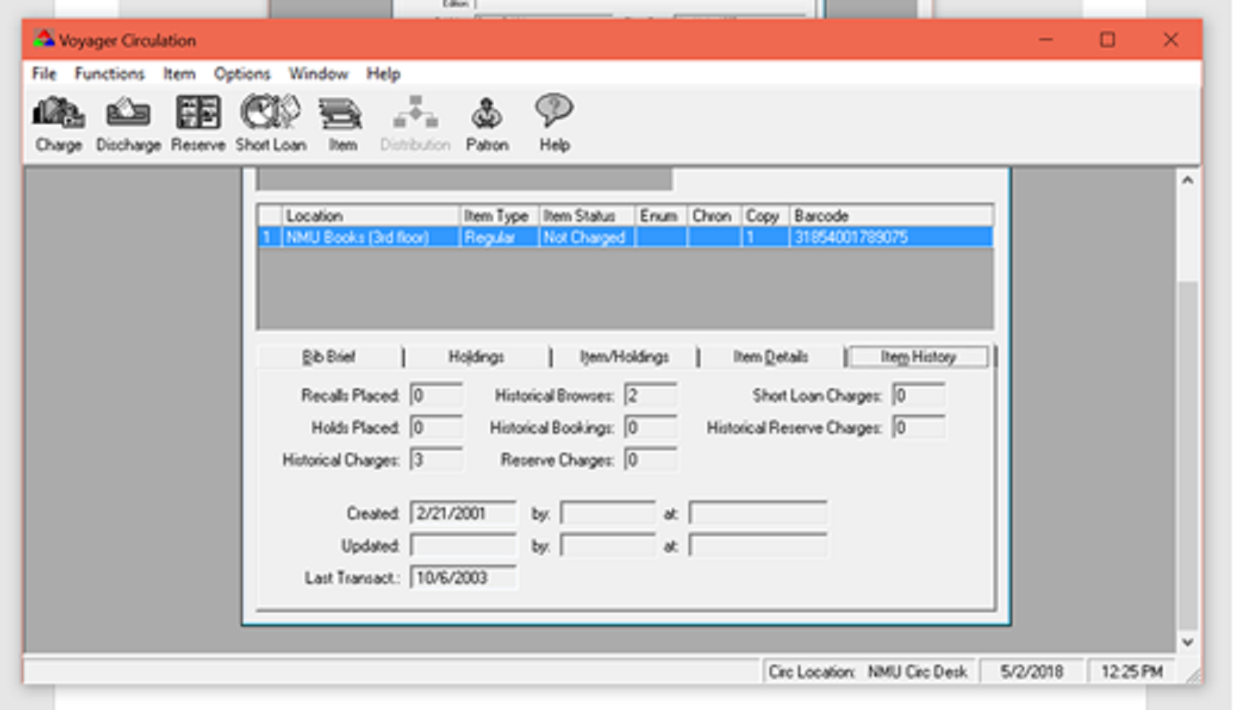
Circulation history

Slide 22
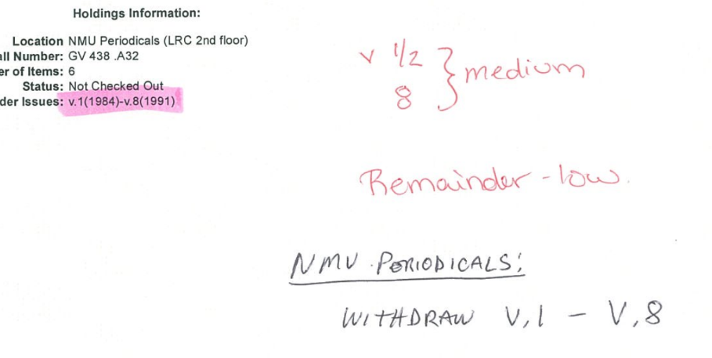
Printout with usage

Slide 23
Form for marking physical pieces
PLEASE _______
PERIOD
Call number:
TITLE:
VOLS (YEARS)
X=weed
S=storage
O=onsite
B=Bruce (gov doc)

Slide 24
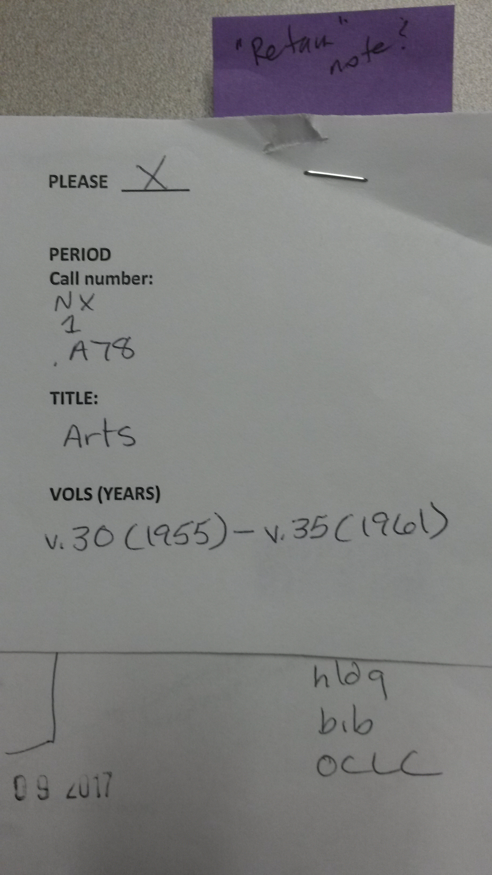
Marking slip

Slide 25
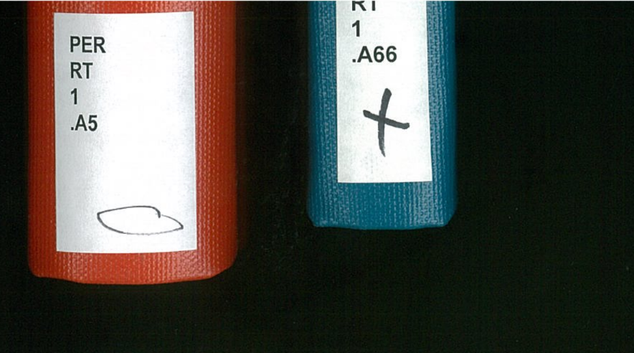
Marked physical volume Spine label

Slide 26
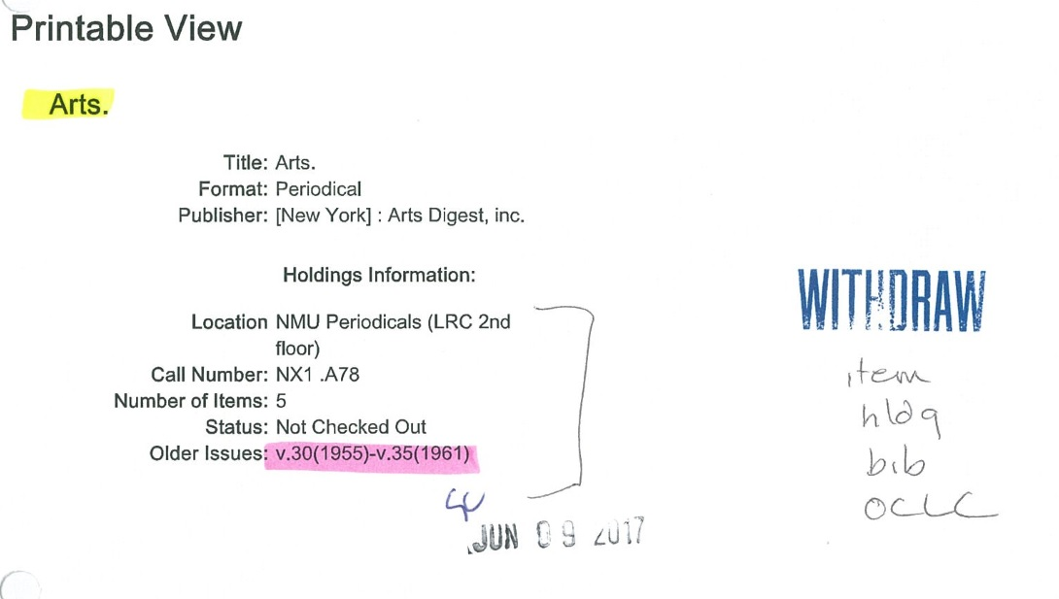
Printout of record

Slide 27
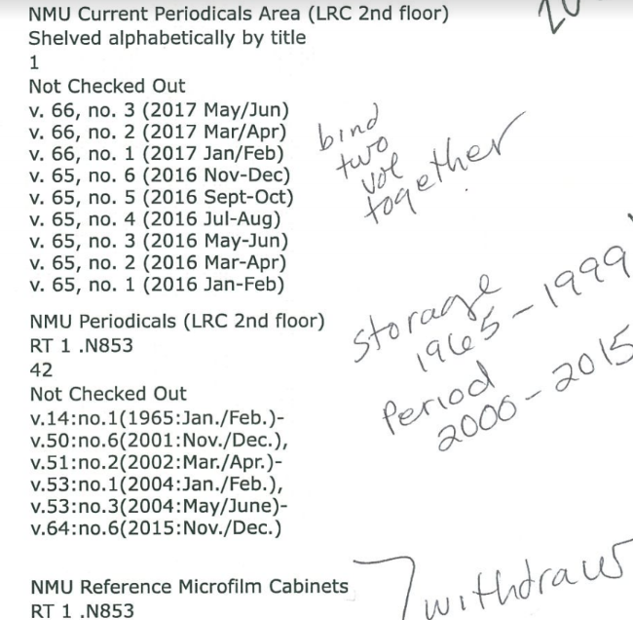
Printout of complex record

Slide 28
What I forgot:
Serials and their families

Slide 29
What I forgot:
Serials and their families
  A title is a title until it has a preceeding title or a successive title
  Students called these “ancestors” and “descendants”

Slide 30
What I forgot:
Serials and their families
Formats can change for the run of a serial

Slide 31
What I forgot:
Serials and their families
Formats can change for the run of a serial
  Microfilm to print
  Print to electronic
  Micro, print, electronic – back and forth

Slide 32
What I forgot:
Serials and their families
Formats can change for the run of a serial
Dates matter; or define current

Slide 33
What I forgot:
Serials and their families
Formats can change for the run of a serial
Dates matter; or define current
  What is the latest issue
  Deceased, cancelled, recent
  Current subscription and recent e-issues

Slide 34
What I forgot:
Serials and their families
Formats can change for the run of a serial
Dates matter; or define current
Communicate, communicate, communicate!

Slide 35
What I forgot:
Serials and their families
Formats can change for the run of a serial
Dates matter; or define current
Communicate, communicate, communicate!
  Simplify
  Train and train again

Slide 36
Clear the floor: results
Microforms
  May 2017: to May 2018
    6 ERIC cabinets -- discarded
    9 sets cabinets – moved to storage
    22 reference cabinets – reduced to 14 cabinets
      These will stay on the current floor

Slide 37
Clear the floor: results
Government Documents
  State documents: moved to another floor, incorporated
  Federal: in process, being weeded, re-classed, moved to another floor, Census will remain
    From 1158 shelves to 108 shelves
    Census will remain on the current floor

Slide 38
Clear the floor: results
Media
  In process
  Already reduced by 32 shelves
  Location still being determined

Slide 39
Clear the floor: results
Bound periodical volumes:
  May 2017: 43 ranges = 65,016 volumes
  May 2018: 1 range – 1,512 volumes

Slide 40
Clear the floor
LSLS Presentation June 8, 2018
Krista E. Clumpner (kclumpne@nmu.edu)

