Slide 1
BOOKBUSTERS
LIBRARIES SUPPORTING SELF-PUBLISHING
ANDREA MCKENNAN, MELSA
SHANE NACKERUD, UMN LIBRARIES
VALERIE HORTON, MINITEX
Notes:
LAKE SUPERIOR LIBRARY CONFERENCE VERSION
Quick audience engagement activity – give gifts
-who’s working on a self-published book? - who’s thinking of working on a self-published book?
– how many times have you seen ghostbuster who’s never seen ghostbusters
graphic: https://www.google.com/search?biw=1344&bih=720&tbm=isch&sa=1&ei=QvGiWr6JMsG_jwSHrJbgCg&q=ghostbusters+library+ghost&oq=ghostbusters+library+ghost&gs_l=psy-ab.3..0l2j0i5i30k1j0i24k1l2.20371.21689.0.21865.6.6.0.0.0.0.108.460.5j1.6.0....0...1c.1.64.psy-ab..0.6.458...0i30k1j0i8i30k1.0._vzj0RDhwEA#imgrc=8voowJB8oMDrhM:
Quick audience engagement activity – give gifts
who’s working on a self-published book?
who’s thinking of working on a self-published book?
– how many times have you seen ghostbuster
who’s never seen ghostbusters

Slide 2



MINNESOTA
LIBRARY
PUBLISHING
PROJECT
Notes:
BRIEFLY What is MN Writes MN Reads & What is MLPP
Funded by Minitex, Academic libraries, and the Regional public library systems
Transition: WHY did we launch these two service – next slide
is MLPP
Funded by Minitex, Academic libraries, and the Regional public library systems
Transtion: WHY did we launch these two service – next slide

Slide 3
Libraries have always been “into” publishing...
Notes:
Library publishing is old and well established
“Many of the earliest academic presses got their start in university libraries in the decades surrounding 1900” Paul Courant, Elisabeth Jones p17 “Getting the Word Out”
Quite a few library presses, but things really picked up 20 years ago with digital publishing tools like Dspace in 2002, and OJS (open journal system) in 2001

Slide 4
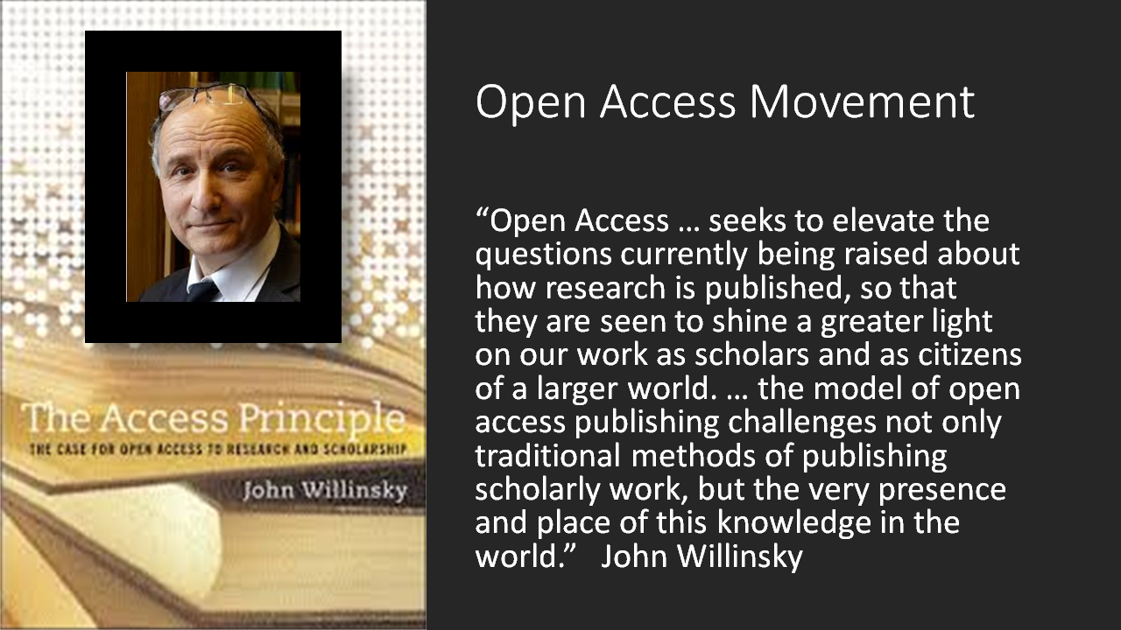
Notes:
Willinsky is A former teacher and now Khosla Family Professor of education at Stanford University, Willinsky is also director of the Public Knowledge Project and widely regarded within the OA movement as a leader.

Slide 5
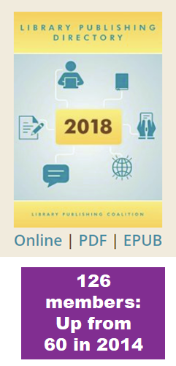

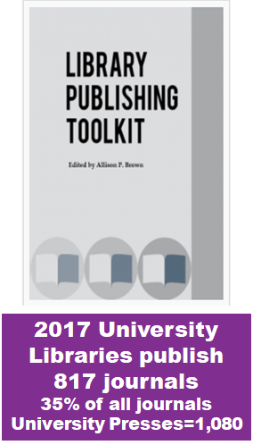
PUBLISHING IN ACADEMIC LIBRARIES
Notes:
In 2008 Karla Hahn survey ARL members only 35 had publishing services
Source of stats:
www.librarypublishin.org/resources/directory
www.aaupnet.org/about-aaup/about-university-presses/aaup-snapshot
www.digitalcommons.unl.edu/viewcontent.cgi?article-1008&content-scholcom (not sure about url)
https://www.scribd.com/document/360508493/NaNoWriMo-2016-Annual-Report

Slide 6

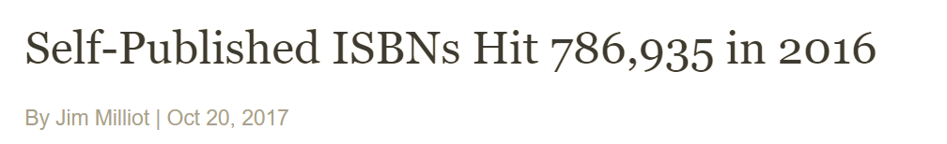
Self Publishing Is Exploding
Notes:
Explosion in self publishing nationwide
Libraries taking control of publishing (lpc and Nanowrimo)
https://www.publishersweekly.com/pw/by-topic/industry-news/manufacturing/article/75139-self-published-isbns-hit-786-935-in-2016.html

Slide 7
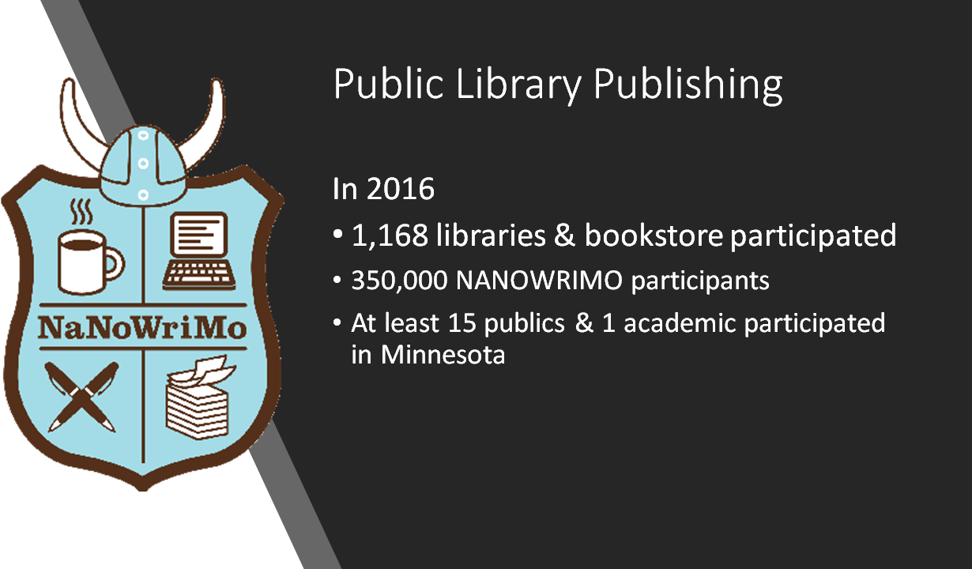
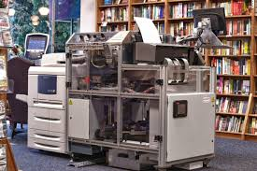
Notes:
SHARE BOOK from St Paul public library
Makerspaces - Expresso machines Loudoun County Public Library (VA) The Symington Press powered by Espresso Book Machine
Other public library presses: Sacramento Public Library’s iStreet Press, Temecula Public Library’s Flash Books, Provincetown (MA) Public Library - Provincetown Public Press

Slide 8
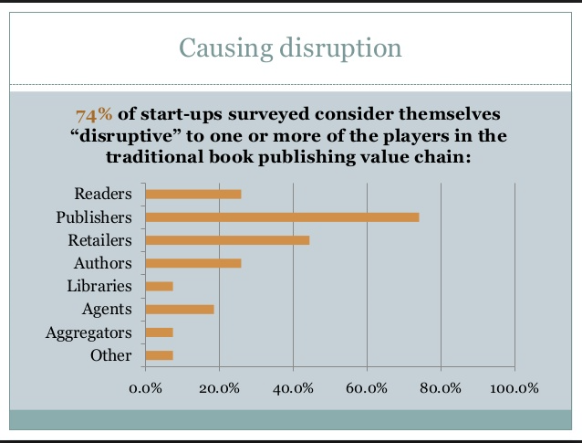

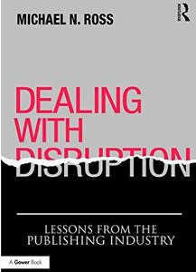

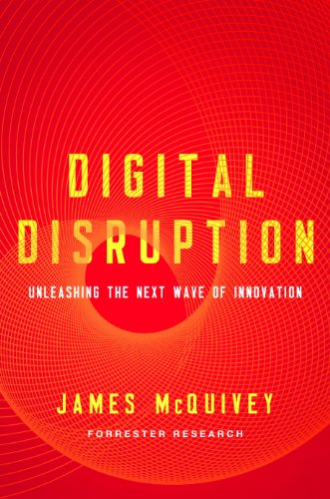
PUBLISHING IS IN DISRUPTION -
What is the Library’s role?
Publishing start up survey. Digital Book World
Notes:
Major disruption going on in the publishing field right now
We don’t know what the libraries role should be - but we are committed to experimenting to learn more and share what we’ve learned - hence this presentation

Slide 9
MN Libraries are offering the first statewide, geolocated Pressbooks installation

Slide 10

Academic library use supports:
  Open textbooks
  OER
  Student writing projects
  Open anthologies
  Course pack organization
  Aggregating articles for IR submissions
Public library use supports:
  Supporting local authors
  NANOWRIMO
  Writers groups
  Writing classes and author fairs
  Local writing contests
  School projects, maker spaces, etc.
Notes:
There is a free version of pressbooks with hidden costs and less fully featured. Pressbooks is coming out with different versions and its changing on us as we go...
There are Disadvantage - struggling with funding & getting the features we need is a work in progress still

Slide 11
MLPP GROWING FAST
Soft launch in the Spring/Summer 2017
 | October 2017 | June 2018
Books in production | 120 | 327
Authors | 162 | 412

Slide 12

Why Support the Local Author Community?
Reaffirm our value as a center for creativity and the arts
Serve indie authors will increase our foot traffic for non-traditional purposes
Reaffirm our role as a dynamic community hub
Reaffirm our value as a community center and gathering place for diverse populations
Opportunities for local writers may lead to better social relations across diverse groups both inside and outside of the library
Reaffirm our role as a leader of local identity
Source: Six Strong Benefits of Supporting your Local Author Community in your Library” LJ
Notes:
Written by Mitchell Davis - VALUE proposition - assisting authors hits into our value as creative centers for arts and literature and community engagement. Focus on local identity and community engagement. This type of work can shape how the community sees the library and help with support
https://biblioboard.com/lp-selfewhitepaper/wp-content/uploads/sites/11/2017/05/SELF-e_WhitePaper_6Benefits.pdf Six Strong Benefits of Supporting Your Local Author Community in Your Library
Written by Mitchell Davis - VALUE proposition - assisting authors hits into our value as creative centers for arts and literature and community engagement. Focus on local identity and community engagement. This type of work can shape how the community sees the library and help with support

Slide 13
A Tool for Creativity
Community College Yearbooks
Notes:
One community college that is too small to launch and IR, is collecting articles/documents written on campus and create a yearbook of the academic output

Slide 14
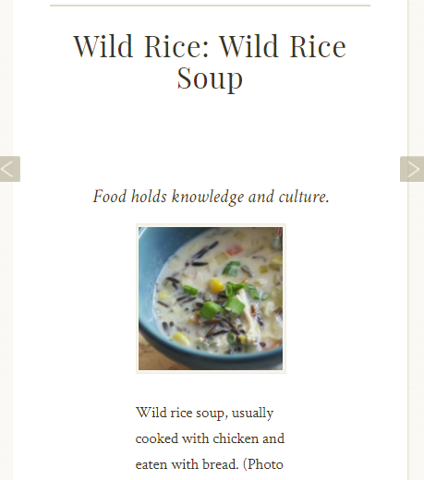
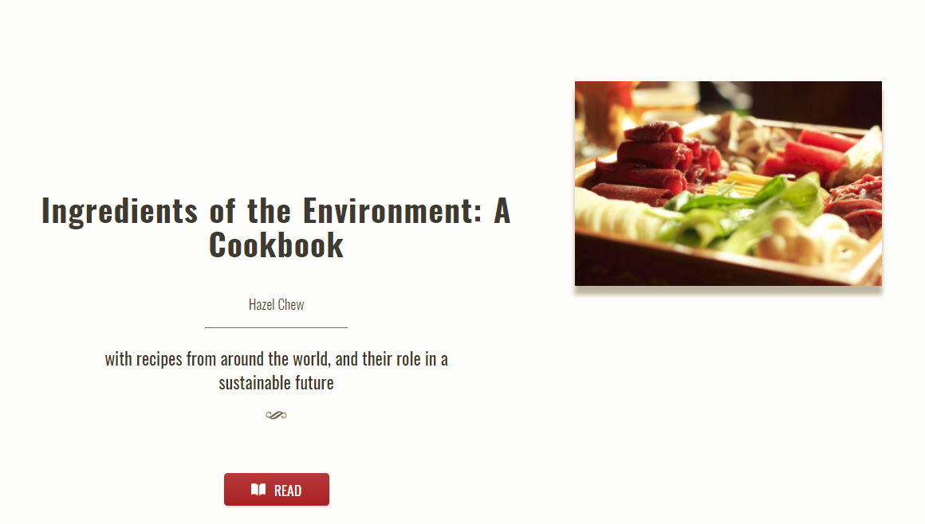
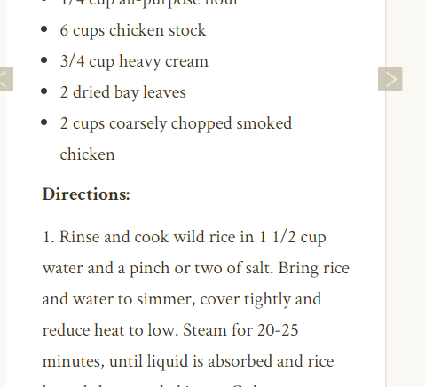
Creativity:
STUDENT COOKBOOK
Notes:
Book created by a student
One community college that is too small to launch and IR, is collecting articles/documents written on campus and create a yearbook of the academic output

Slide 15
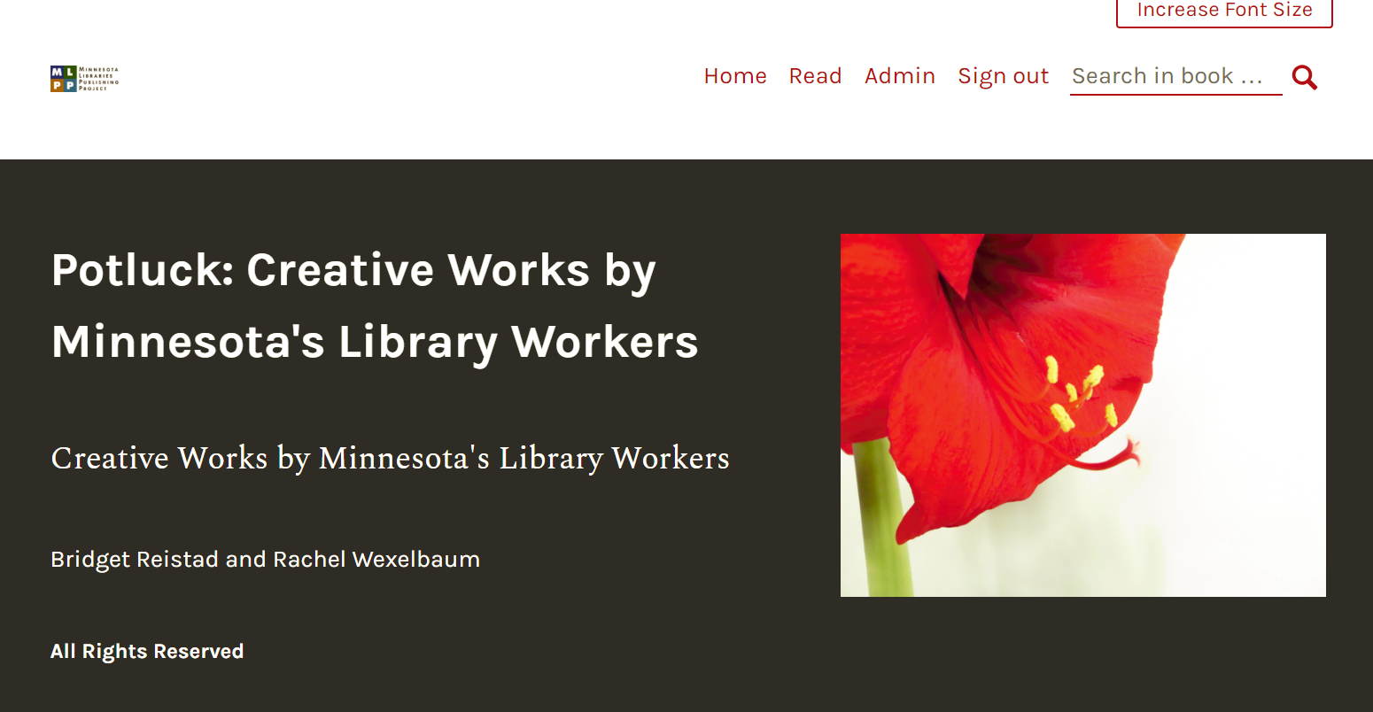
Creativity:
Public, Academic, and School Librarian as Writers
Notes:
Creativity and collaboration:

Slide 16
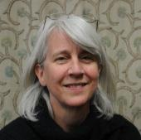
Creativity:
BOOKS-ON-THE-FLY
Barbara Fister,
Gustavus Adolphus College
“I demo'd the platform at a meeting of liberal arts ... [librarians] and while we aren't publishing the results, I asked for contributions of articles or blog posts in advance from attendees and we created a 90+/- page book on the fly.
I'm hoping to do something similar with our faculty next fall so they can see how it could be used in classes and for their own work.”
Notes:
One community college that is too small to launch and IR, is collecting articles/documents written on campus and create a yearbook of the academic output

Slide 17
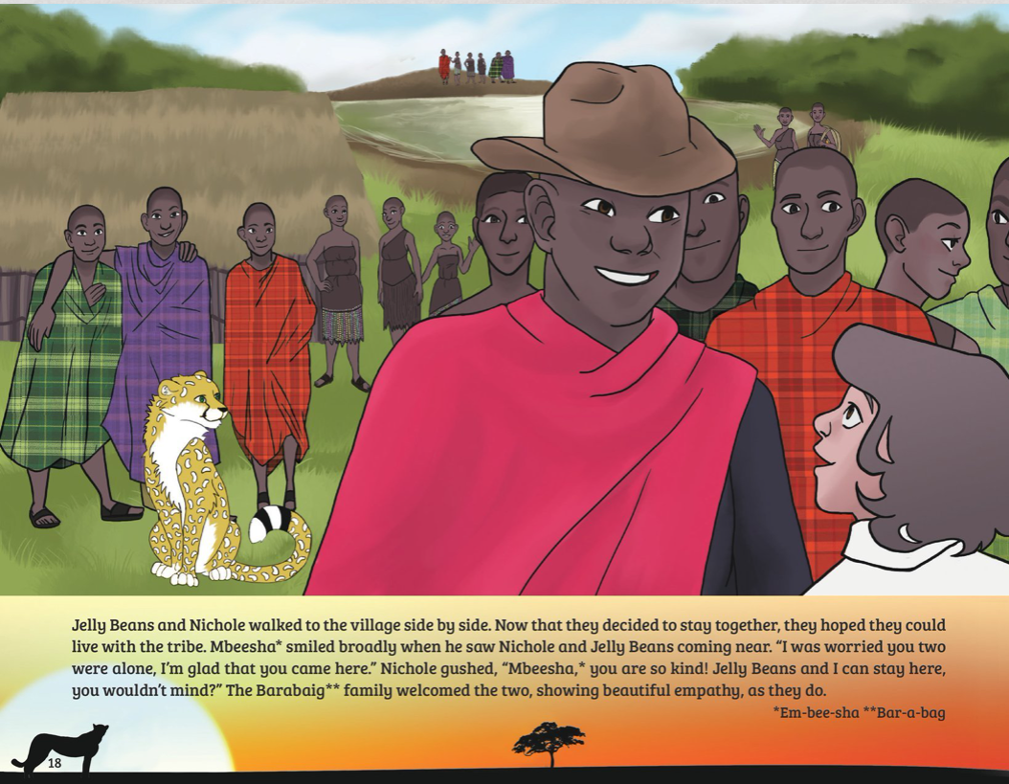
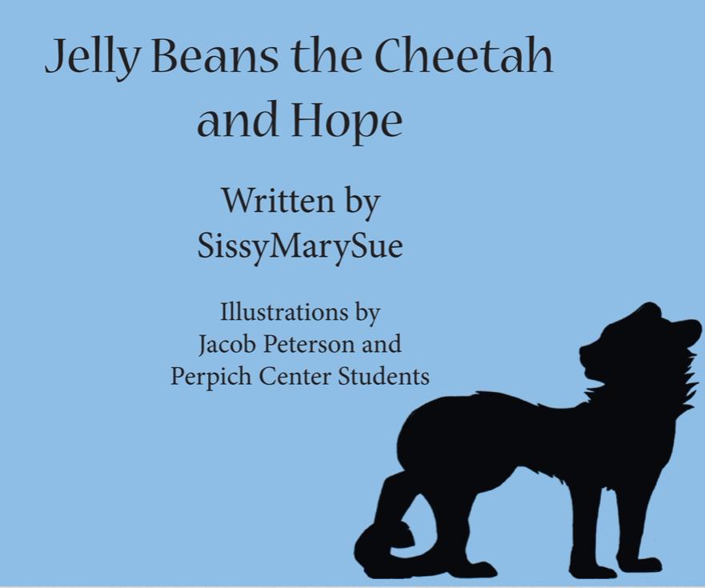
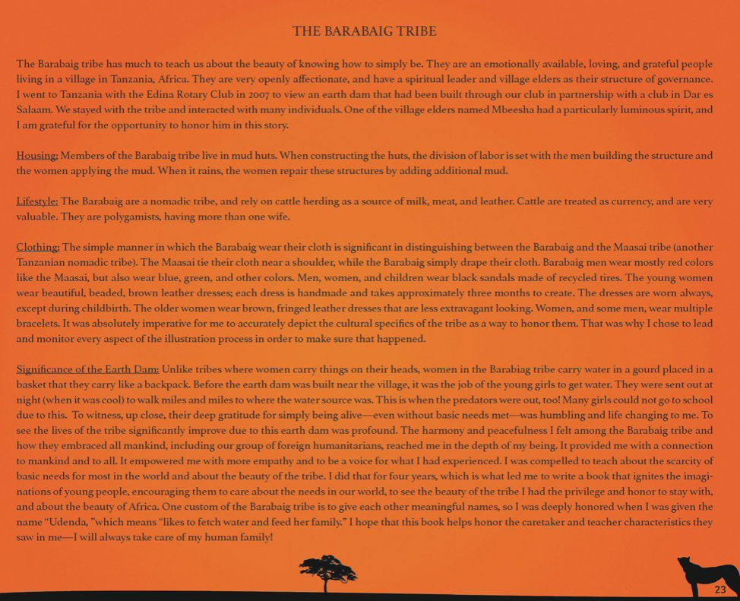
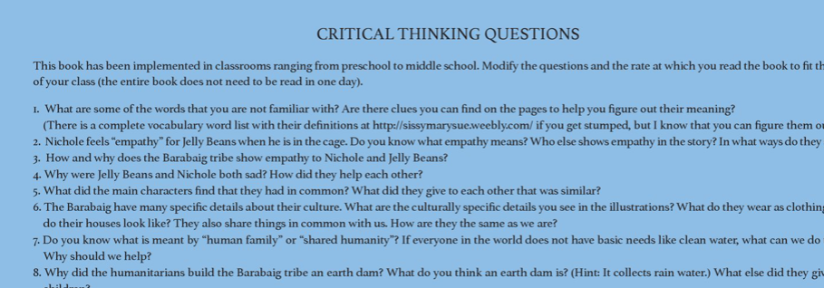
Creativity:
Tool to Promote Understanding and Diversity

Slide 18

Creativity and Convergence:
Minnesota Digital Library-- LOCAL HISTORY
Notes:
We work with 190 libraries and cultural heritage organizations trying to promote and capture MN history and culture - venue to display and hopefully, in the future retain, these titles
Not are we partnering with publics - but we’re planning more outreach to cultural heritage

Slide 19
Pressbooks: Features and Service
Notes:
https://whitegirlsbelike.com/category/i-probably-have-ghosts-in-my-attic/

Slide 20
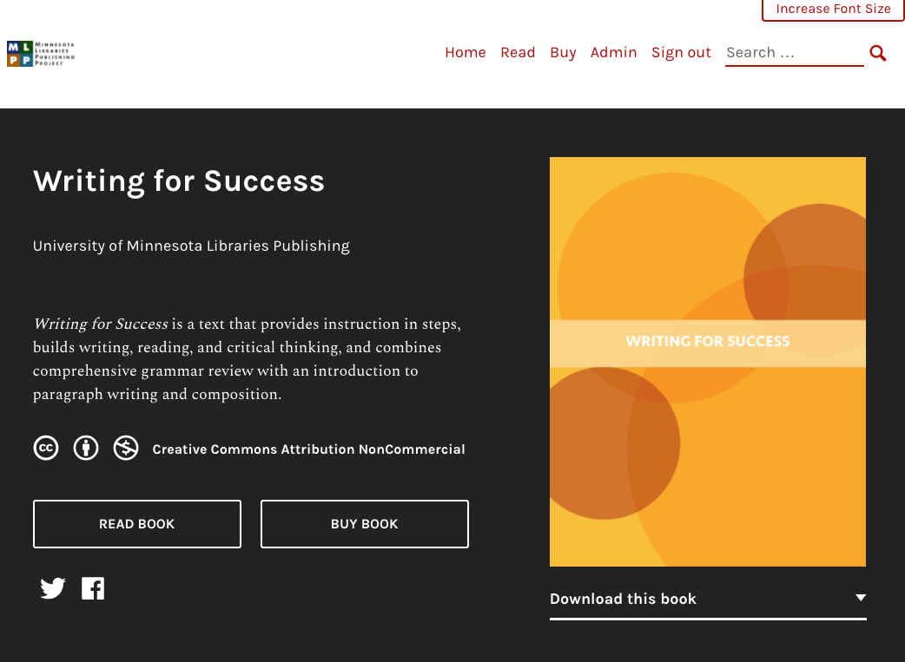
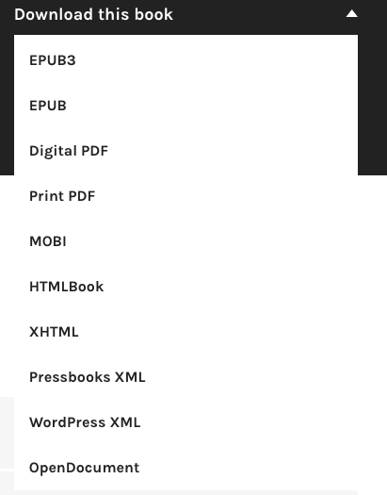
https://mlpp.pressbooks.pub/writingsuccess/

Slide 21
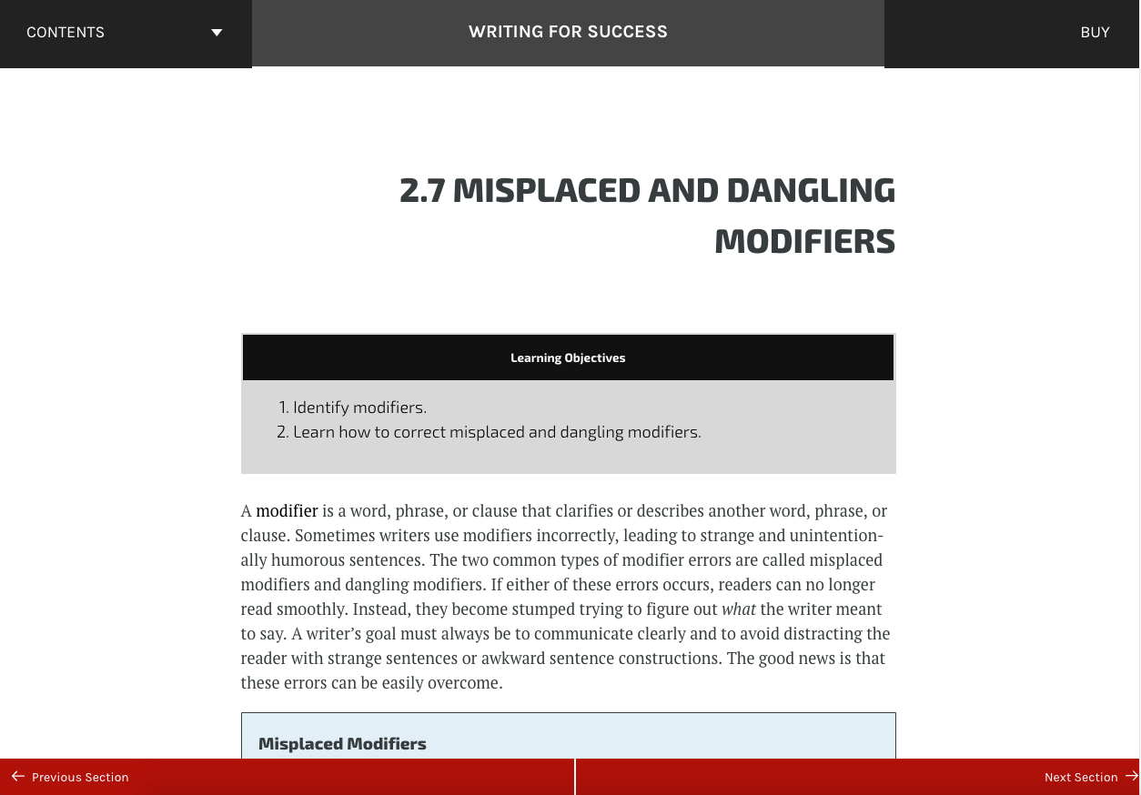
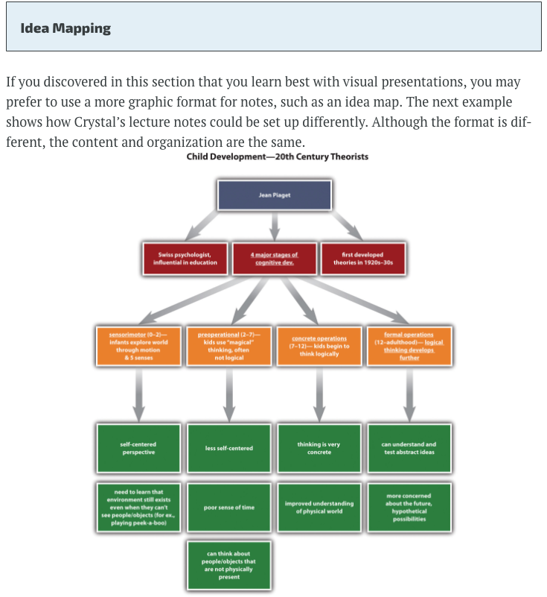
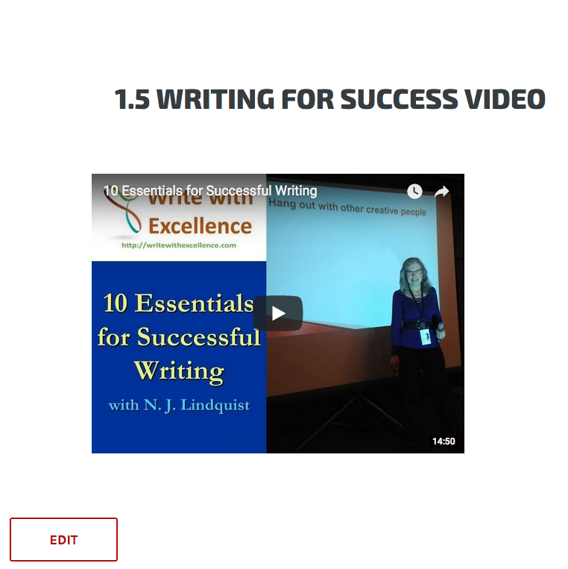
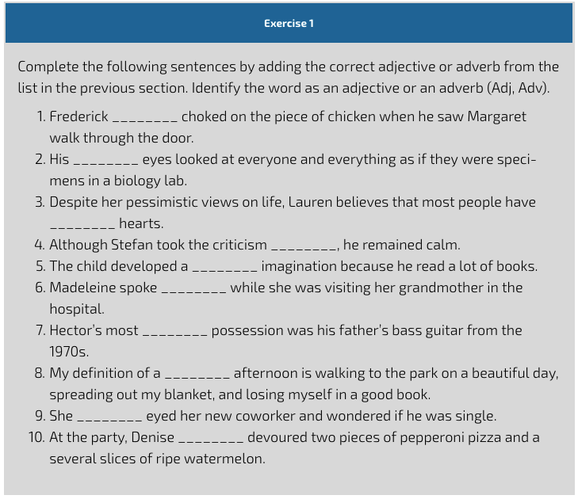

Slide 22
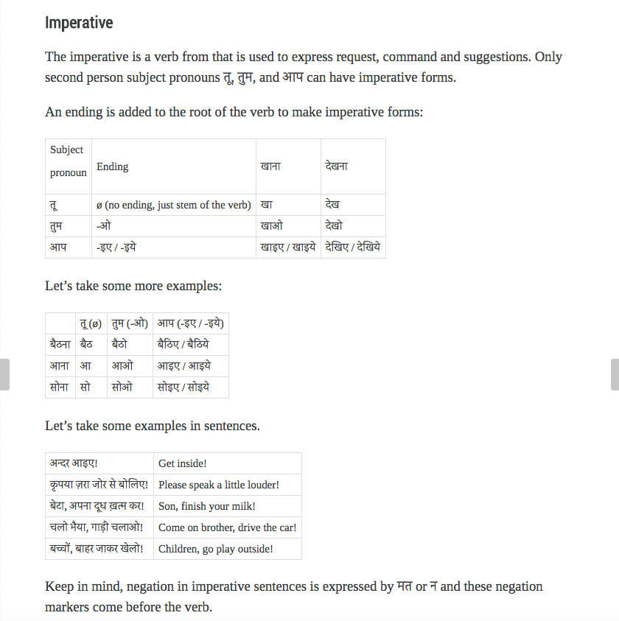
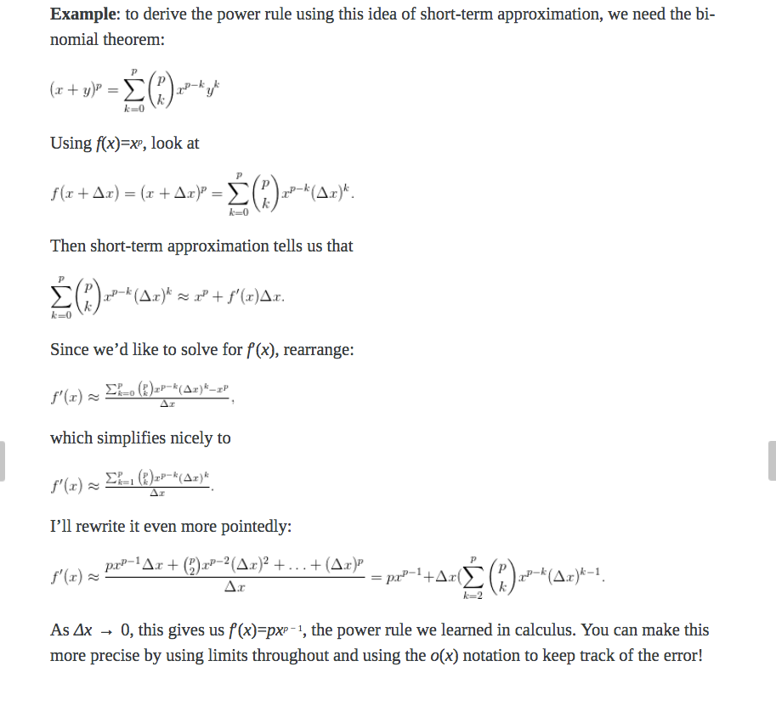

Slide 23
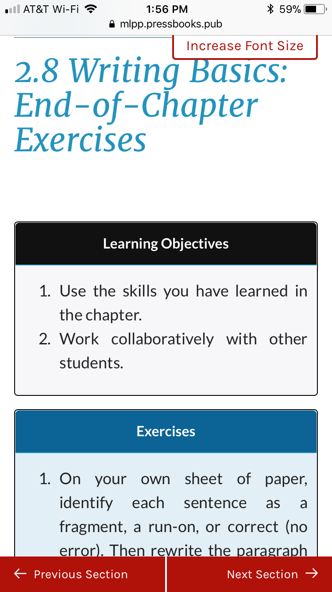
Mobile ready
Responsive design

Slide 24
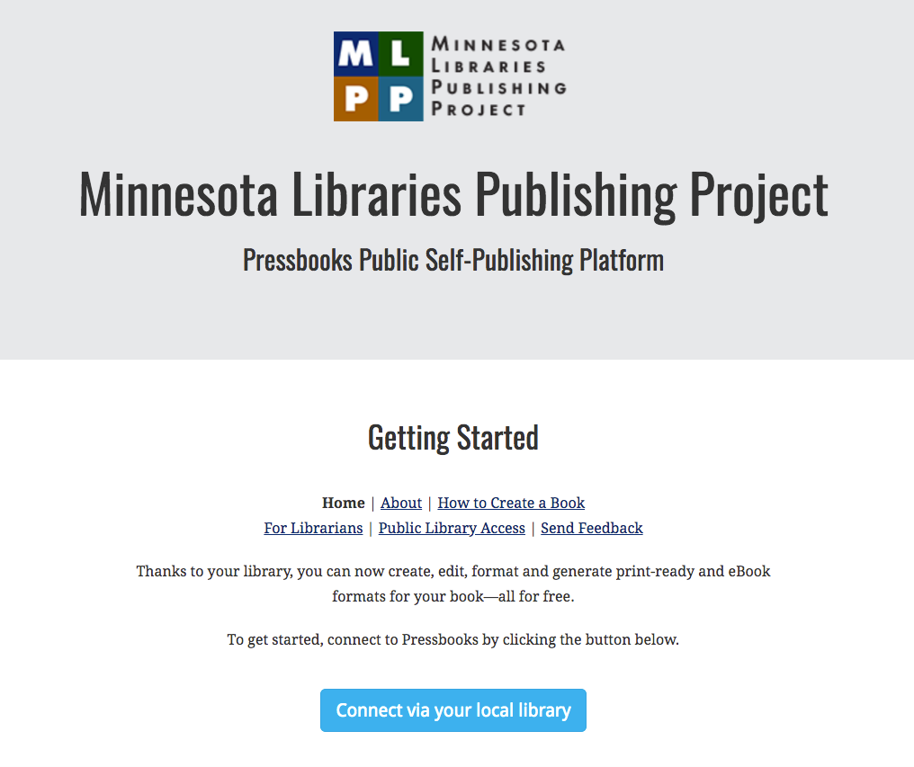
https://mlpp.pressbooks.pub/

Slide 25
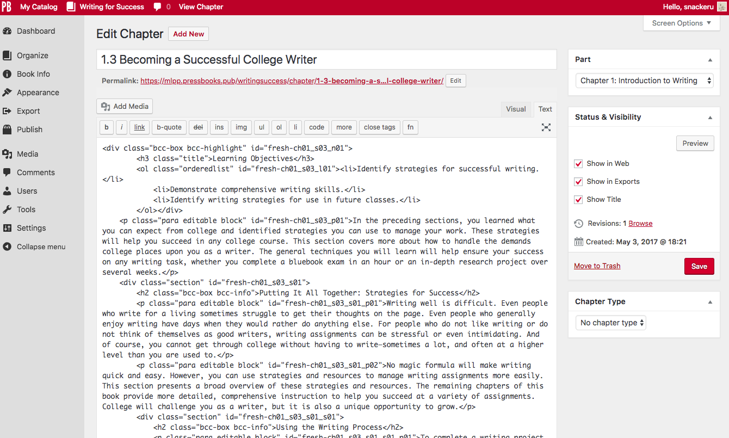
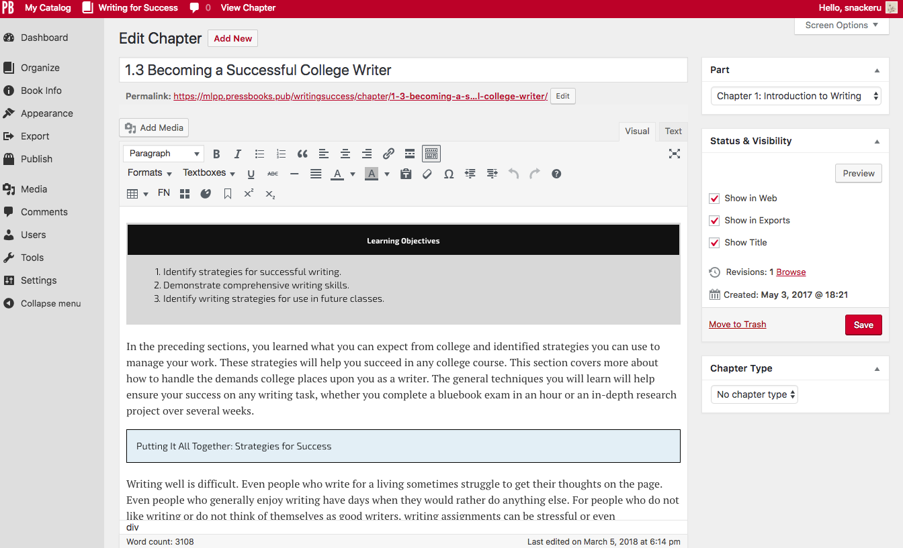
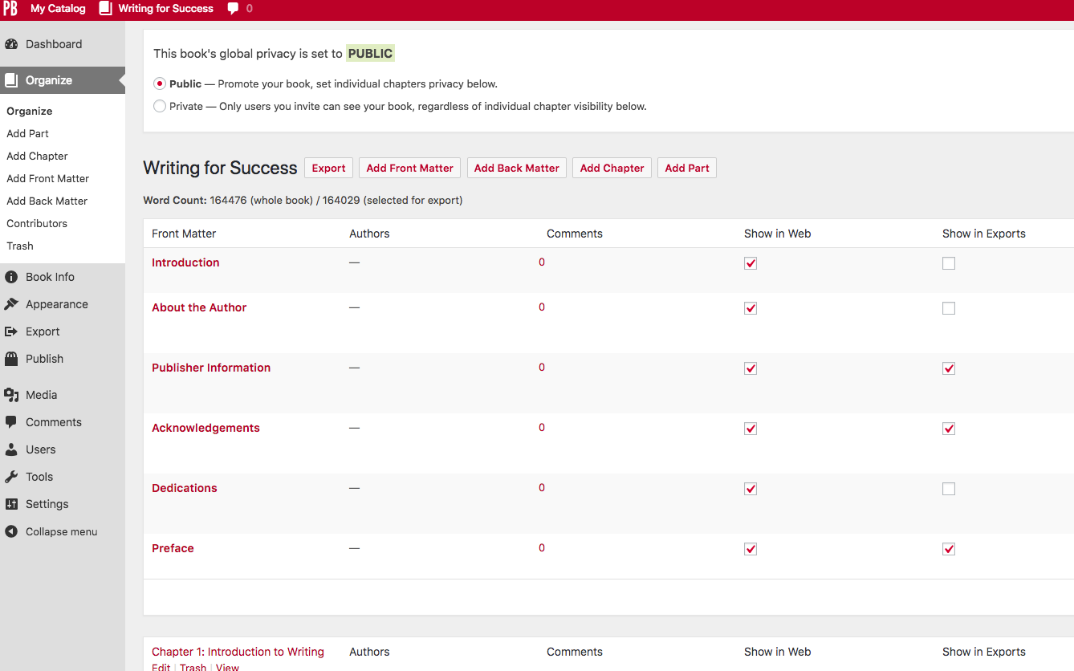

Slide 26
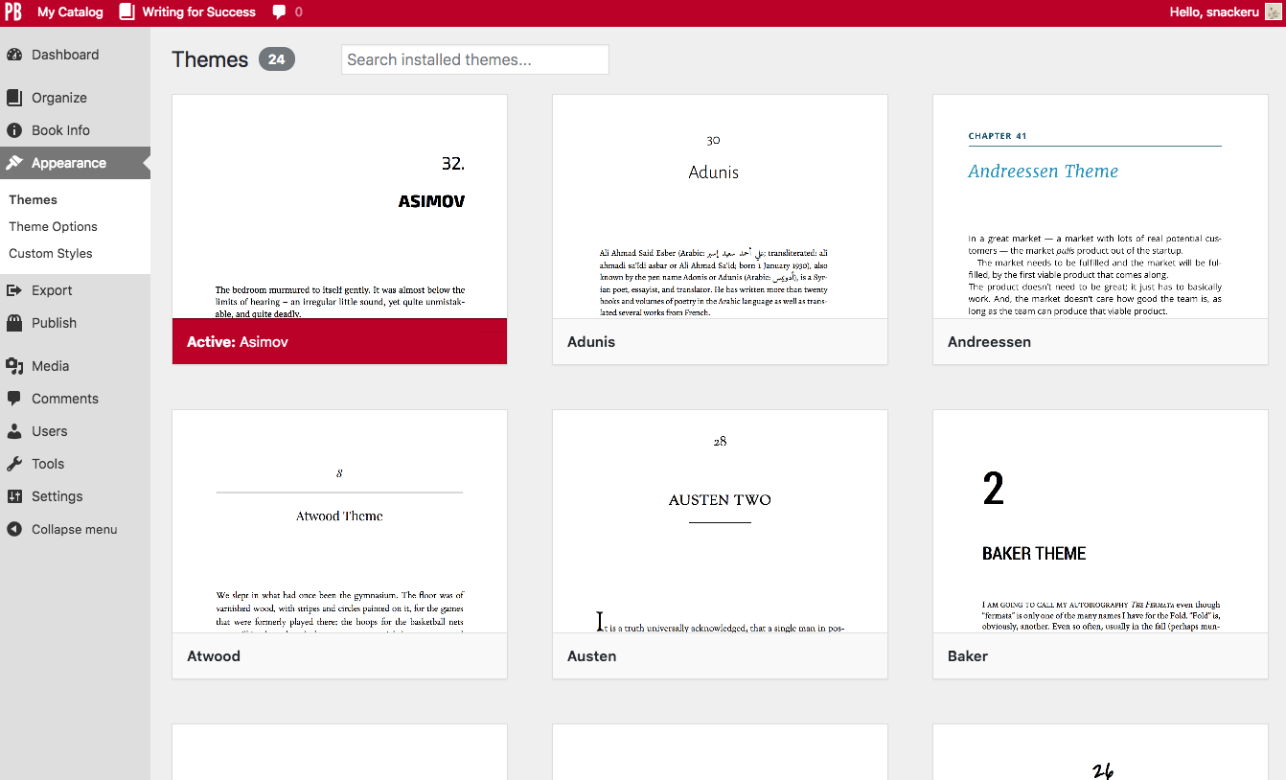

Slide 27
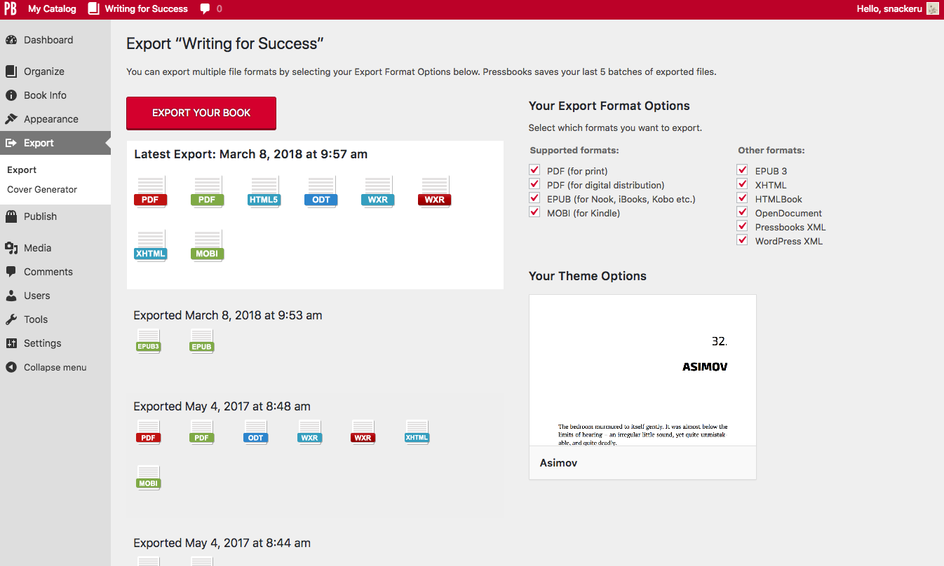

Slide 28
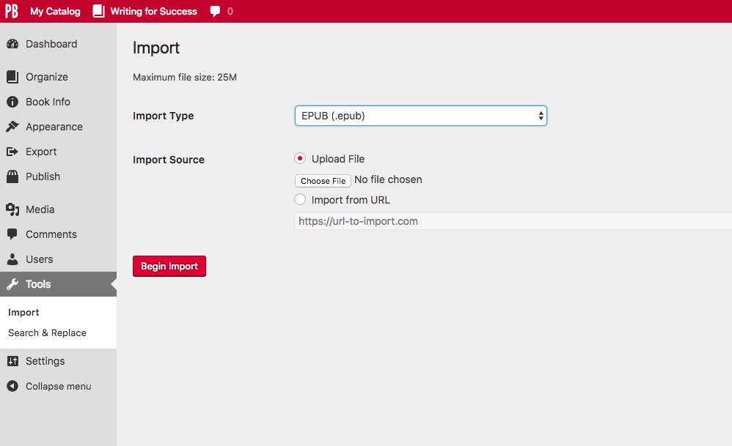
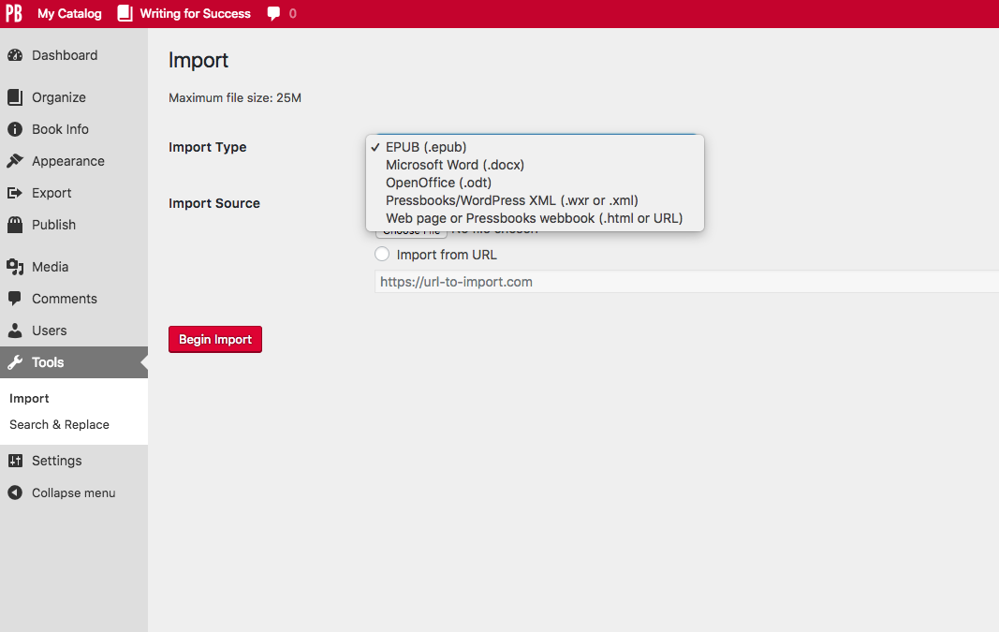

Slide 29
How could you use MLPP Pressbooks?
Provide library patrons an easy to use tool to self publish
Author and host open textbooks or OER
Experiment with online forms of publishing
Create EPUBs or PDFs of content
Create and host foreign language content
Create math based content
Author and host original research
Create pre-print works for authors to gather feedback
Publish fiction, poetry, or subject specific works

Slide 30
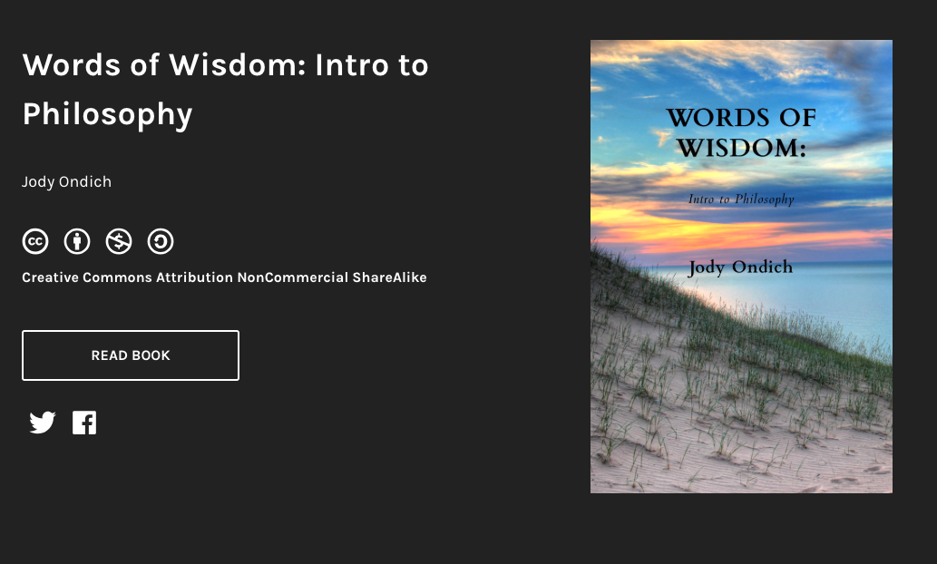

PHILOSOPHY TEXTBOOK AT LAKE SUPERIOR COLLEGE
https://mlpp.pressbooks.pub/introphil/
Notes:
Lake Superior College

Slide 31
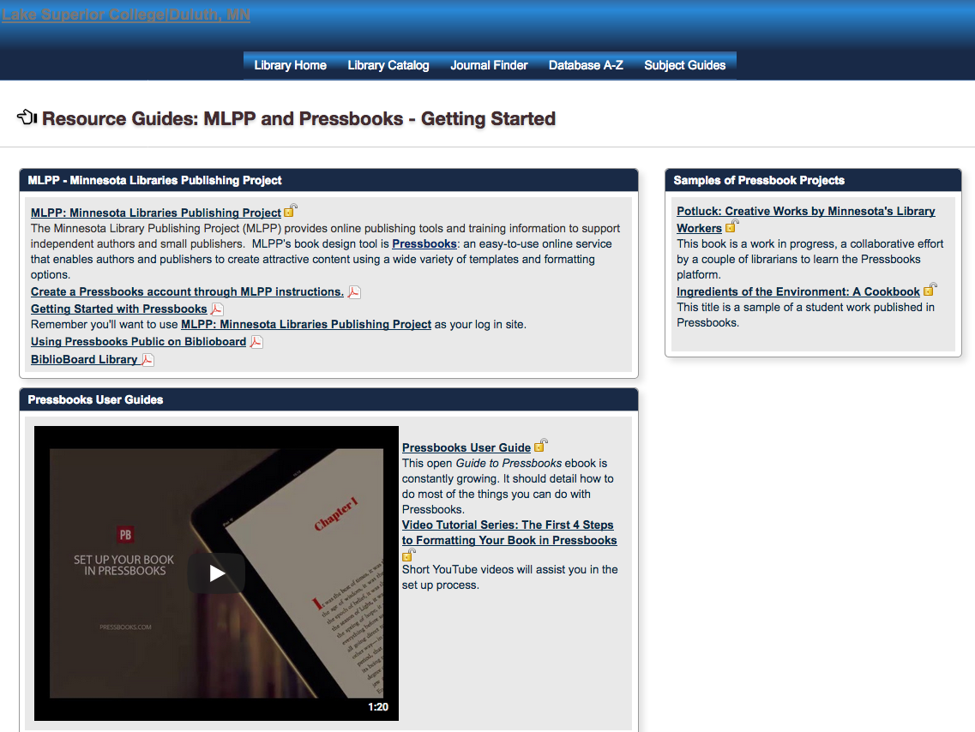
http://lsc.lib.minnstate.edu/subjects/guide.php?subject=Pressbooks
Notes:
Lake Superior College

Slide 32


LEADERSHIP TEXTBOOKS AT WINONA STATE
https://mlpp.pressbooks.pub/undertherushes/
https://mlpp.pressbooks.pub/peeradviceldrs614/
Notes:
Winona State - Leadership courses

Slide 33

COOKBOOK BY A MACALESTER STUDENT
https://mlpp.pressbooks.pub/sustainabilitycookbook/
Notes:
Book created by a student

Slide 34
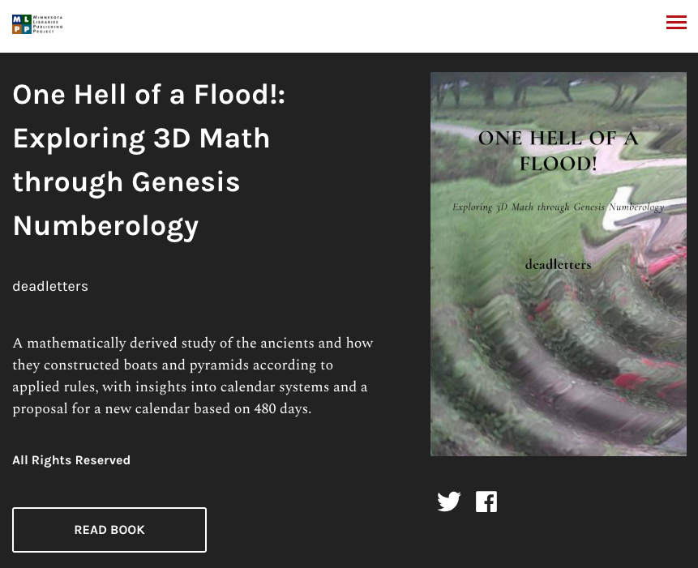
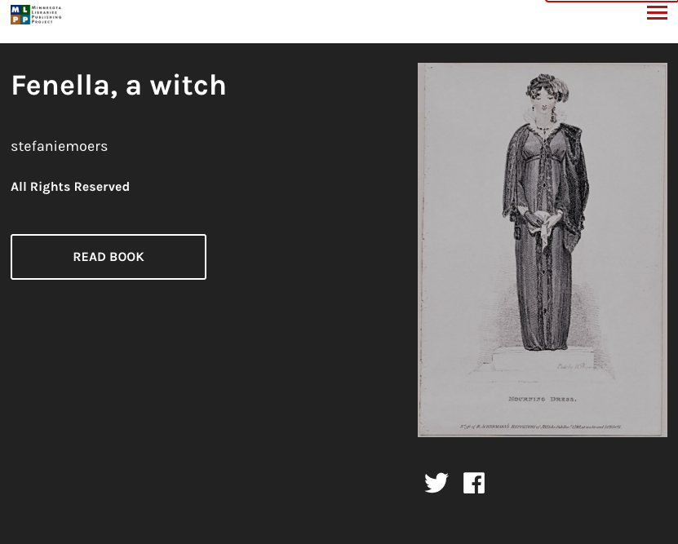
https://mlpp.pressbooks.pub/fenellathewitch/
https://mlpp.pressbooks.pub/onehellofaflood/

Slide 35
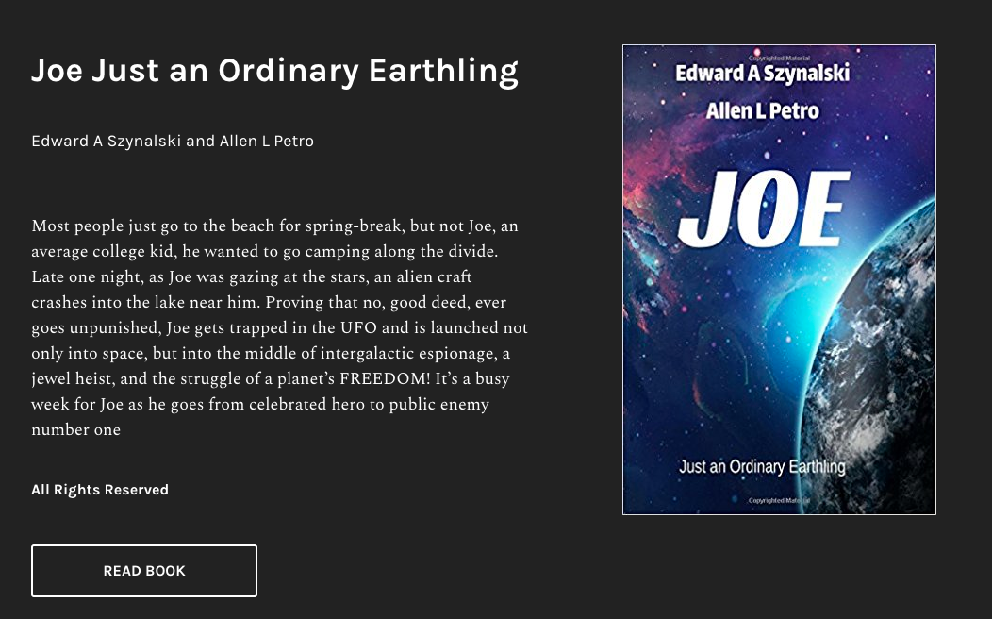
https://mlpp.pressbooks.pub/joejustanordinaryearthling/

Slide 36
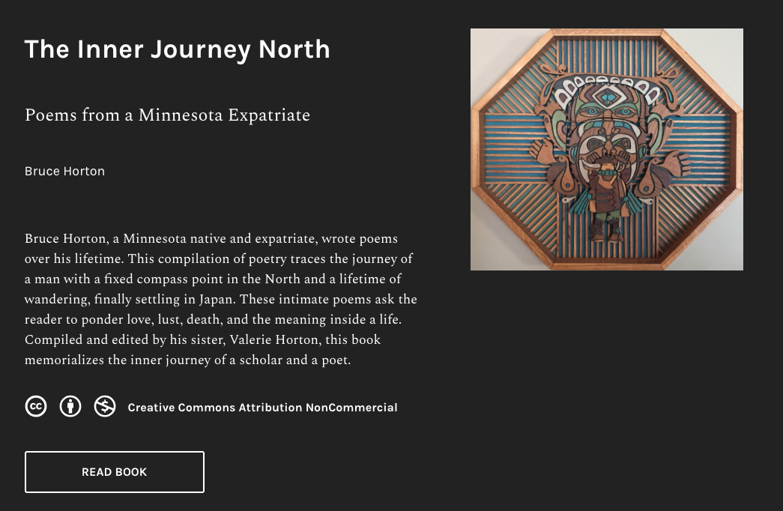
https://mlpp.pressbooks.pub/hortonpoems/

Slide 37
MLPP version of Pressbooks
Geolocated, free access for MN residents
No watermarks
Lots of export formats (PDF, EPUB, MOBI, XML, etc.)
No fees to download or reuse
Book cover generator
Direct submit to SELF-e

Slide 38
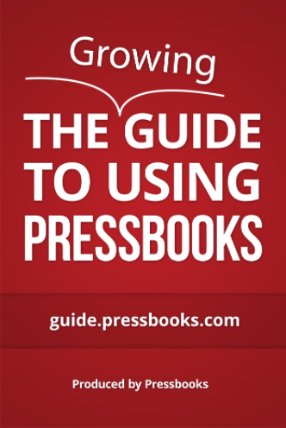
Handy links
Minnesota Libraries Publishing Project - https://mlpp.pressbooks.pub/
Pressbooks user guide - https://guide.pressbooks.com/
Videos - https://www.youtube.com/user/pressbooks
Authoring Open Textbooks - https://press.rebus.community/authoropen/

Slide 39


Slide 40


Slide 41
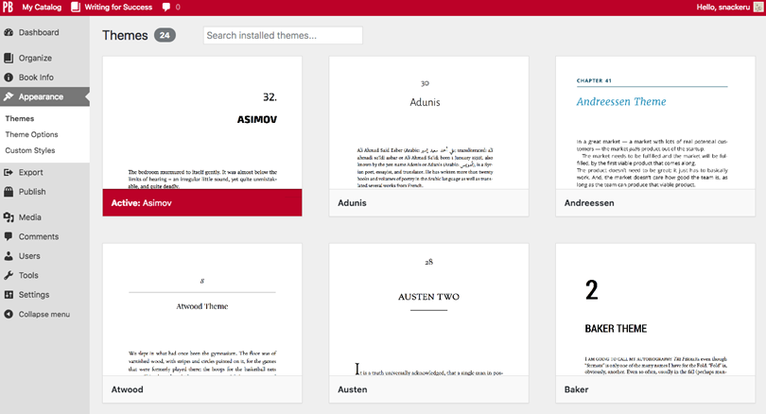
Create: Pressbooks
Format your manuscript and export to variety of formats

Slide 42
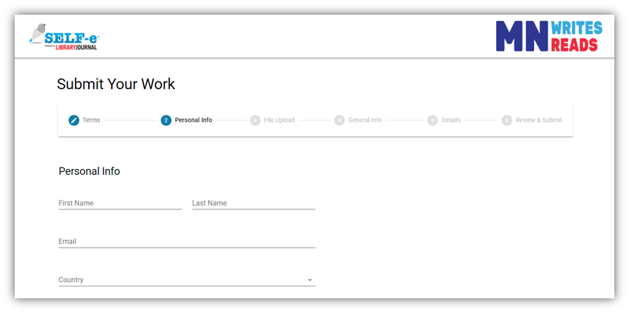
Share: SELF-e
Submit ebooks to state and possibly nationwide collections

Slide 43
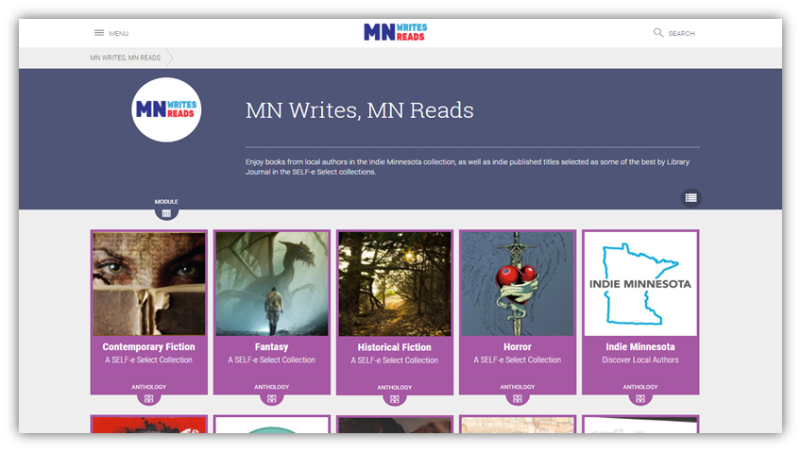
Read: Biblioboard
Read unlimited use titles with no check out periods

Slide 44
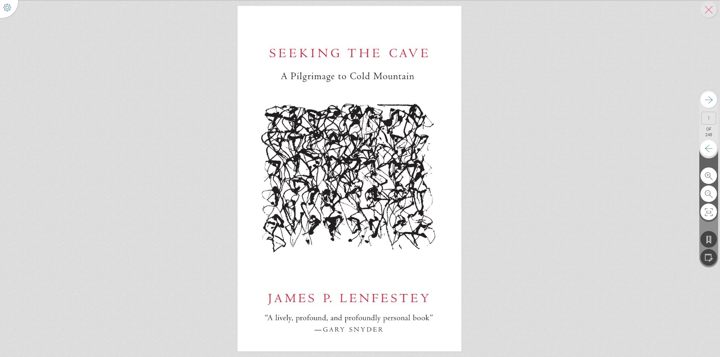
Read: Biblioboard

Slide 45
Why We’re Excited
Now we can add work of local authors to our
collections and give readers access to local content.
Self-publishing is increasingly common,
and libraries should play a role.
Libraries as places of content creation,
not just consumption.
Ability to serve as archive of
community history.
Notes:
I Like this slide!

Slide 46
Project Ideas
Compilation of student work
Anthologies by community groups
Curated anthology or journal
NaNoWriMo
Conference proceedings
Visual works – photographs, scanned letters, drawings
Gifts

Slide 47
For Writers
Pressbooks can be stand alone tool
Writers retain all rights to shared titles – most
are selling elsewhere
Link to purchase book in print
Library users are book buyers
Potential recognition in nationwide SELF-e Select collection
Promote to writers’ groups

Slide 48
Author Contest
Fiction and YA categories
Winners will receive $1,000 and will be
featured in Library Journal
Accepting submissions
April-June 2018

Slide 49
Thank you to our contributing libraries
MELSA and CRPLSA
Minitex
Macalester College
Augsburg University
UMN Morris
Mankato State University
Gustavus Adolphus College
Bethany Lutheran College
Cooperating Libraries in Consortium (CLIC)
Northwestern University
College of St. Ben’s / St. John’s University
Winona State University
Hamline University
Concordia College

Slide 50
“Human sacrifice! Dogs and cats living together!
Mass hysteria!”
...and libraries supporting self-publishing

Slide 51
Who you gonna call?
wE NEED TO RENAME HANDOUT -V H
Andrea McKennan - andrea@melsa.org
Shane Nackerud - snackeru@umn.edu
Valerie Horton - vhorton@umn.edu
Handout: z.umn.edu/LTCbookbusters
Copy

